Slide 1
Chapter 7 Class Templates array and vector; Catching Exceptions
C++ How to Program, 9/e

Slide 2
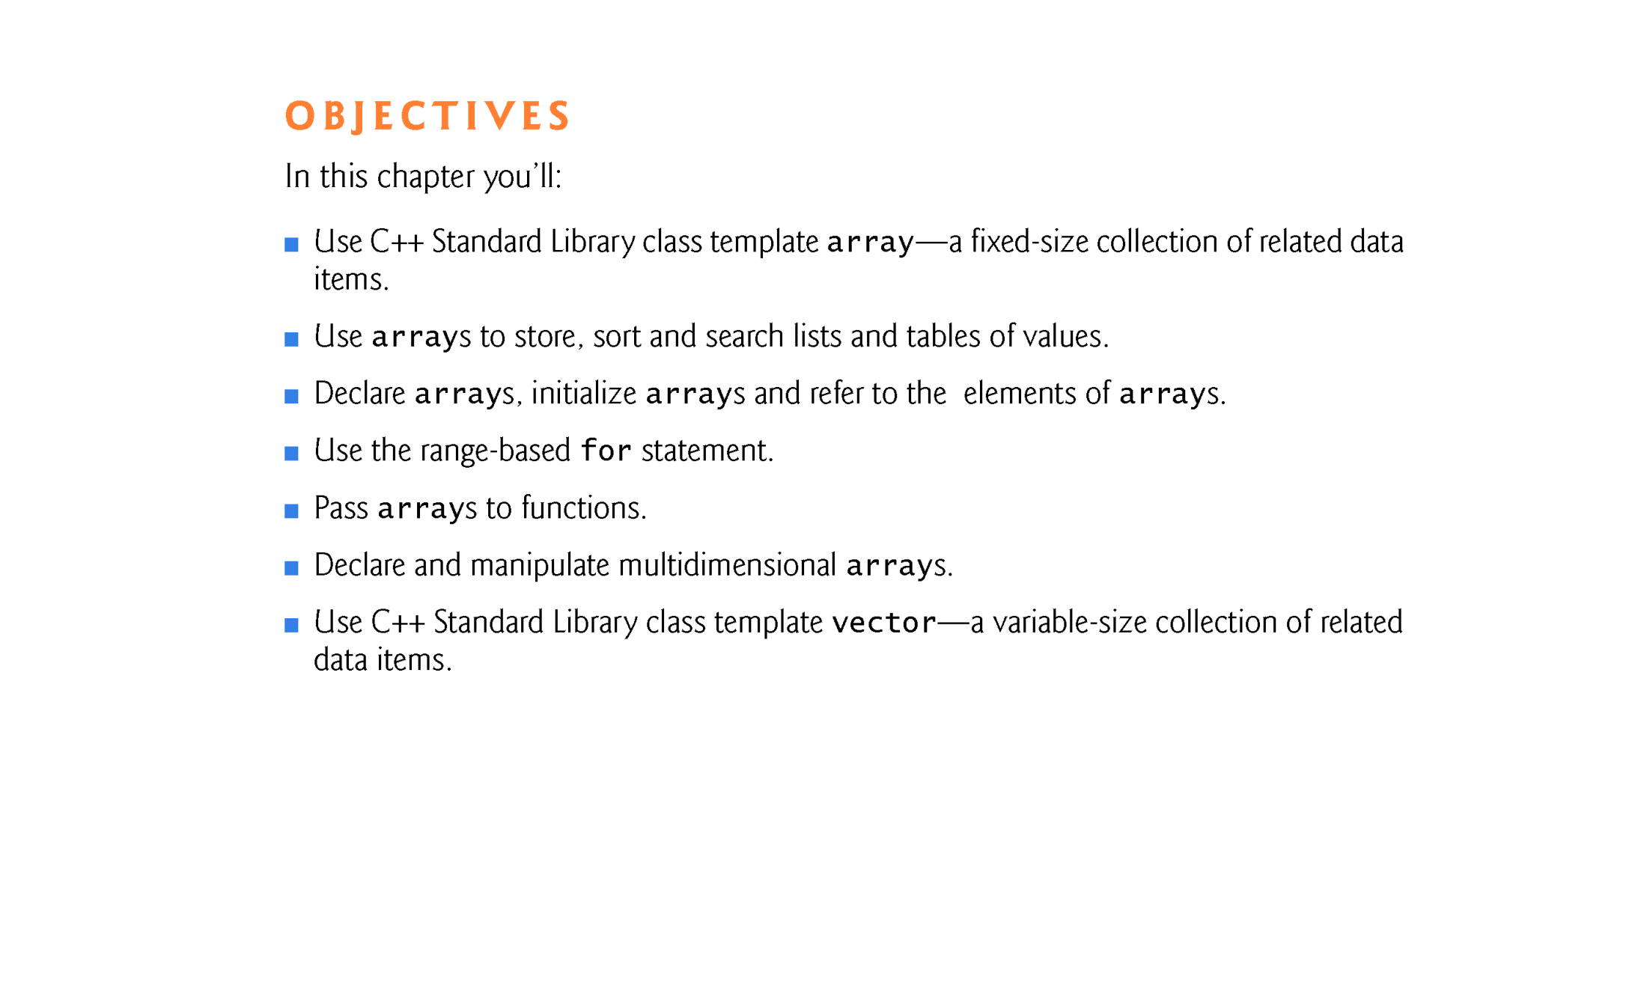

Slide 3
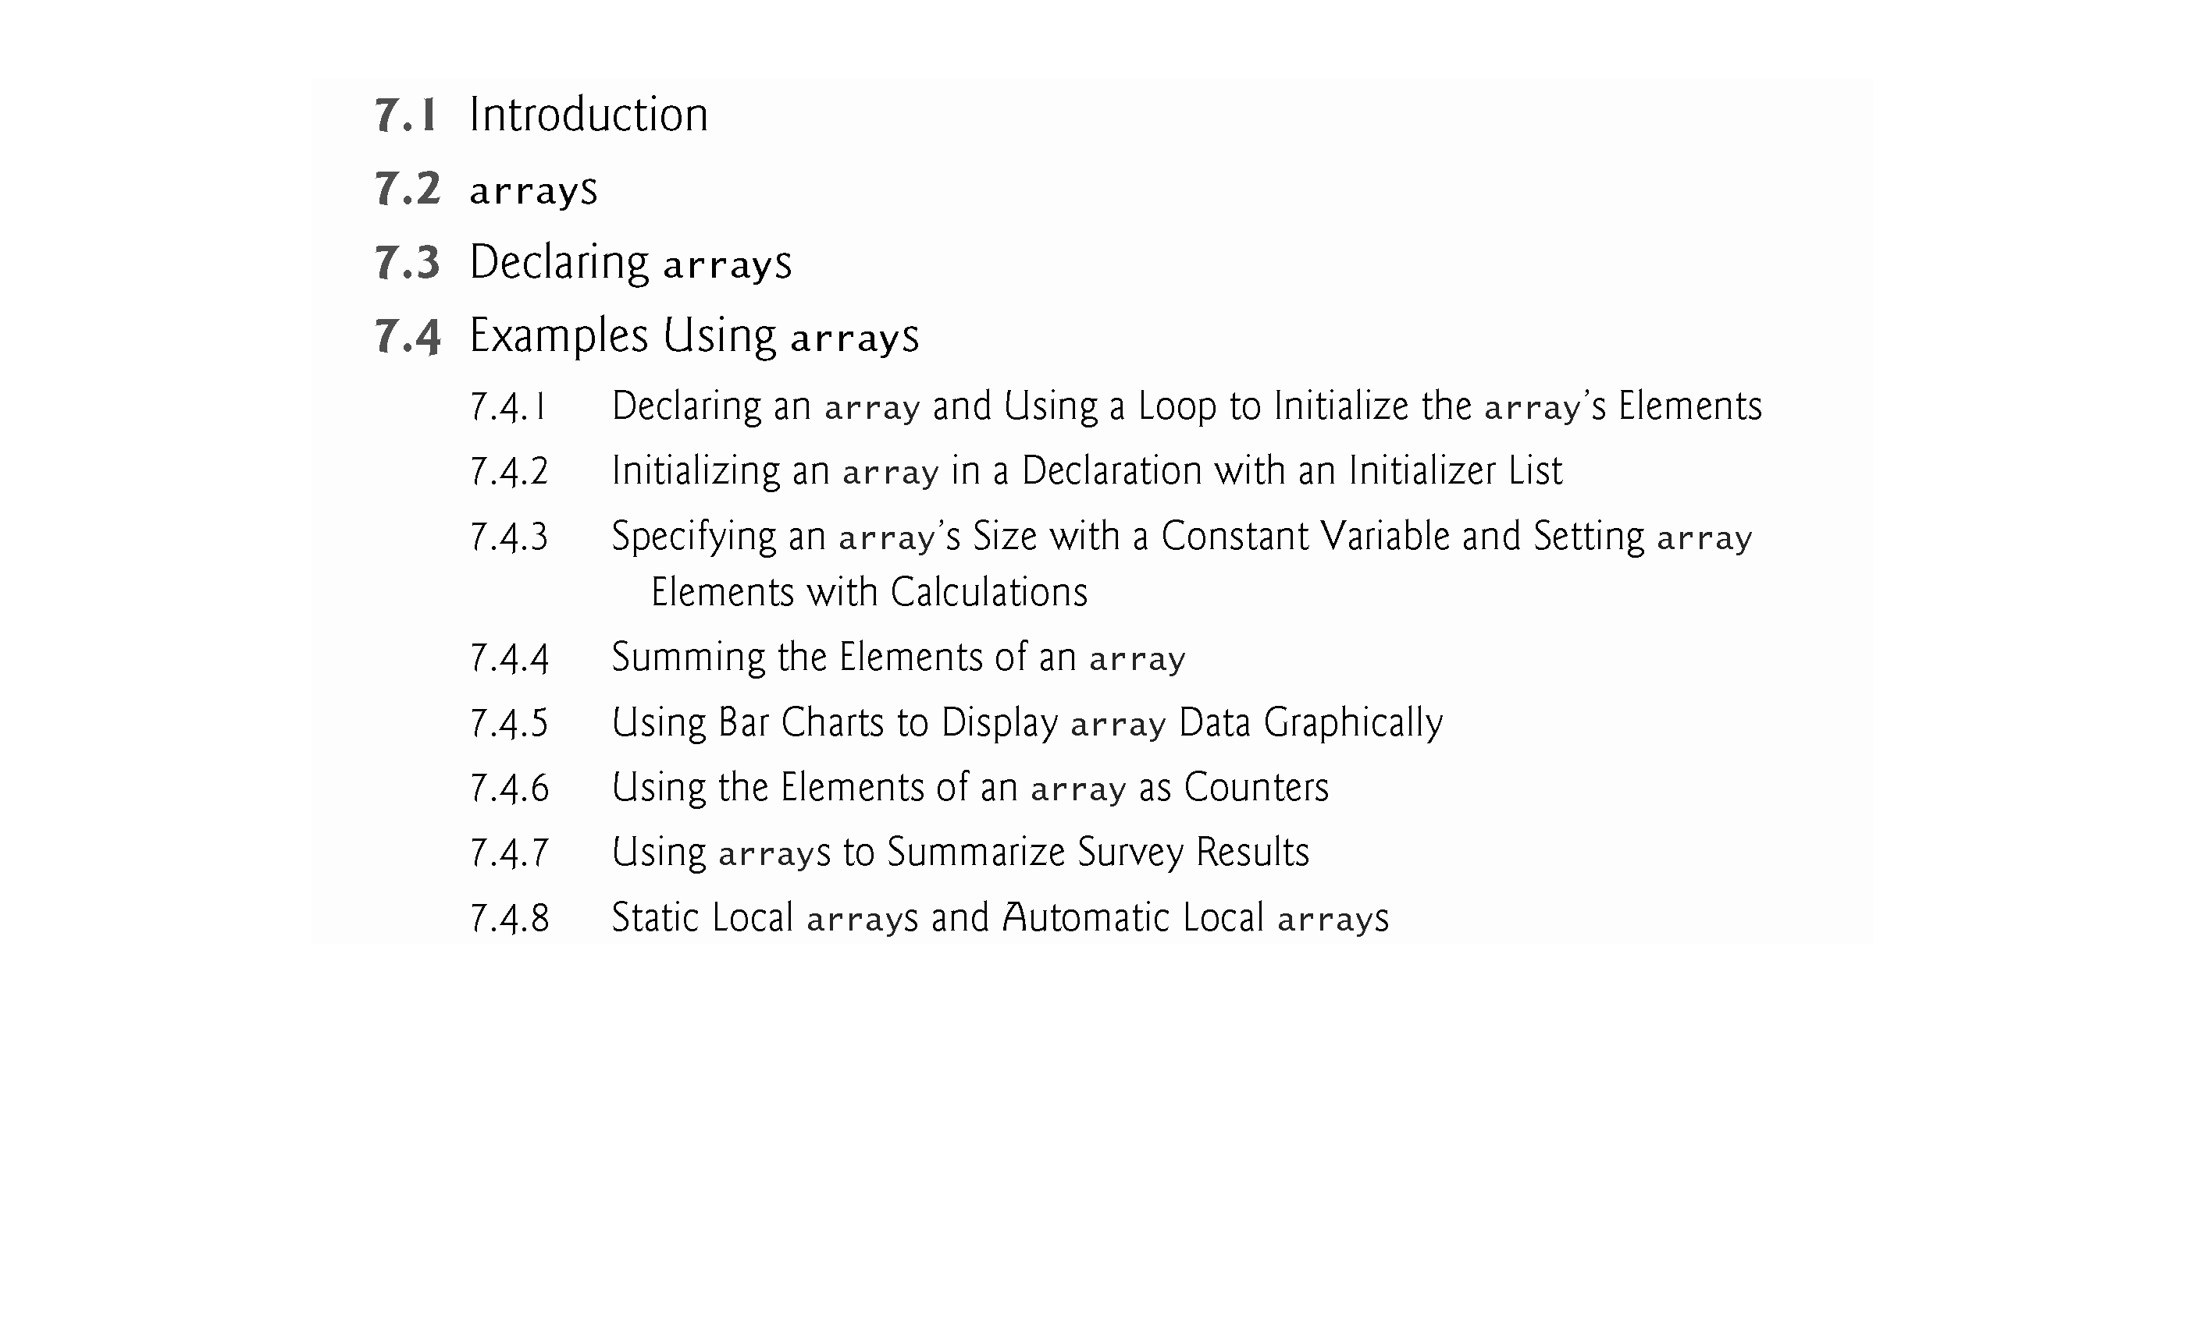

Slide 4
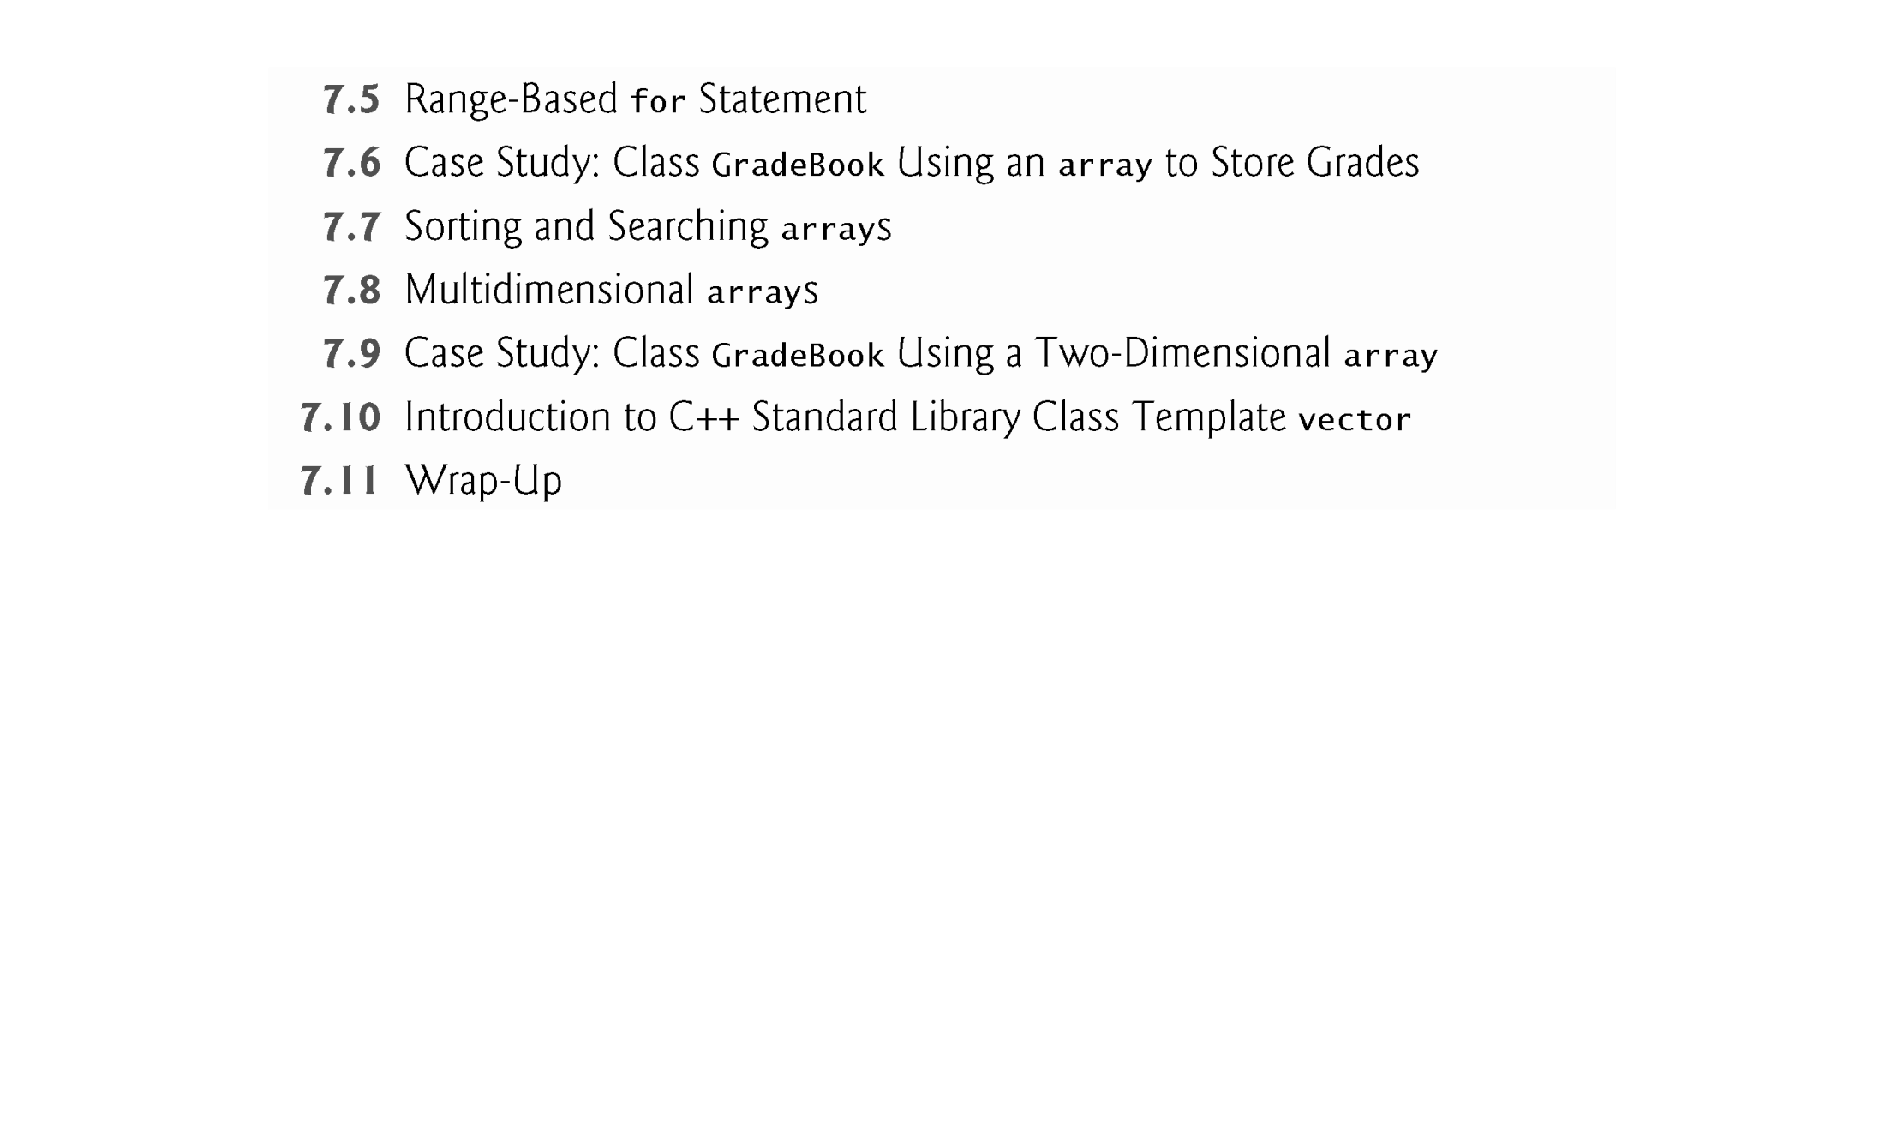

Slide 5
7.1 Introduction
This chapter introduces the topic of data structures - collections of related data items.
We discuss arrays which are fixed-size collections consisting of data items of the same type, and vectors which are collections (also of data items of the same type) that can grow and shrink dynamically at execution time.
Both array and vector are C++ standard library class templates.
After discussing how arrays are declared, created and initialized, we present examples that demonstrate several common array manipulations.

Slide 6
7.2 arrays
An array is a contiguous group of memory locations that all have the same type.
To refer to a particular location or element in the array, specify the name of the array and the position number of the particular element.
Figure 7.1 shows an integer array called c.
12 elements.
The position number is more formally called a subscript or index (this number specifies the number of elements from the beginning of the array).
The first element in every array has subscript 0 (zero) and is sometimes called the zeroth element. [zero-based addressing]
The highest subscript in array c is 11, which is 1 less than the number of elements in the array (12).
A subscript must be an integer or integer expression (using any integral type).

Slide 7
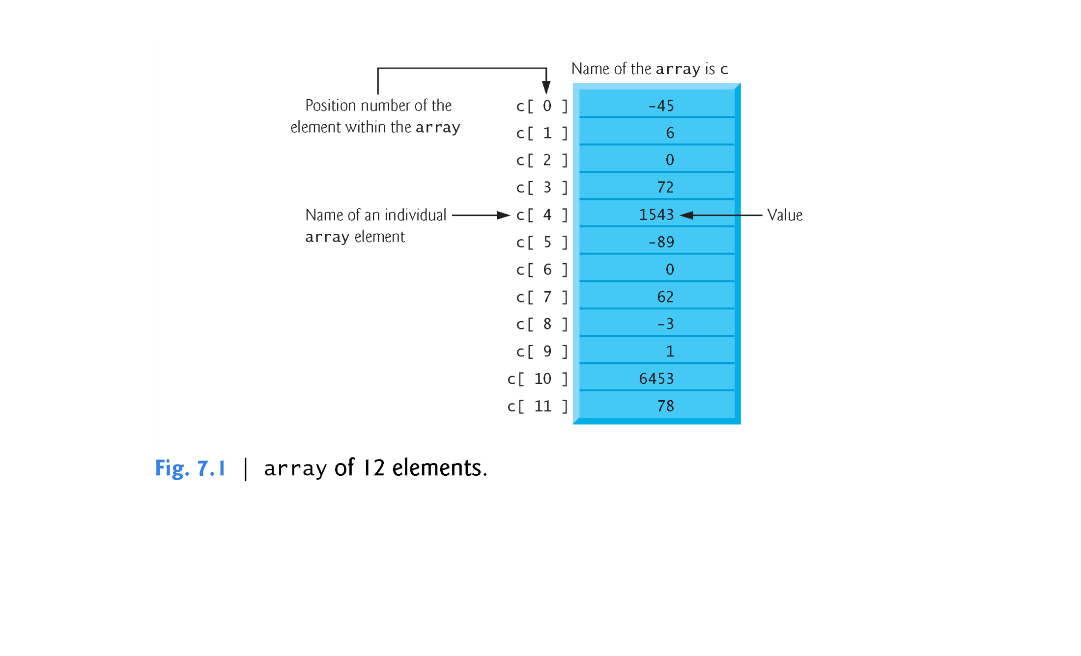

Slide 8
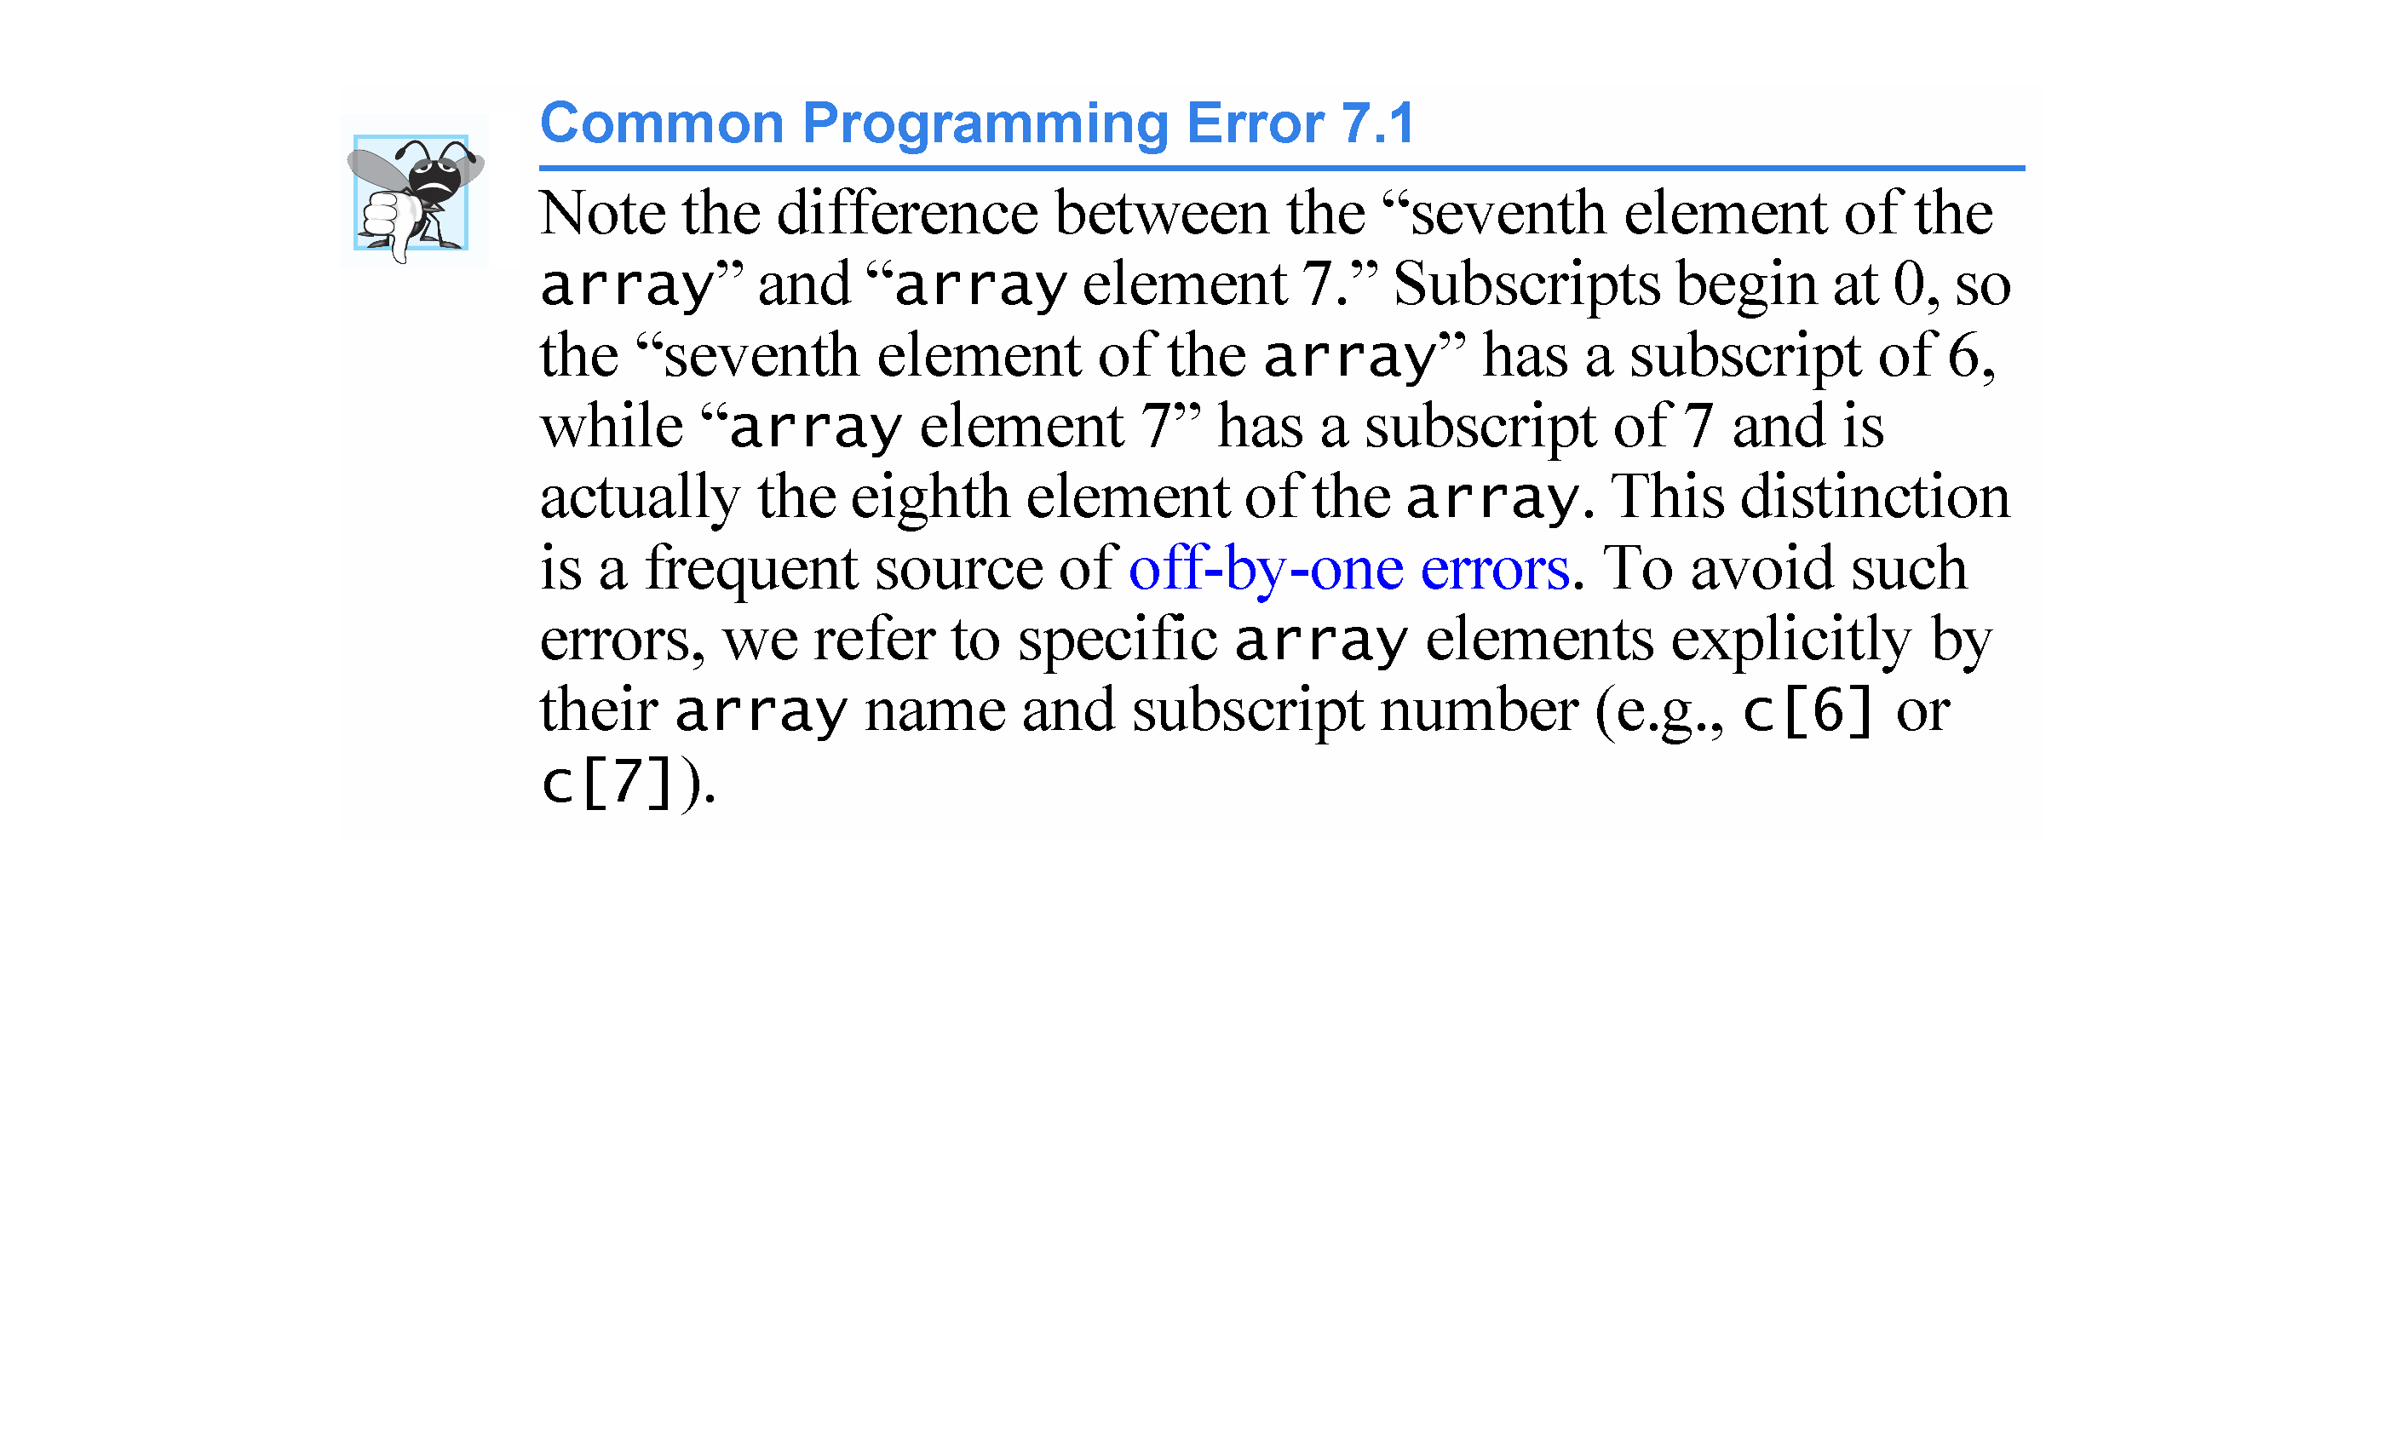

Slide 9
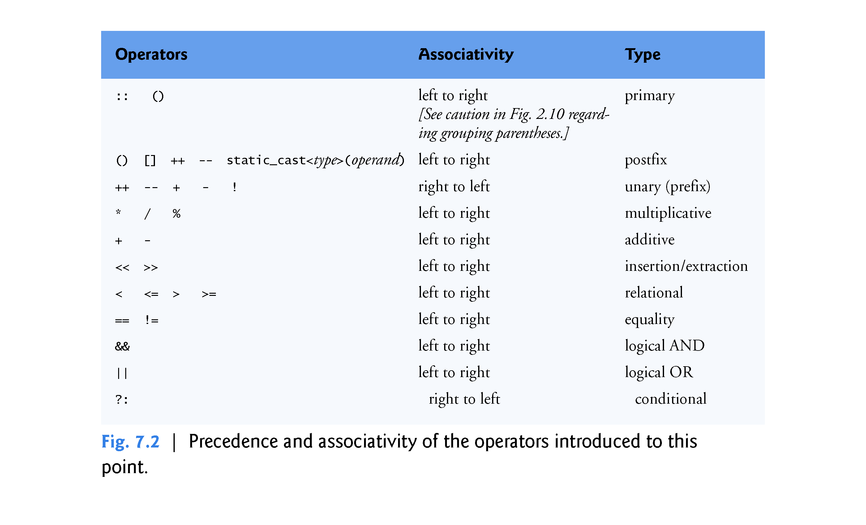

Slide 10
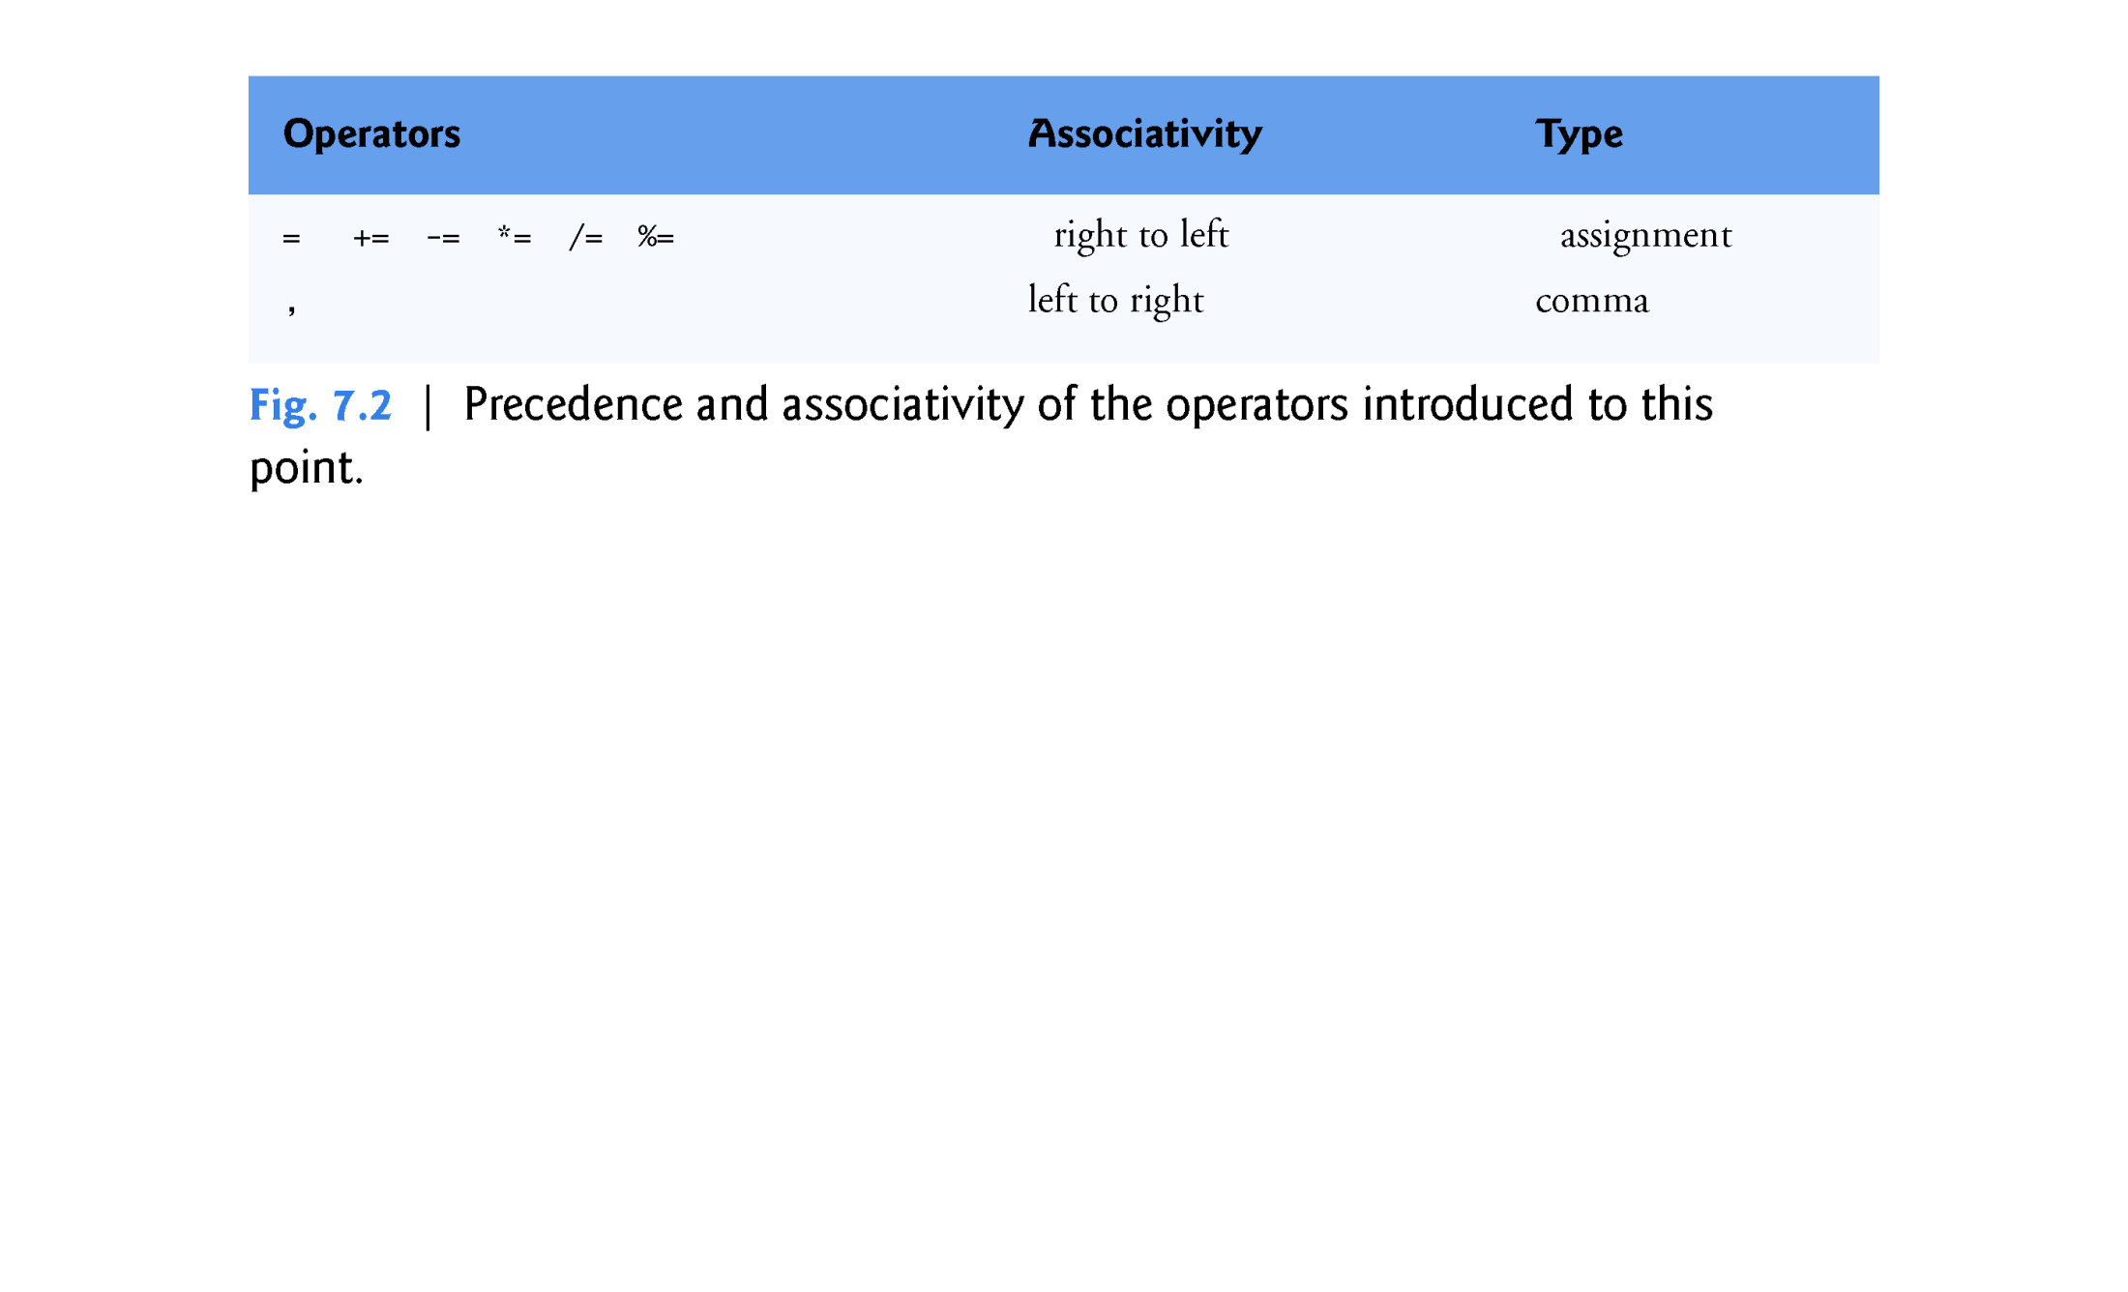

Slide 11
7.3 Declaring arrays
arrays occupy space in memory.
To specify the type of the elements and the number of elements required by an array use a declaration of the form:
array< type, arraySize > arrayName;
The notation <type, arraySize> indicates that array is a class template.
The compiler reserves the appropriate amount of memory based on the type of the elements and the arraySize.
arrays can be declared to contain values of most data types.

Slide 12
7.4 Examples Using arrays
The following examples demonstrate:
how to declare arrays
how to initialize arrays
how to perform common array manipulations.

Slide 13
7.4.1 Declaring an array and Using a Loop to Initialize the array’s Elements
The program in Fig. 7.3 declares five-element integer array n (line 10).
size_t represents an unsigned integral type.
This type is recommended for any variable that represents an array’s size or an array’s subscripts. Type size_t is defined in the std namespace and is in header <cstddef>, which is included by various other headers.
If you attempt to compile a program that uses type size_t and receive errors indicating that it’s not defined, simply include <cstddef> in your program.

Slide 14
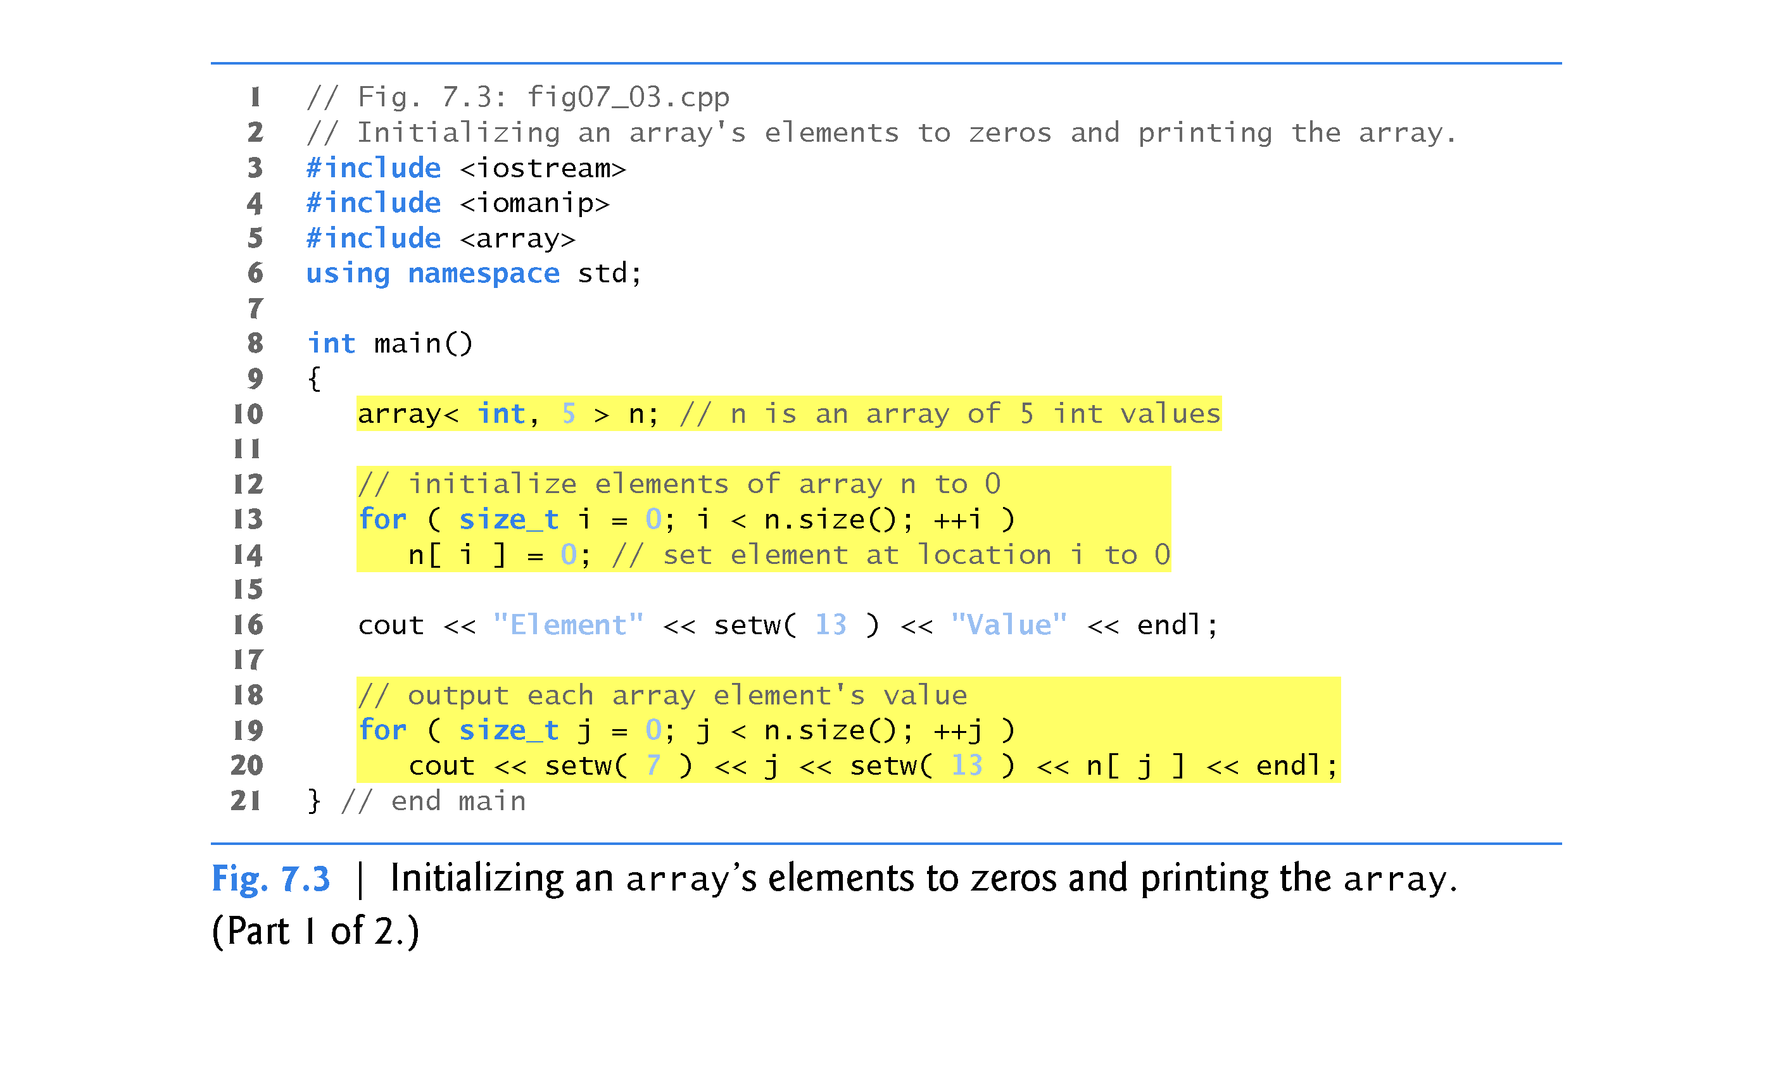

Slide 15
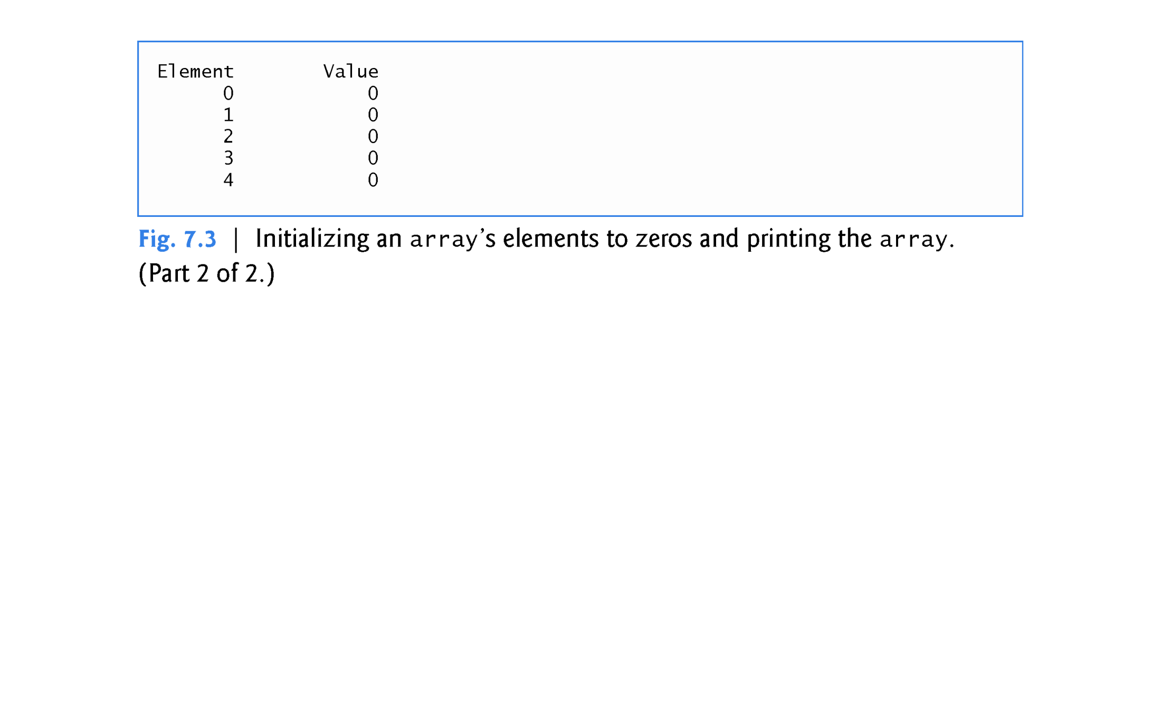

Slide 16
7.4.2 Initializing an array in a Declaration with an Initializer List
The elements of an array also can be initialized in the array declaration by following the array name with an equals sign and a brace-delimited comma-separated list of initializers.
The program in Fig. 7.4 uses an initializer list to initialize an integer array with five values (line 11) and prints the array in tabular format (lines 13–17).
If there are fewer initializers than elements in the array, the remaining array elements are initialized to zero.

Slide 17
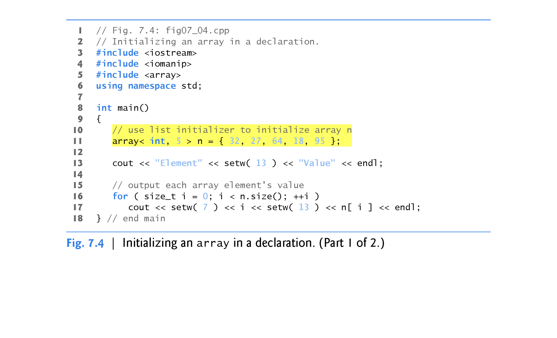

Slide 18
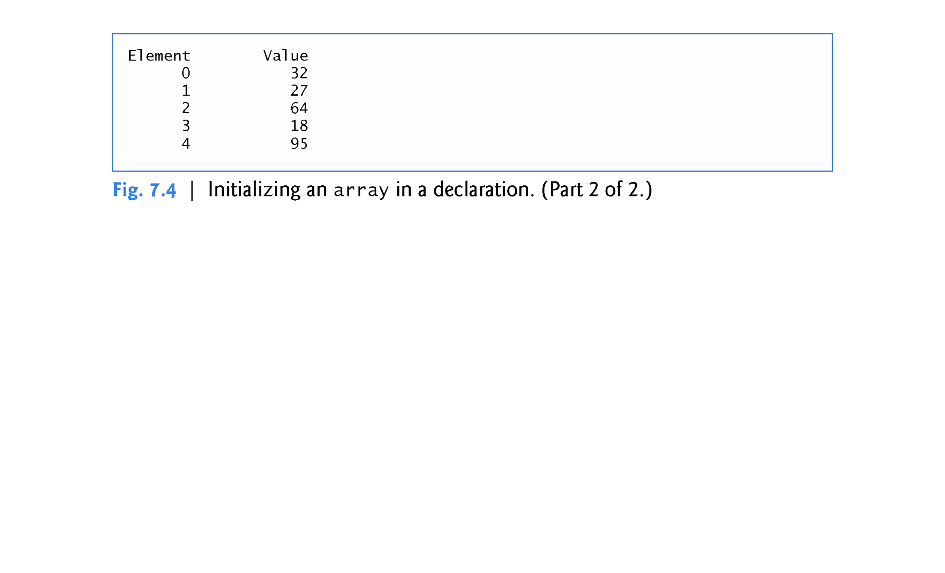

Slide 19
7.4.3 Specifying an array’s Size Setting array Elements with Calculations
Figure 7.5 sets the elements of a 5-element array s to the even integers 2, 4, 6, 8 and 10 (lines 15–16) and prints the array in tabular format (lines 18–22).
Line 11 uses the const qualifier to declare a constant variable arraySize with the value 5.
A constant variable that’s used to specify array’s size must be initialized with a constant expression when it’s declared and cannot be modified thereafter.
Constant variables are also called named constants or read-only variables.

Slide 20
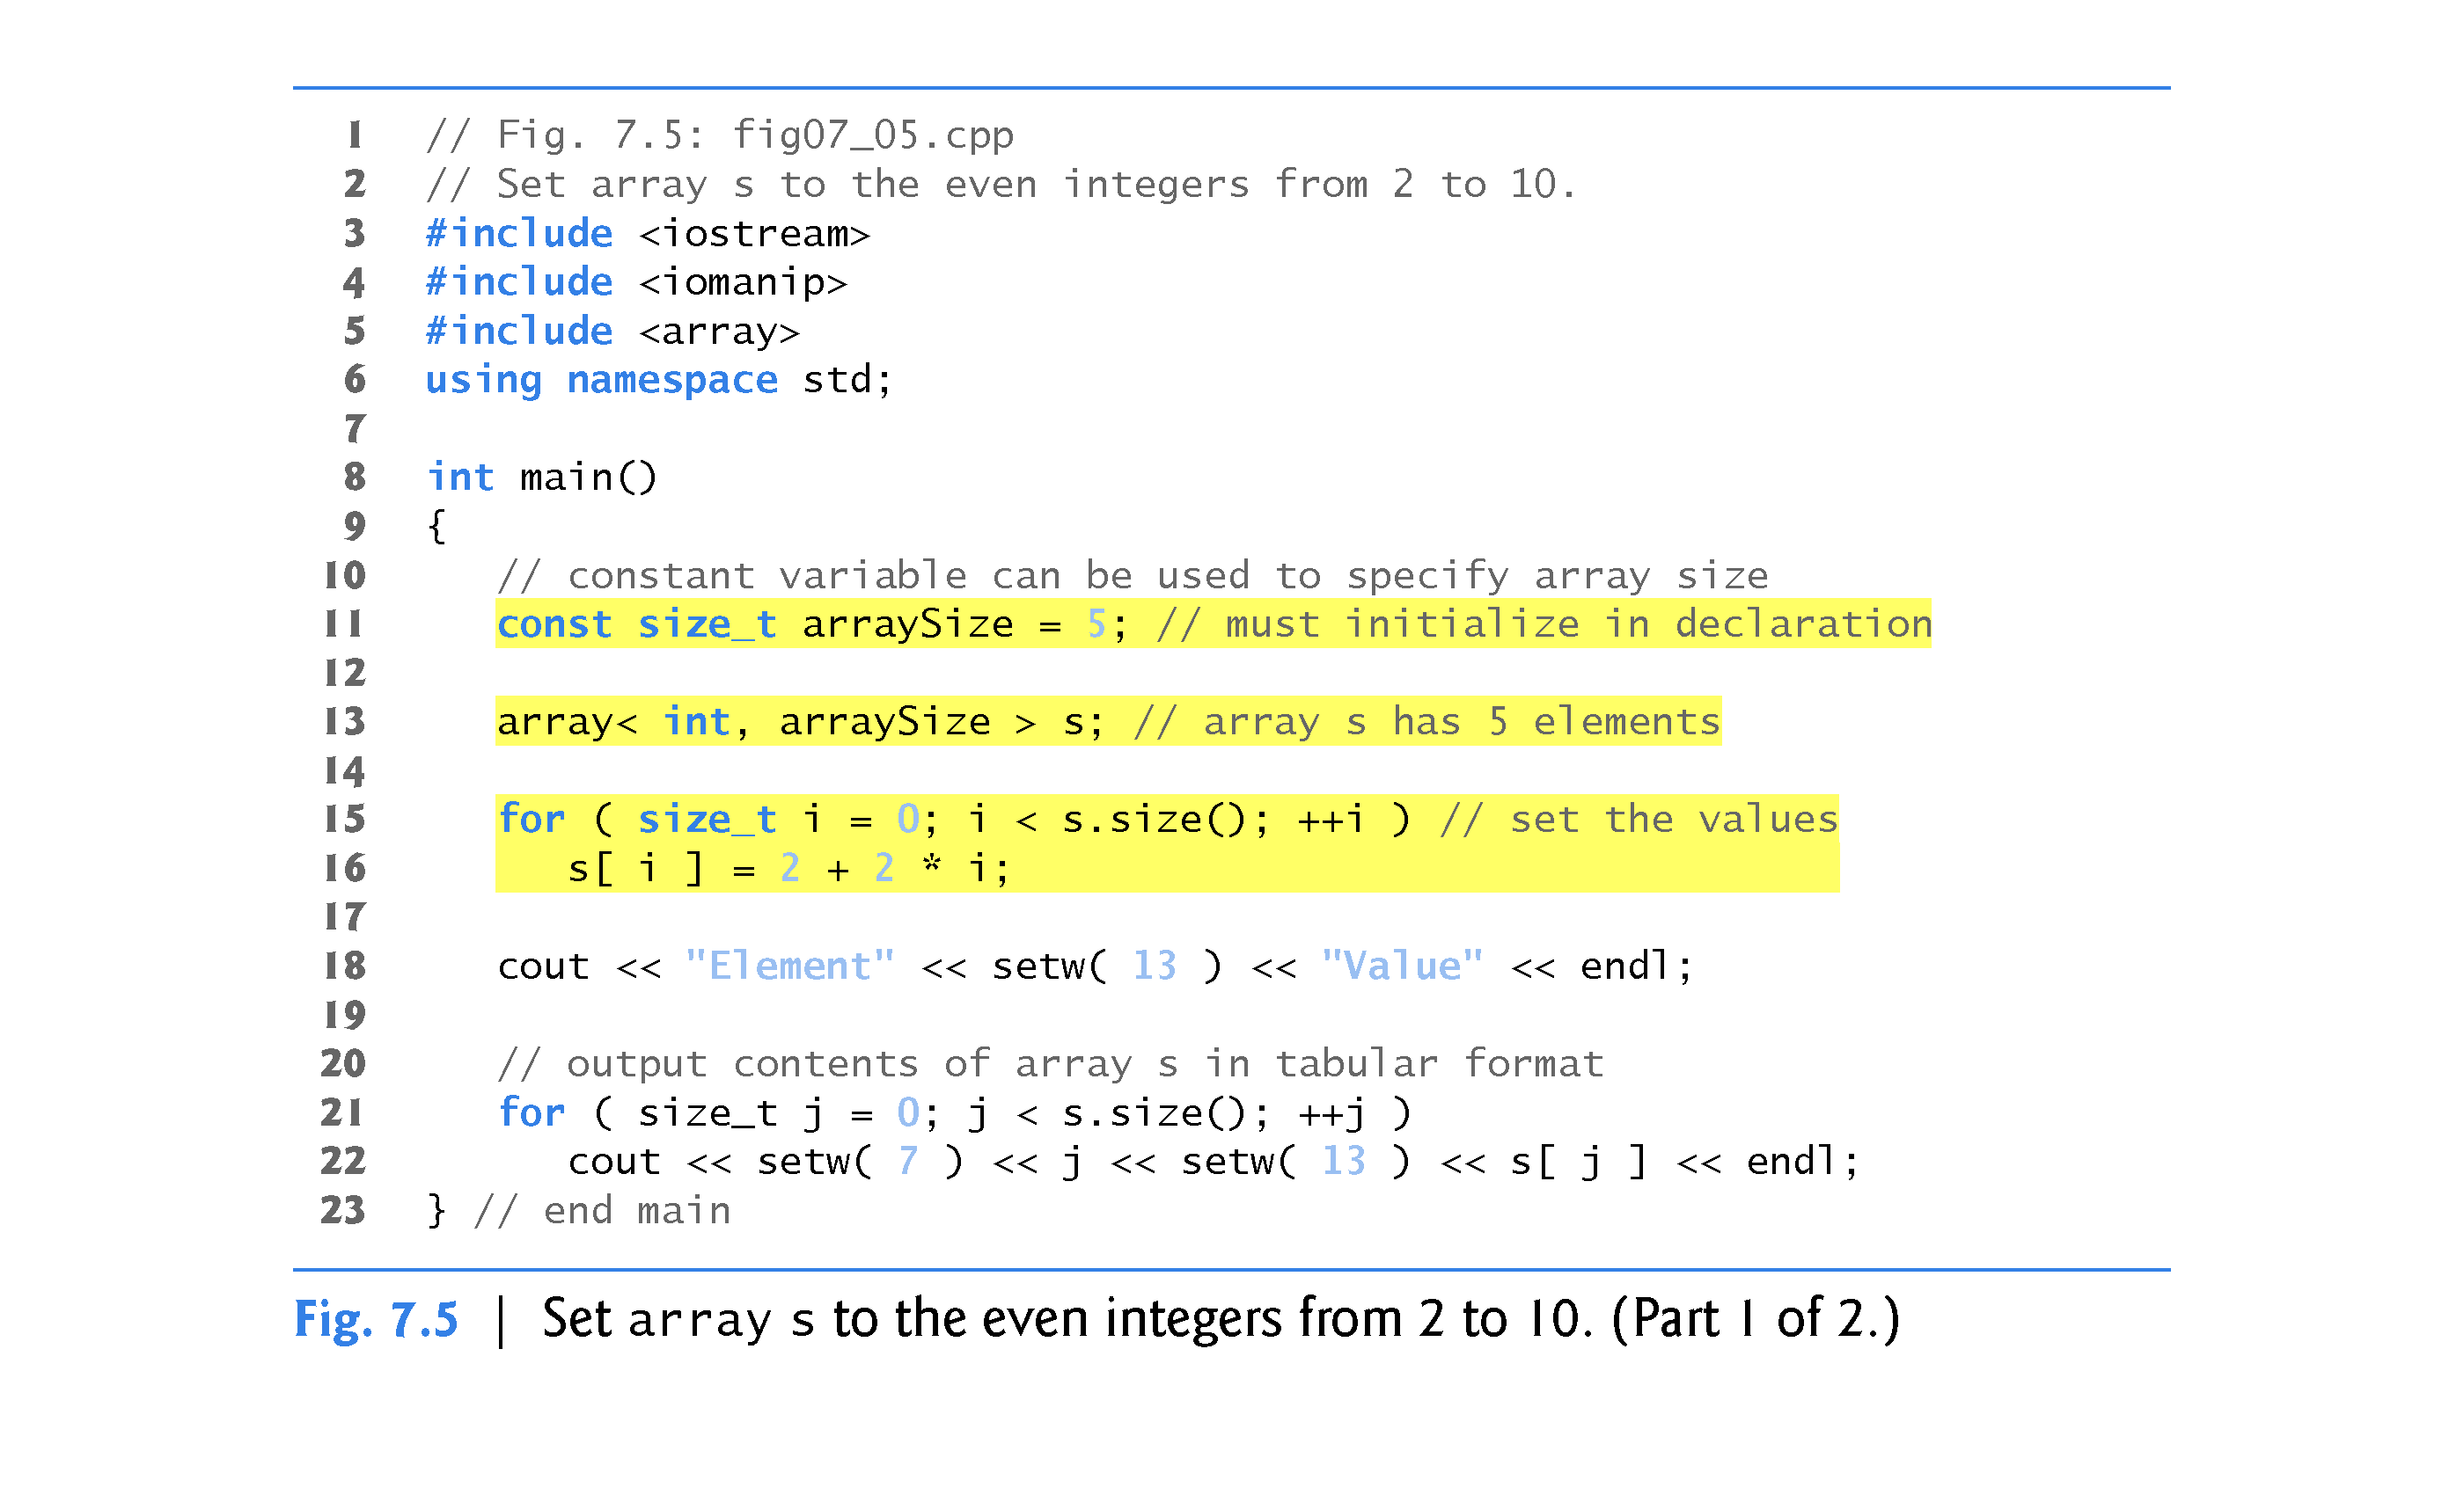

Slide 21
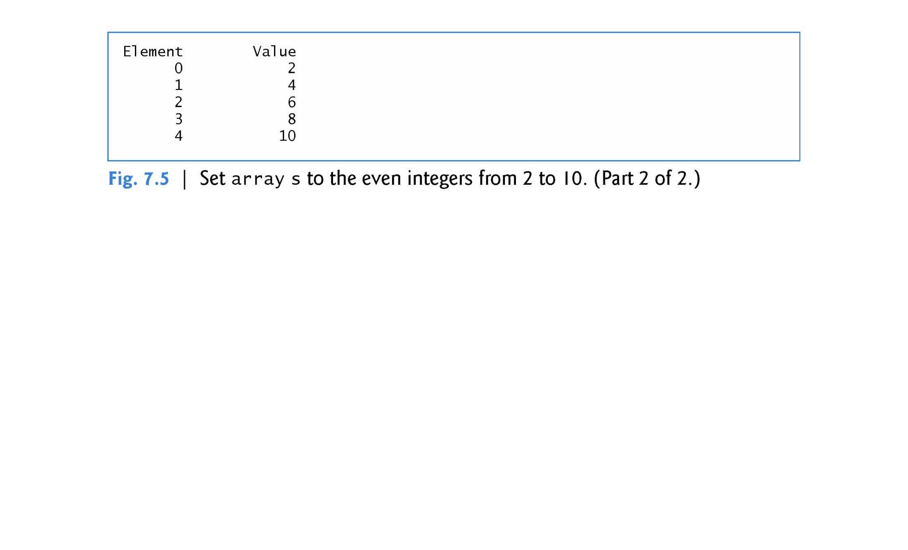

Slide 22
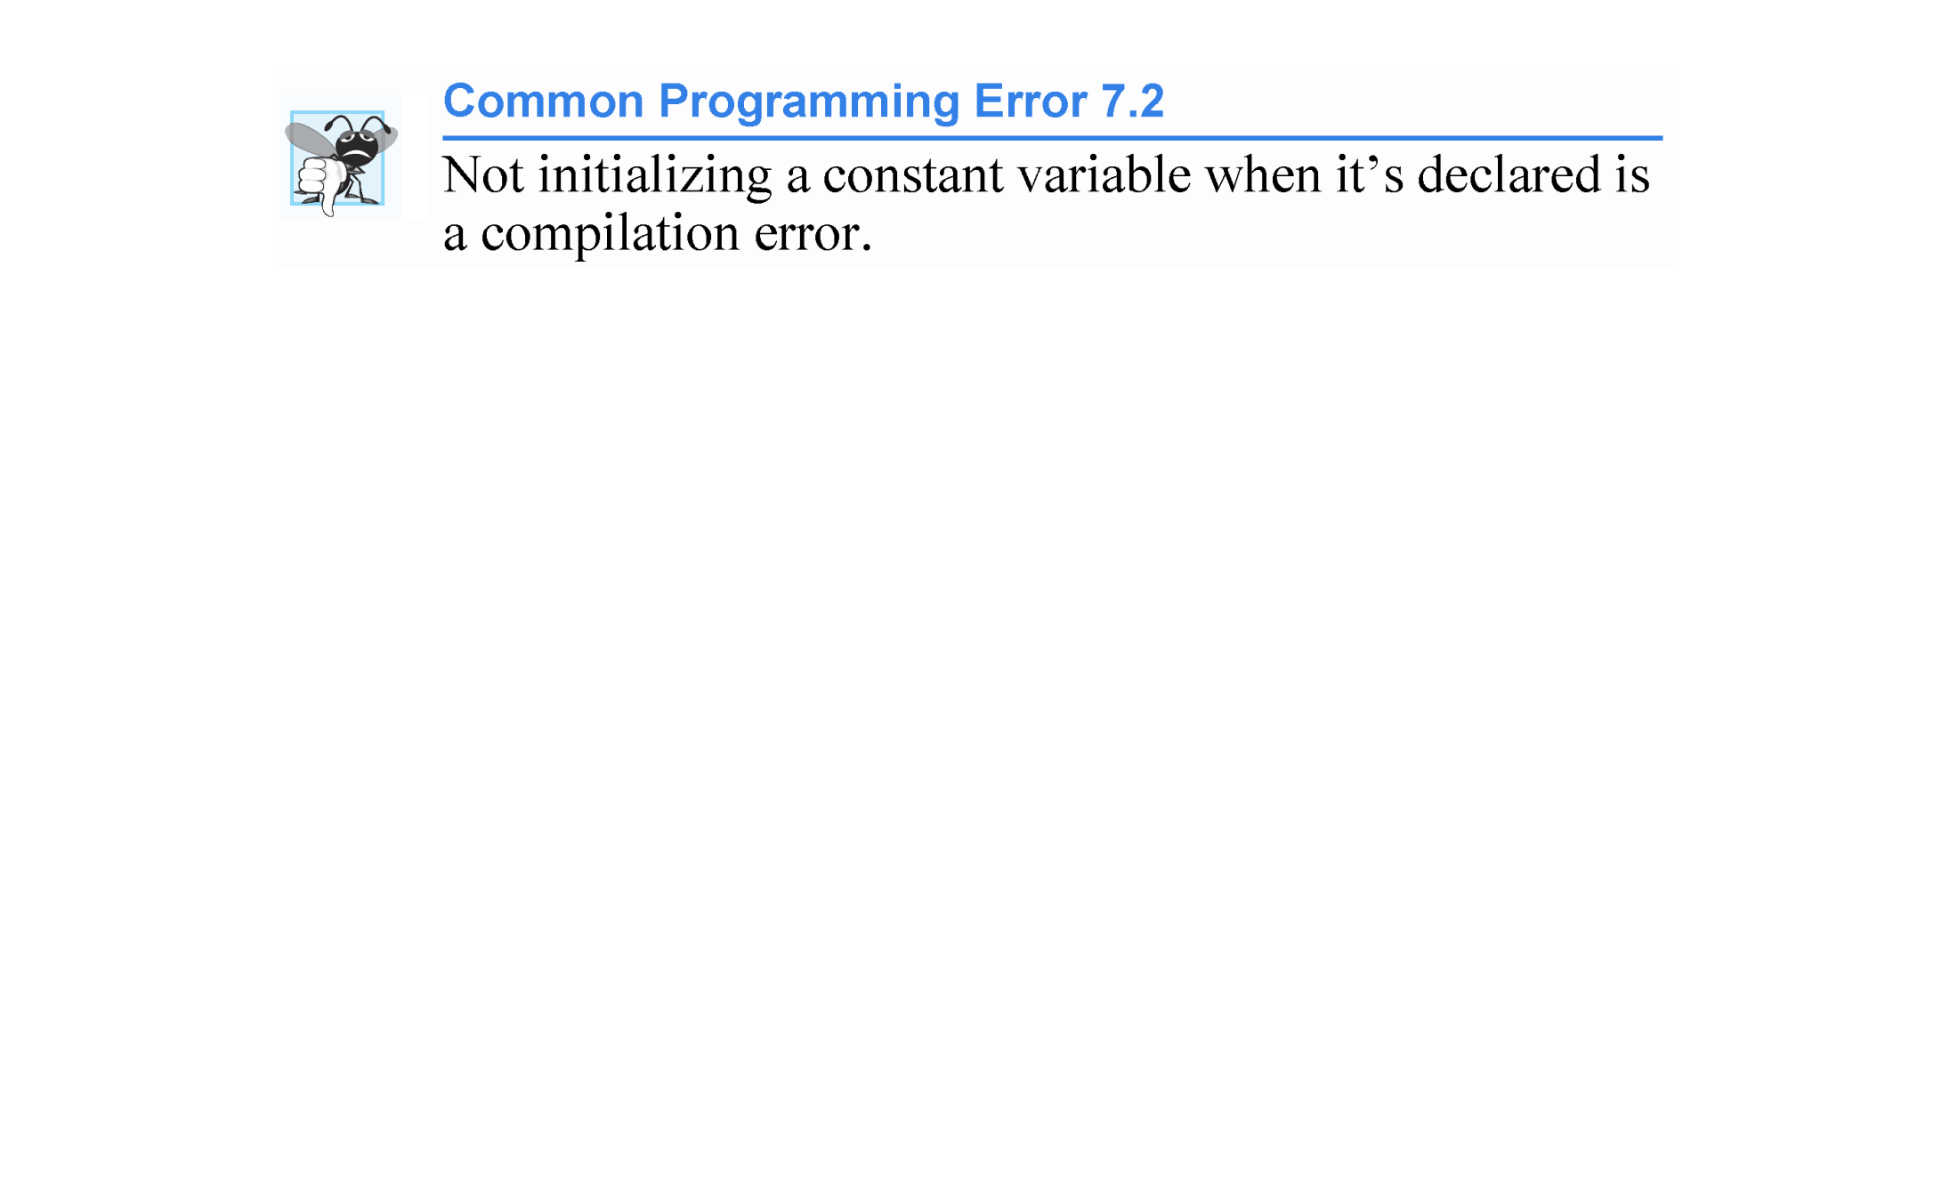

Slide 23
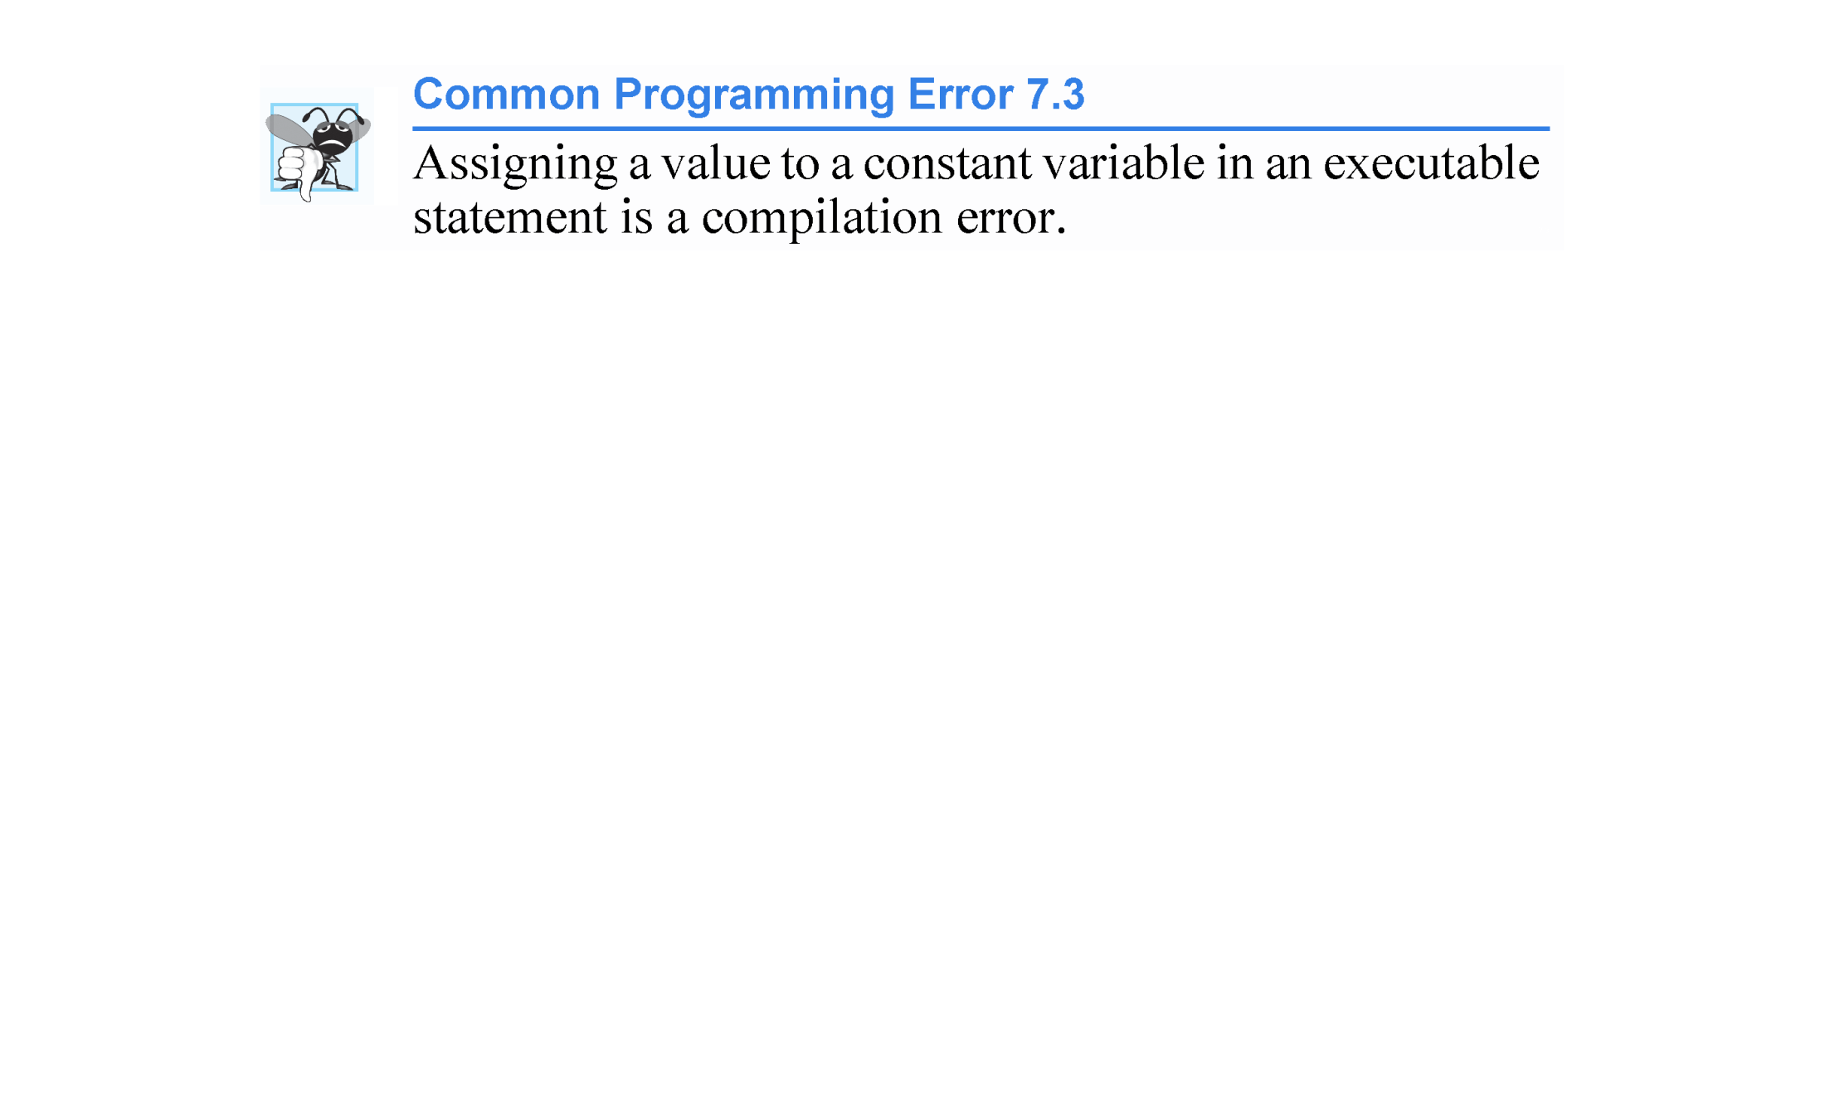

Slide 24
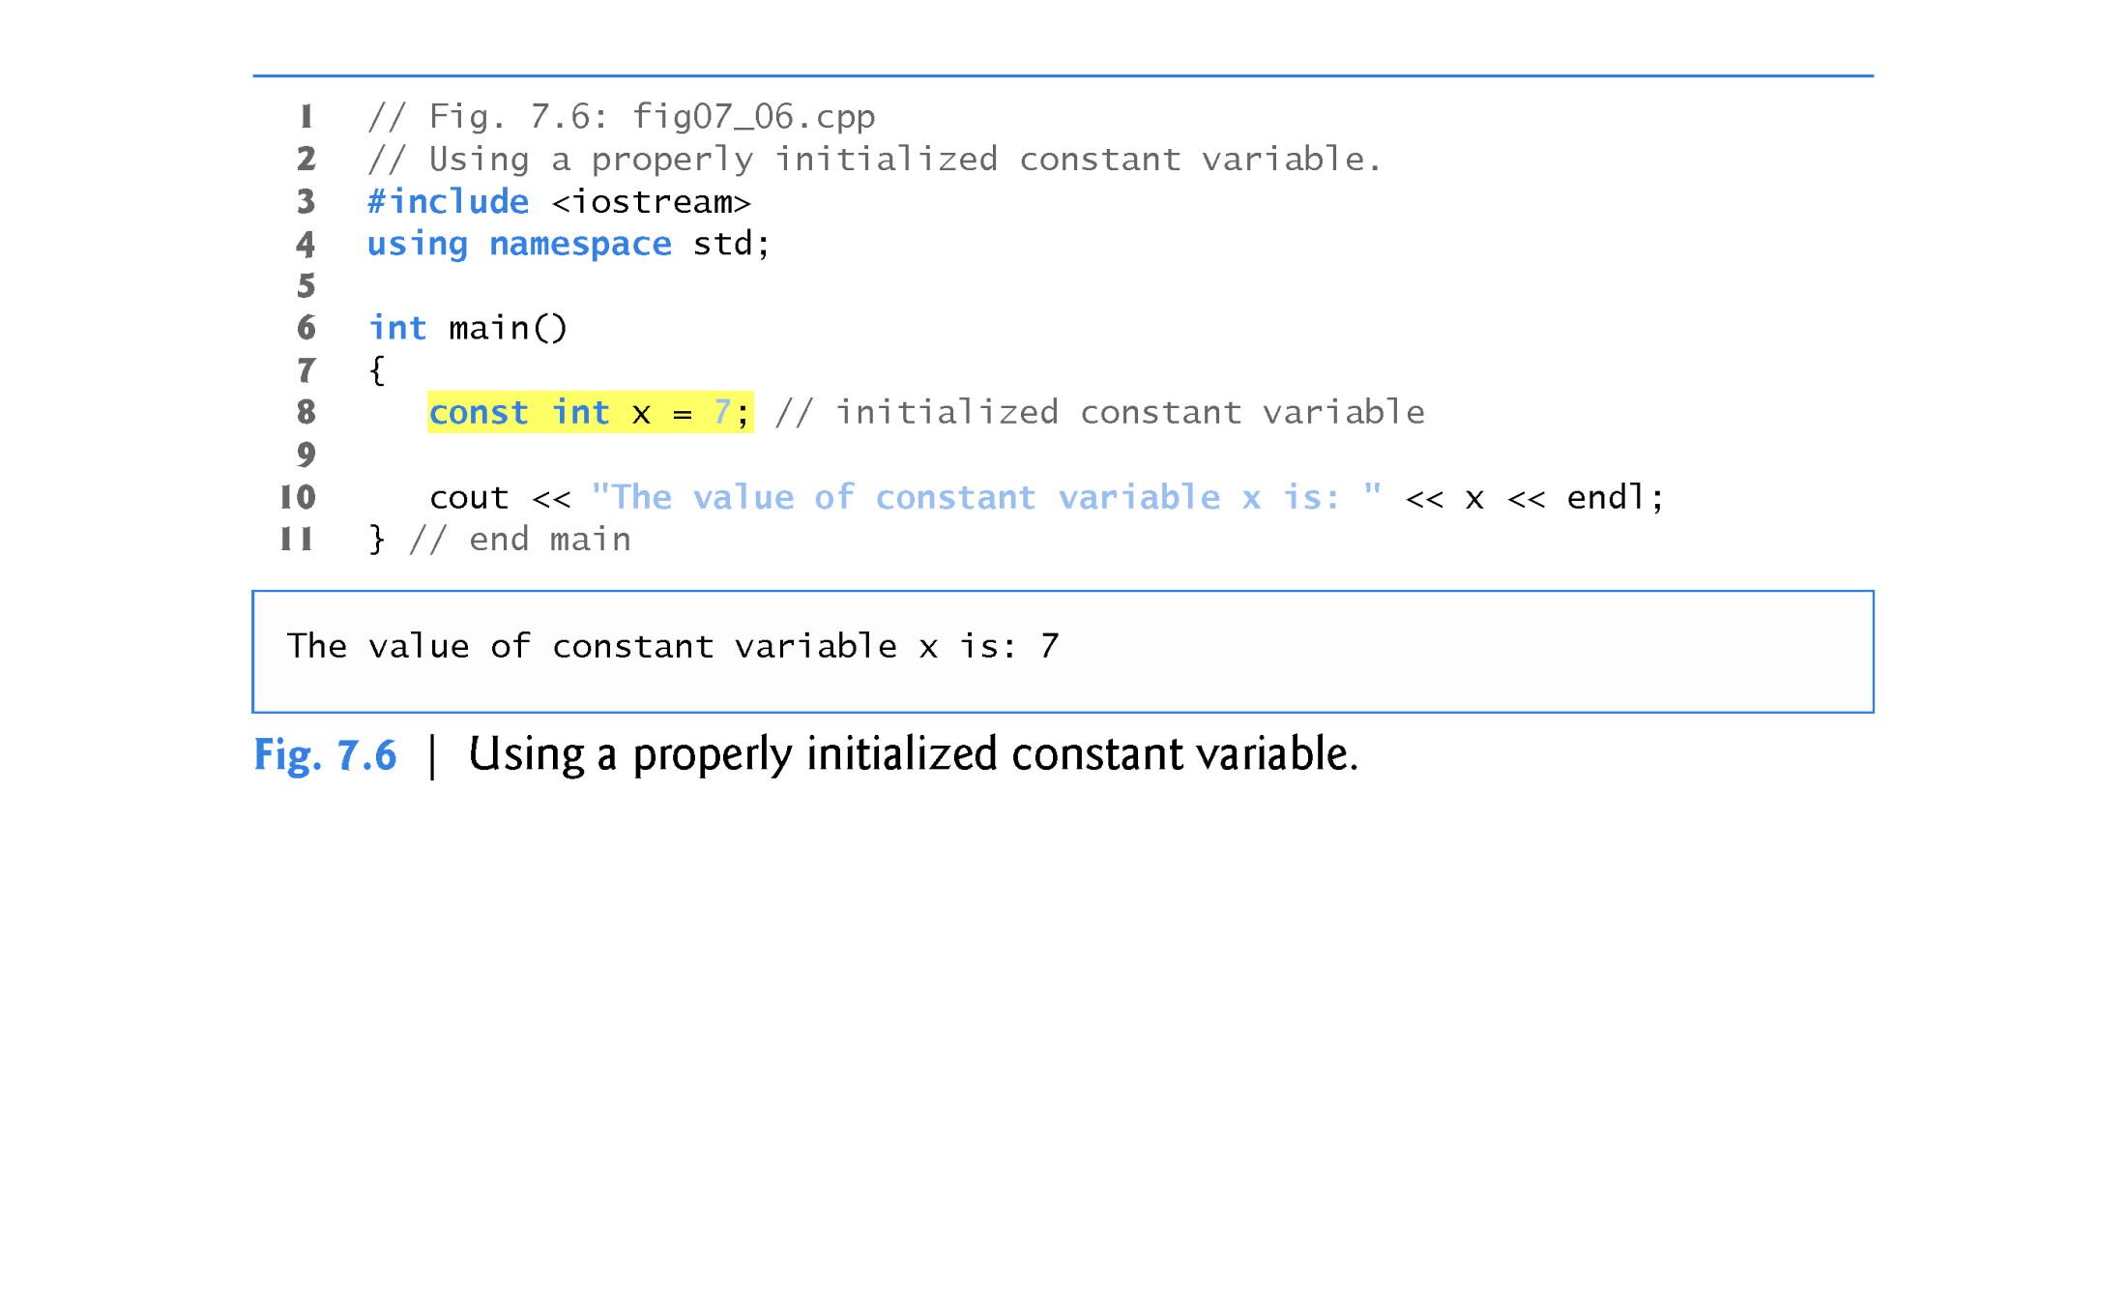

Slide 25
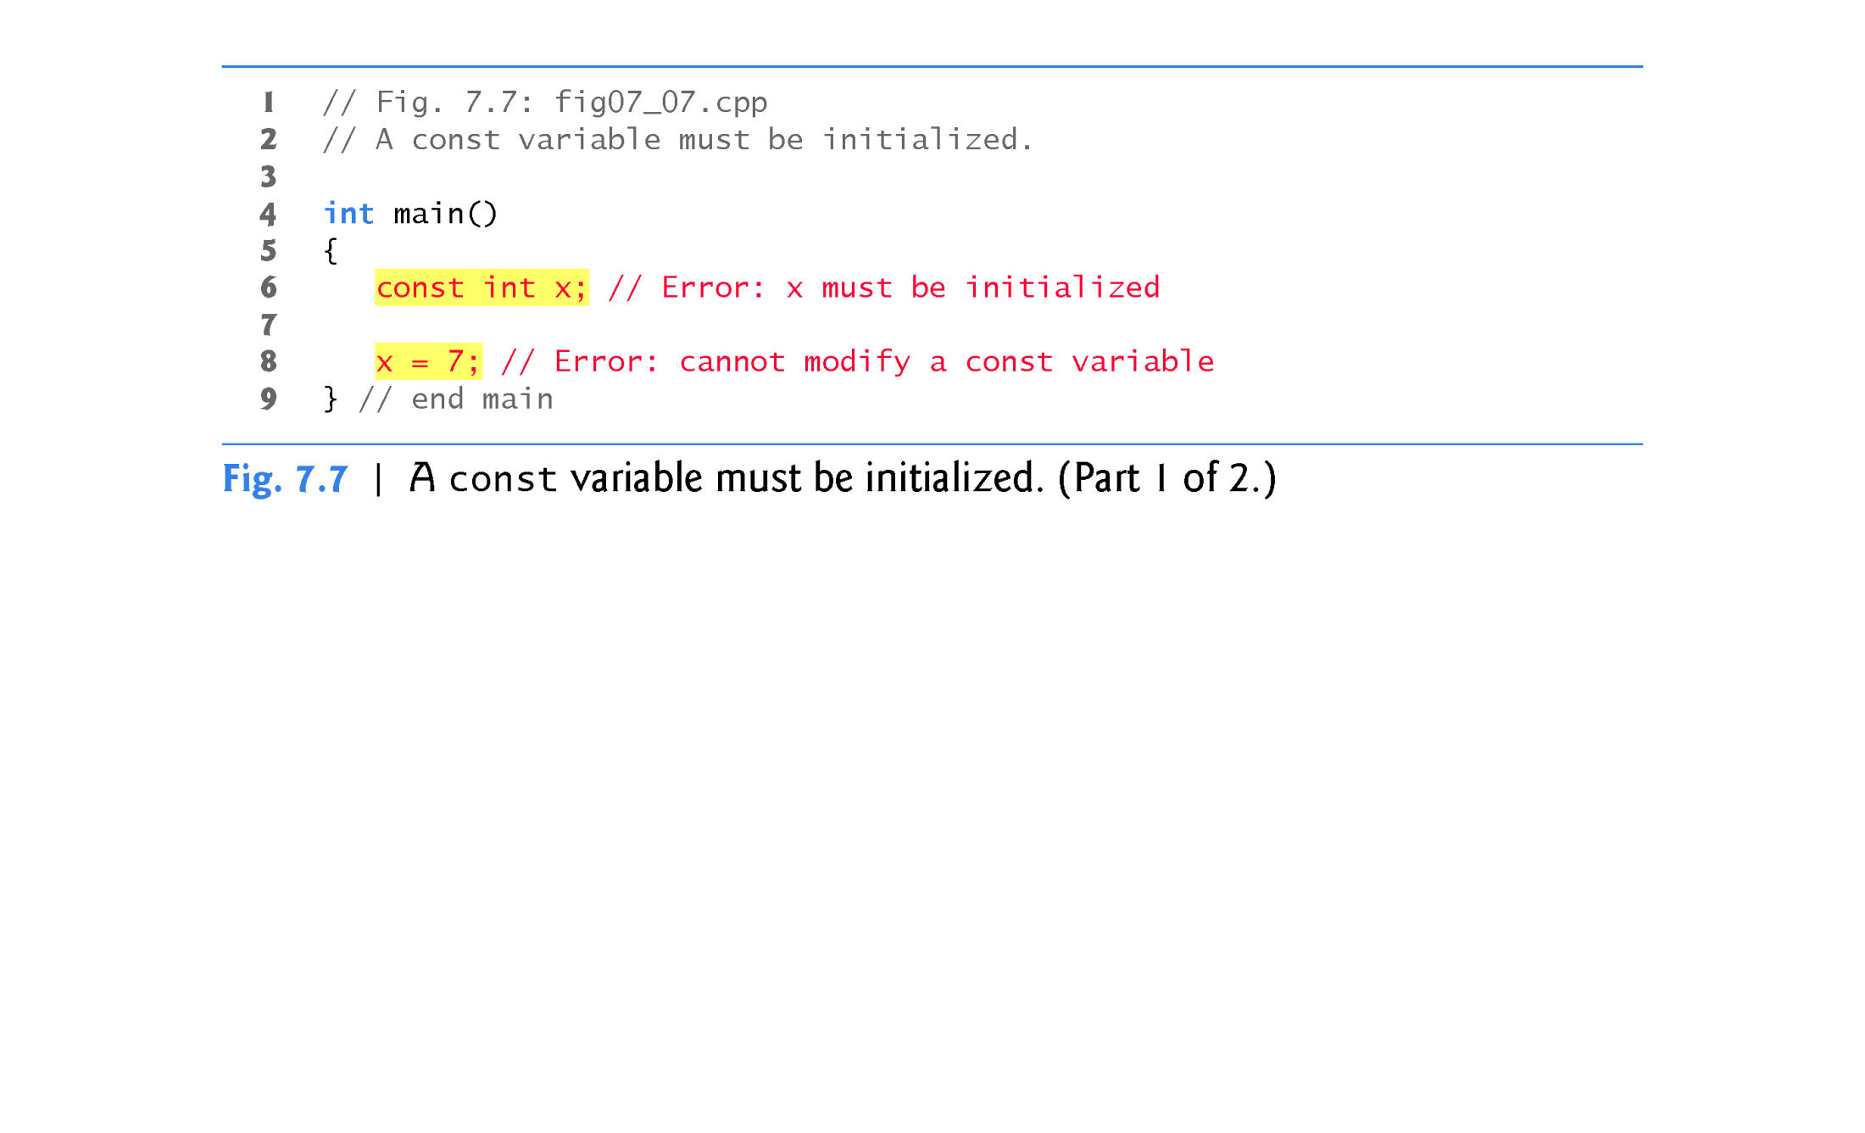

Slide 26
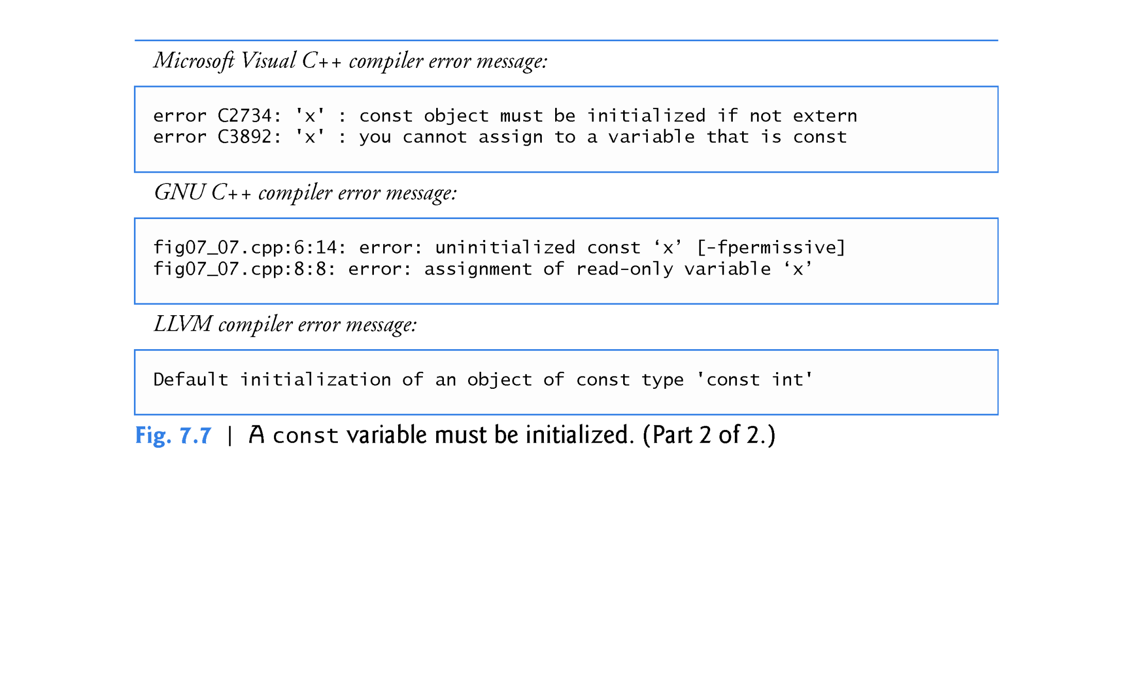

Slide 27
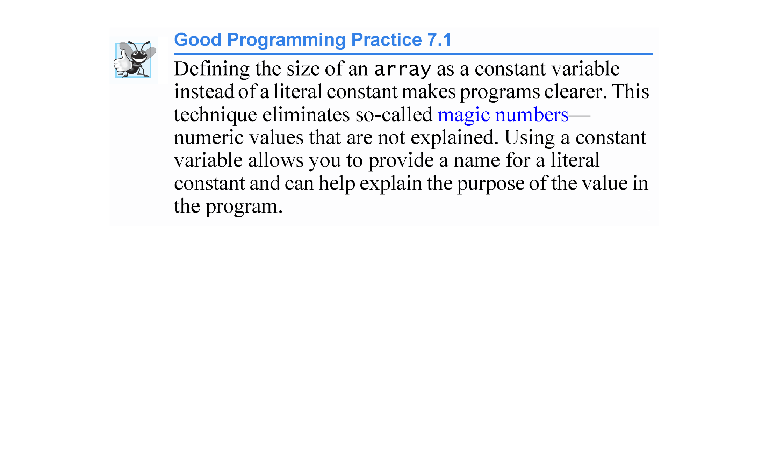

Slide 28
7.4.4 Summing the Elements of an array
Often, the elements of an array represent a series of values to be used in a calculation.
The program in Fig. 7.8 sums the values contained in the four-element integer array a.

Slide 29
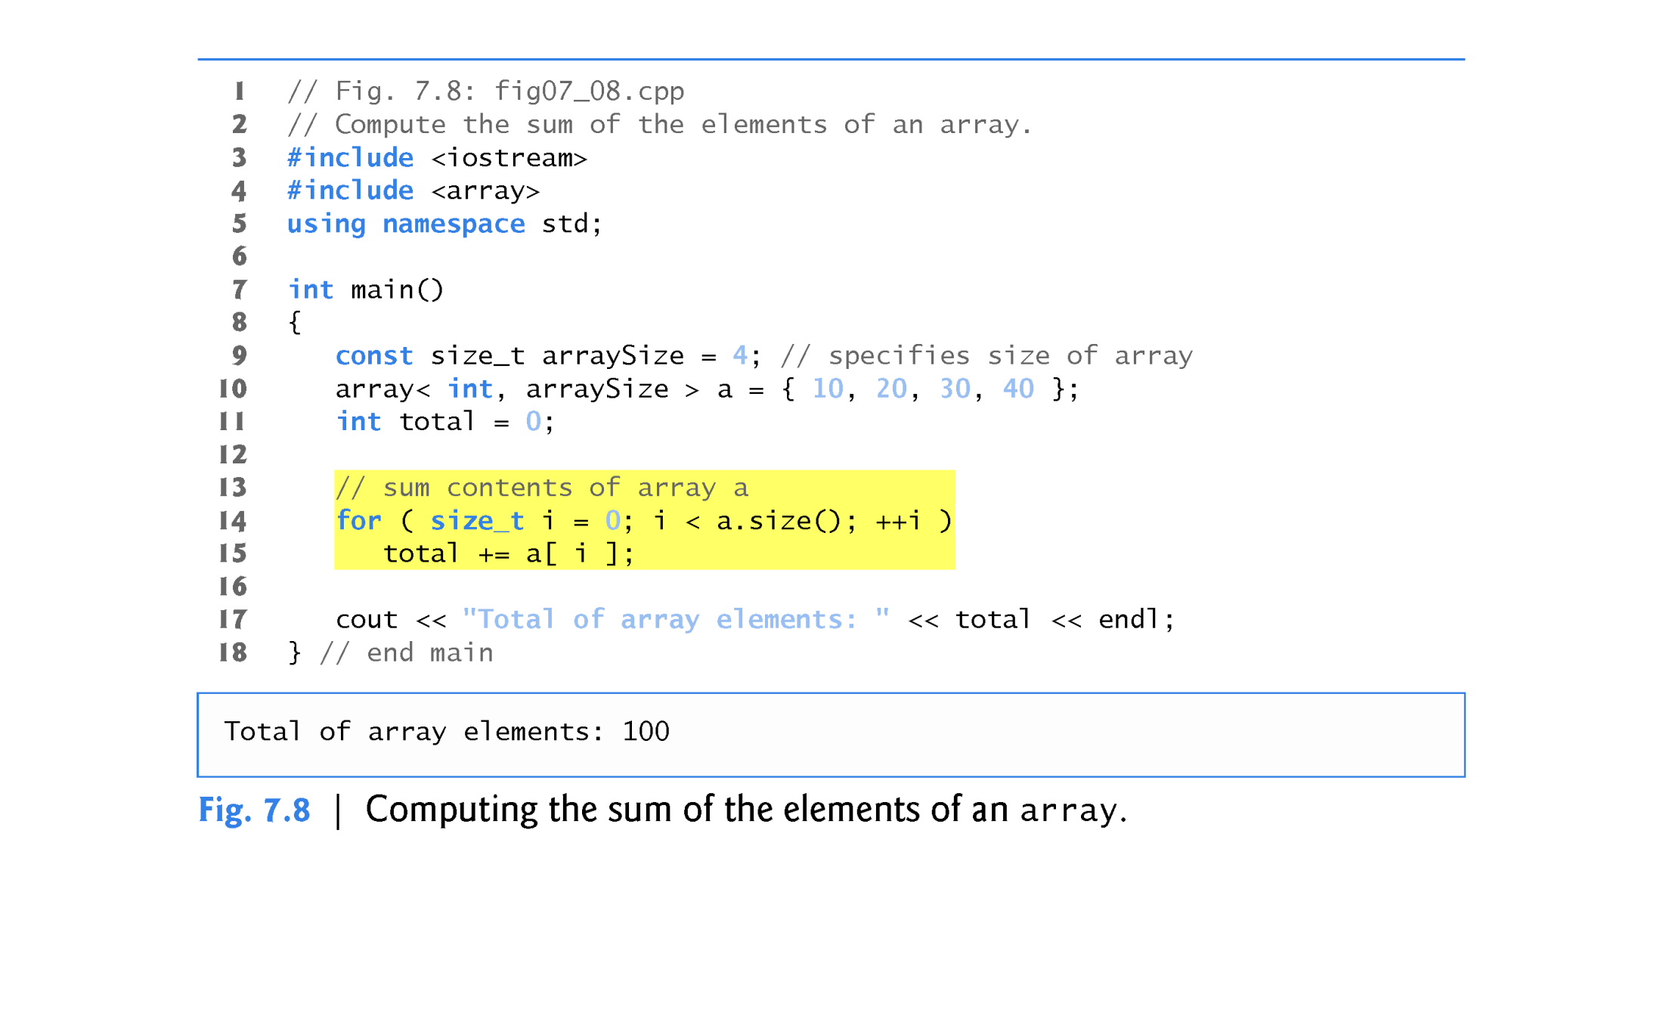

Slide 30
7.4.5 Using Bar Charts to Display array Data Graphically
Many programs present data to users in a graphical manner.
One simple way to display numeric data graphically is with a bar chart that shows each numeric value as a bar of asterisks (*).
Our next program (Fig. 7.9) stores data in an array of 11 elements, each corresponding to a grade category.

Slide 31
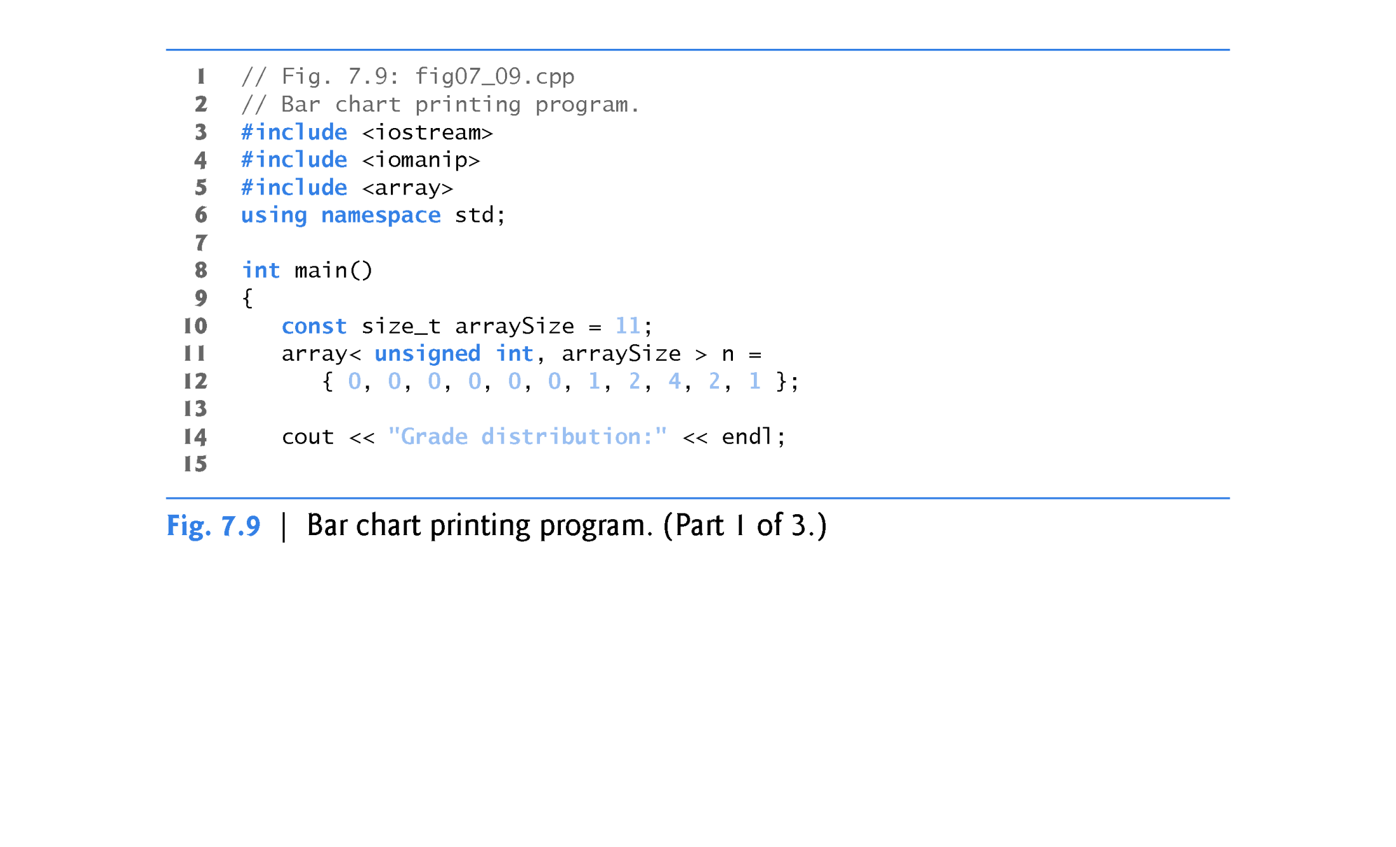

Slide 32
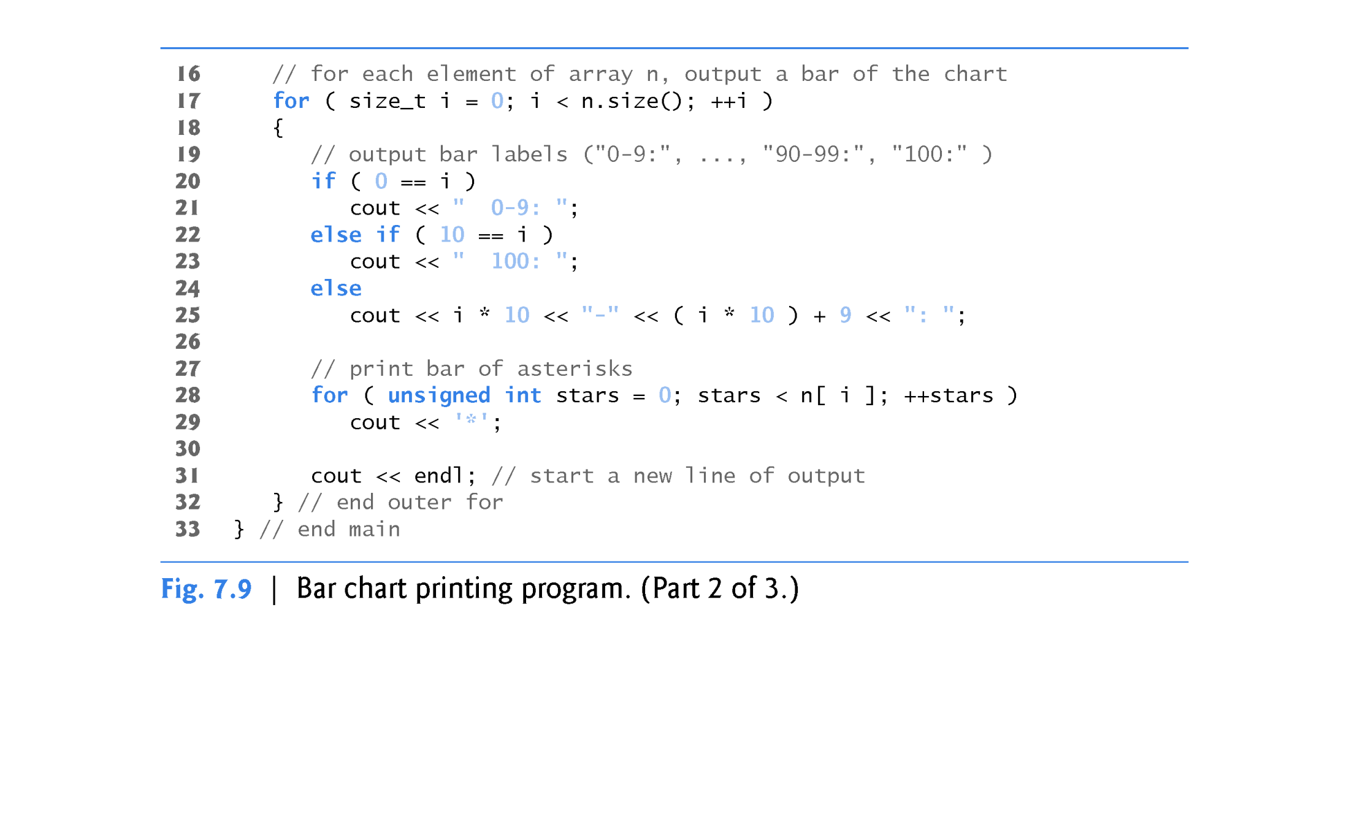

Slide 33
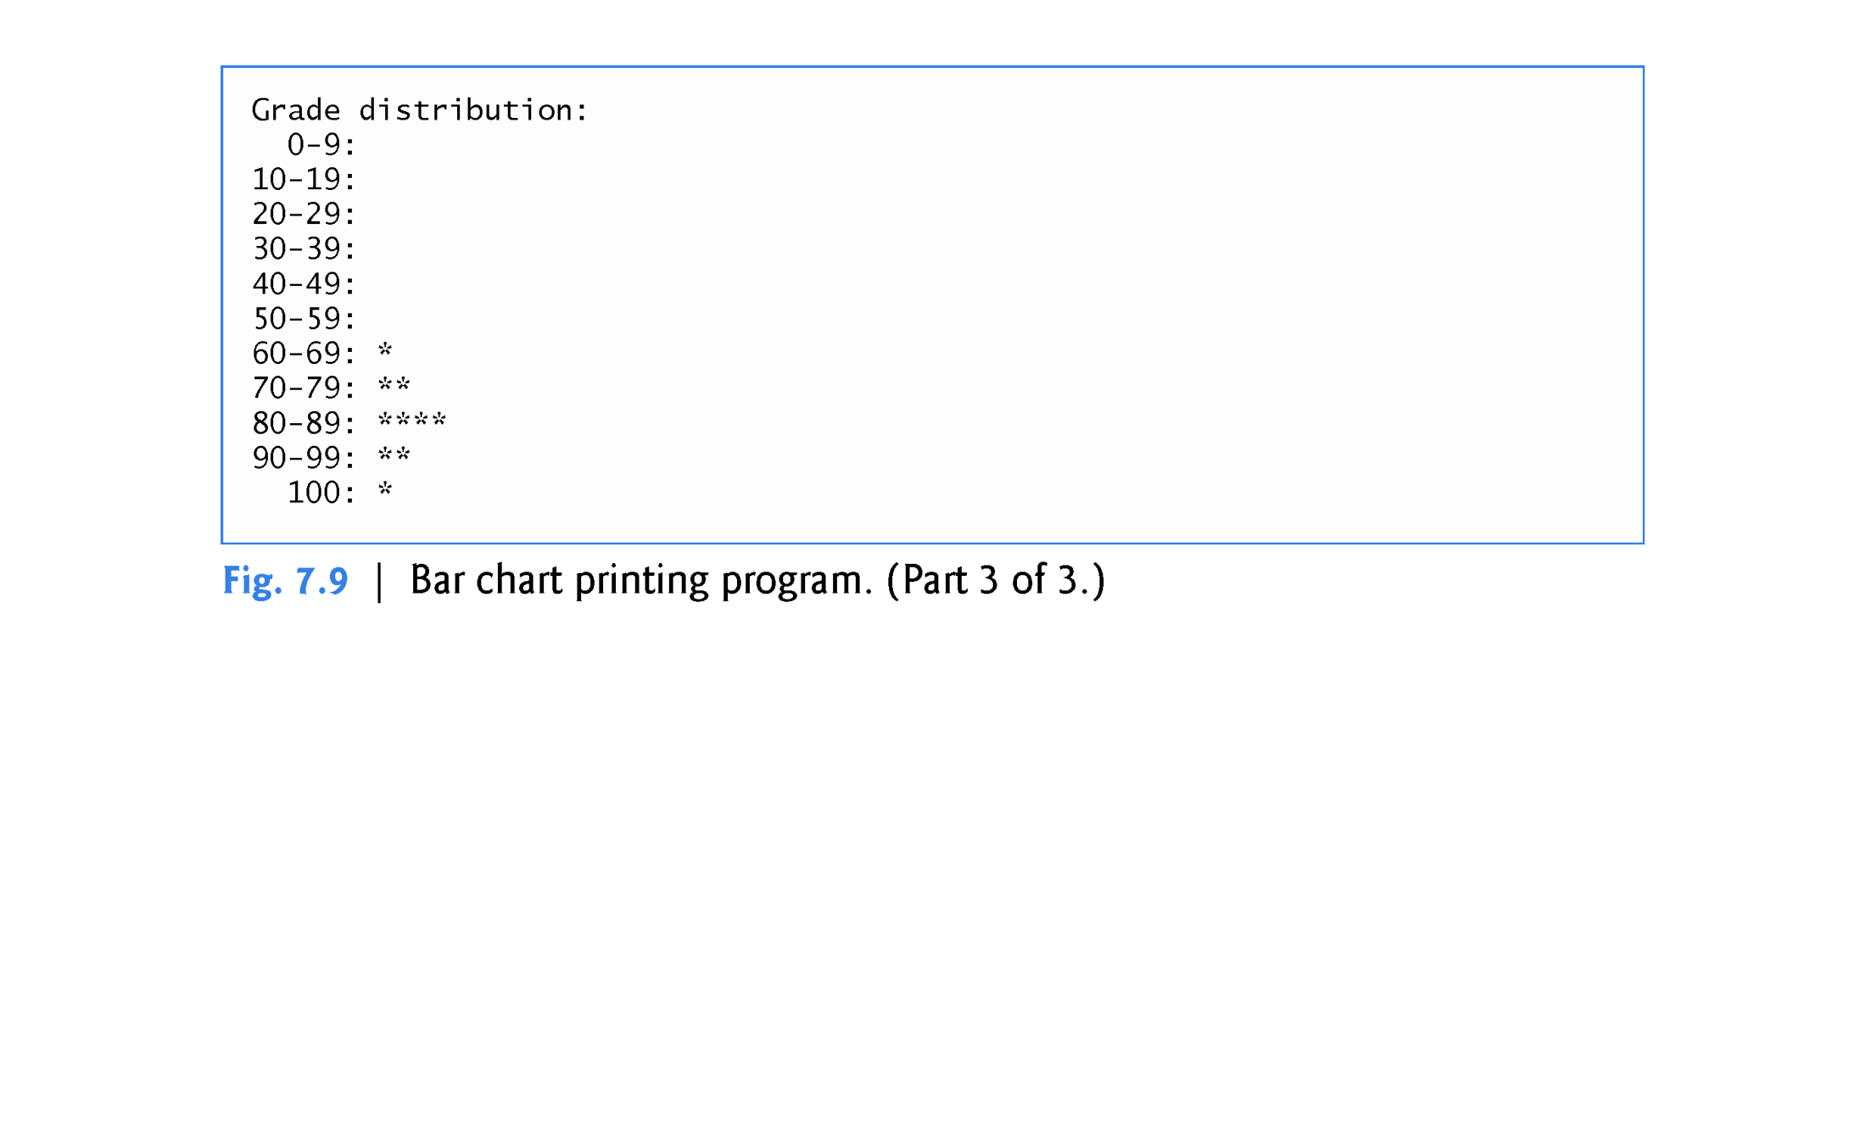

Slide 34
7.4.6 Using the Elements of an array as Counters
Sometimes, programs use counter variables to summarize data, such as the results of a survey.
In Fig. 6.9, we used separate counters in our die-rolling program to track the number of occurrences of each side of a die as the program rolled the die 6,000,000 times.
An array version of this program is shown in Fig. 7.10.
This version also uses the new C++11 random-number generation capabilities that were introduced in Section 6.9.
The single statement in line 22 of this program replaces the switch statement in lines 23–45 of Fig. 6.9.

Slide 35
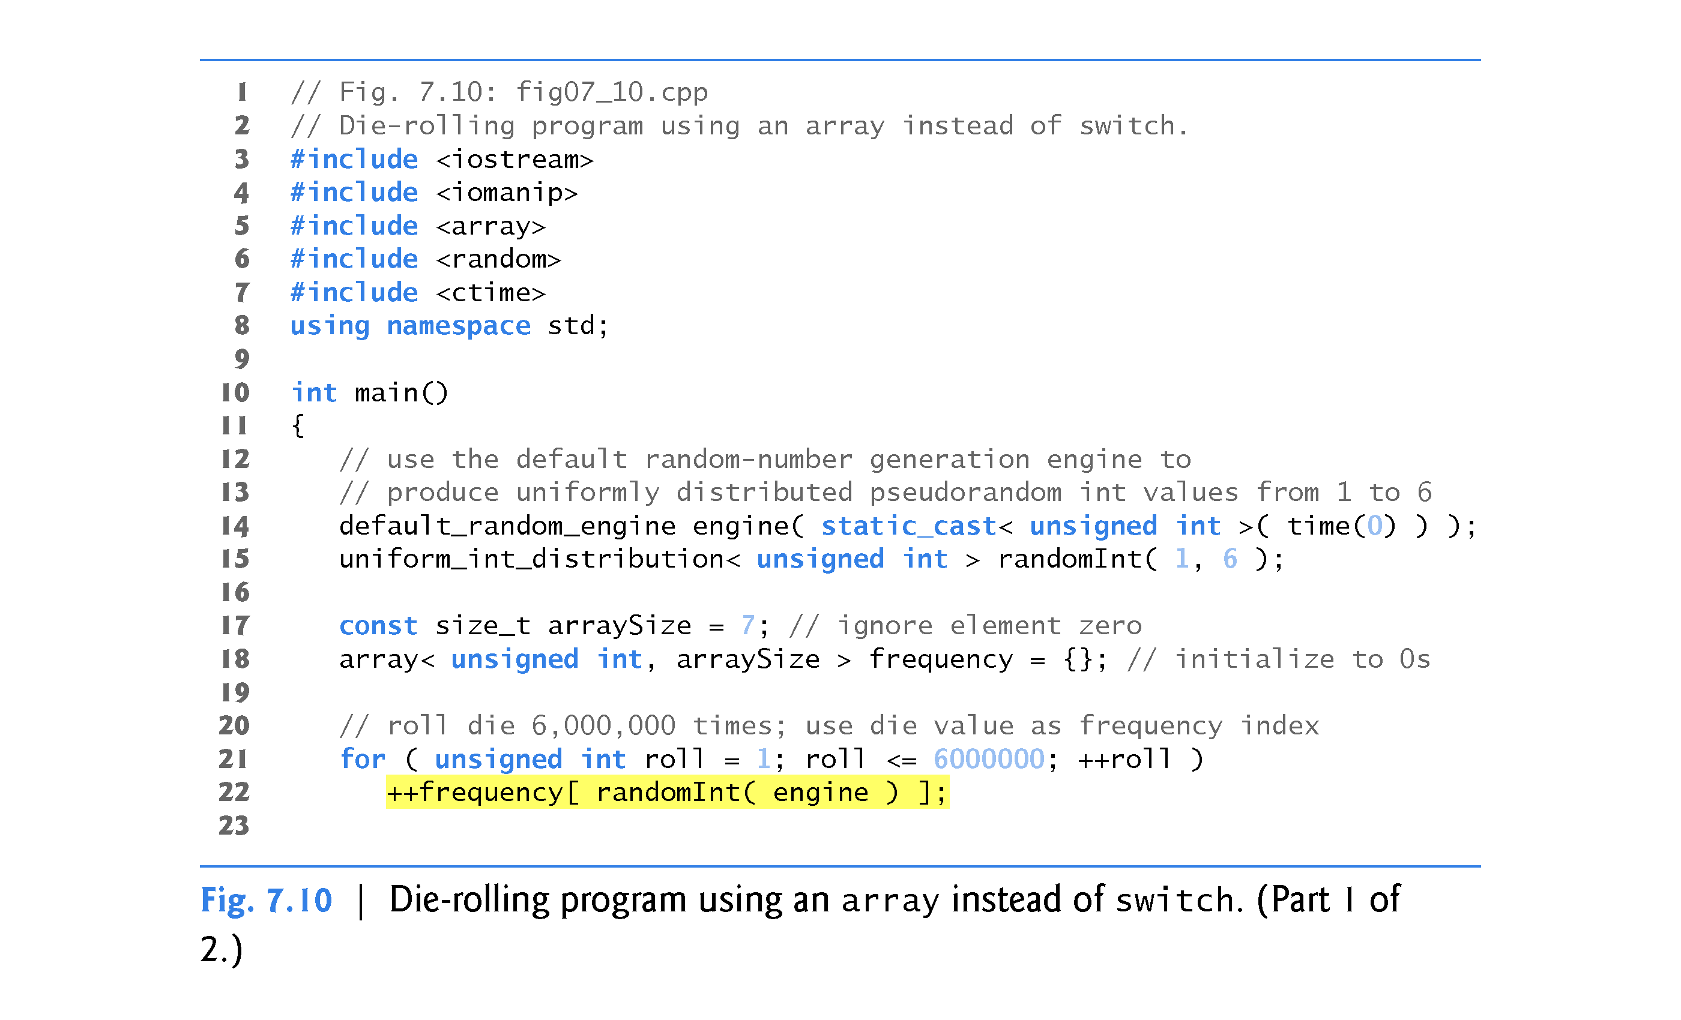

Slide 36
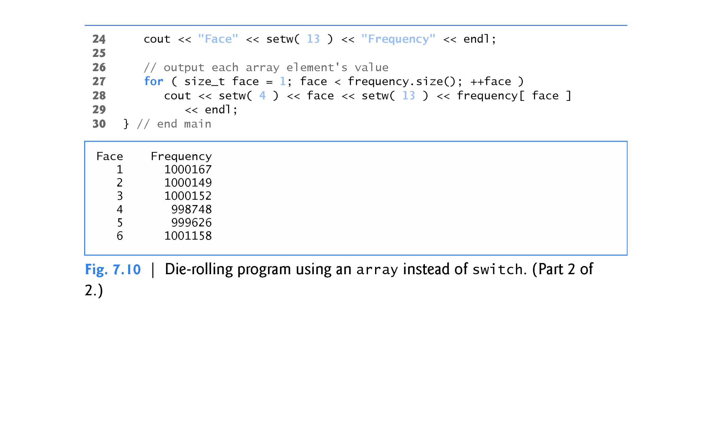

Slide 37
7.4.7 Using arrays to Summarize Survey Results
Our next example (Fig. 7.11) uses arrays to summarize the results of data collected in a survey.
Consider the following problem statement:
Twenty students were asked to rate on a scale of 1 to 5 the quality of the food in the student cafeteria, with 1 being “awful” and 5 being “excellent.” Place the 20 responses in an integer array and determine the frequency of each rating.
C++ provides no automatic array bounds checking to prevent you from referring to an element that does not exist.
Thus, an executing program can “walk off” either end of an array without warning.
In Section 7.10, we demonstrate the class template vector’s at function, which performs bounds checking for you.
Class template array also has an at function.

Slide 38
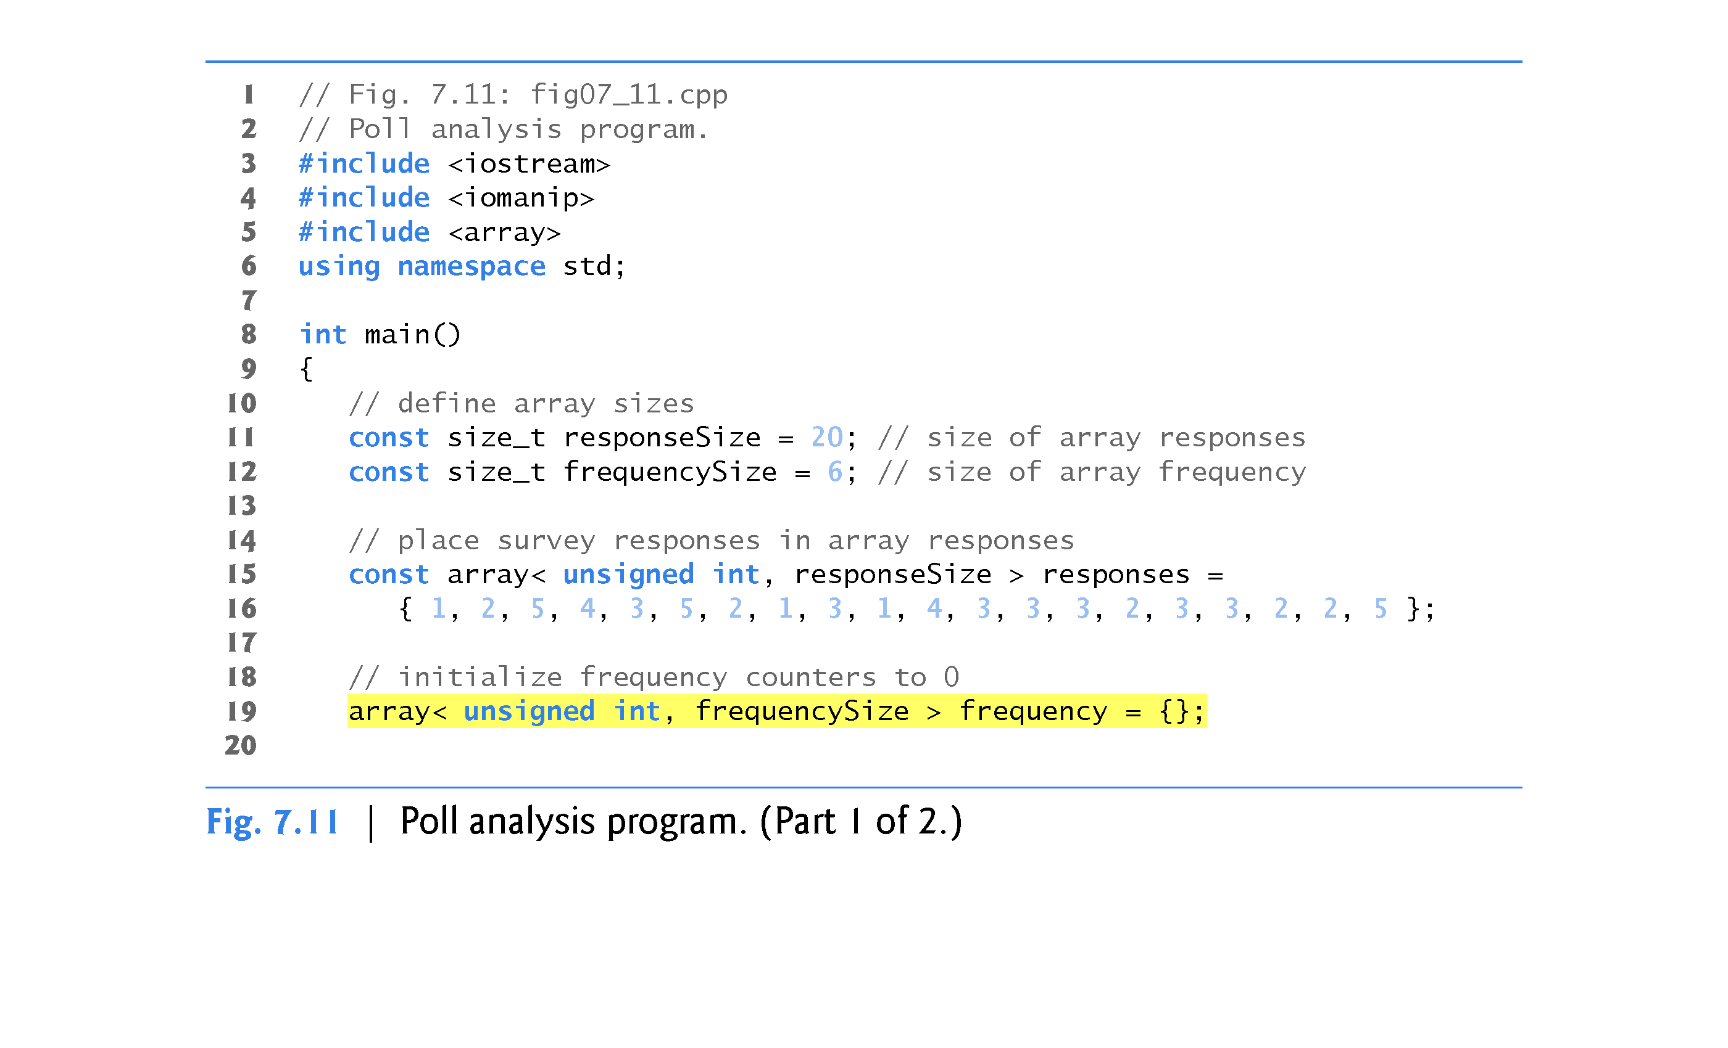

Slide 39
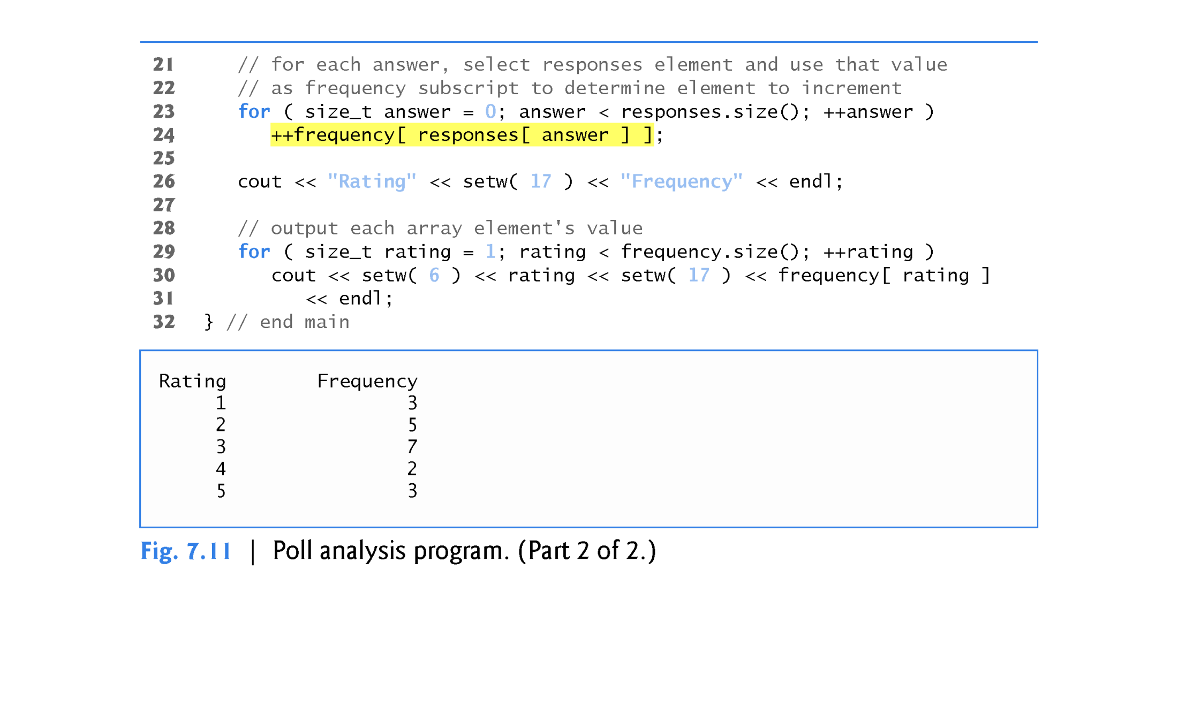

Slide 40
7.4.7 Using arrays to Summarize Survey Results
It’s important to ensure that every subscript you use to access an array element is within the array’s bounds - that is, greater than or equal to 0 and less than the number of array elements.
Allowing programs to read from or write to array elements outside the bounds of arrays are common security flaws.
Reading from out-of-bounds array elements can cause a program to crash or even appear to execute correctly while using bad data.
Writing to an out-of-bounds element (known as a buffer overflow) can corrupt a program’s data in memory, crash a program and allow attackers to exploit the system and execute their own code.

Slide 41
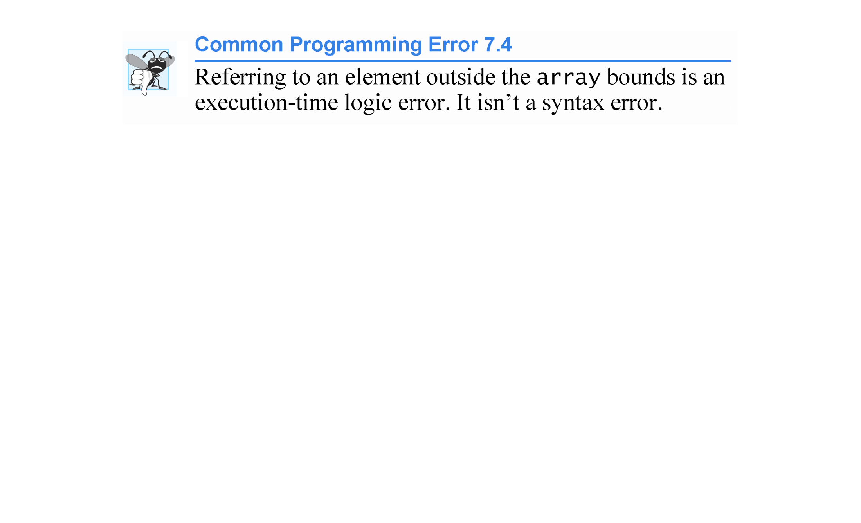

Slide 42
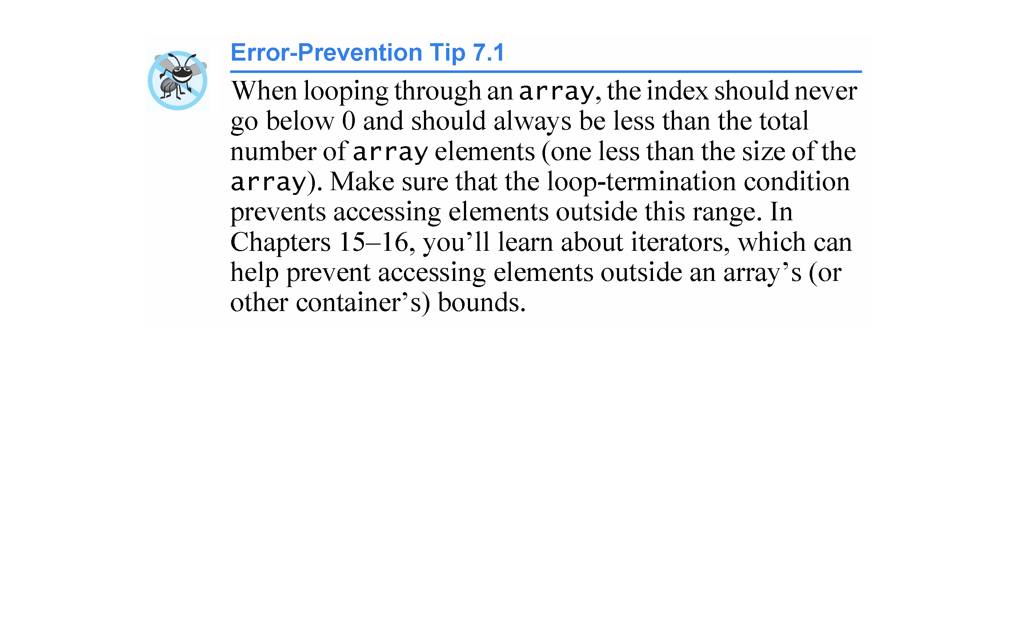

Slide 43
7.4.8 Static Local arrays and Automatic Local arrays
A program initializes static local arrays when their declarations are first encountered.
If a static array is not initialized explicitly by you, each element of that array is initialized to zero by the compiler when the array is created.

Slide 44
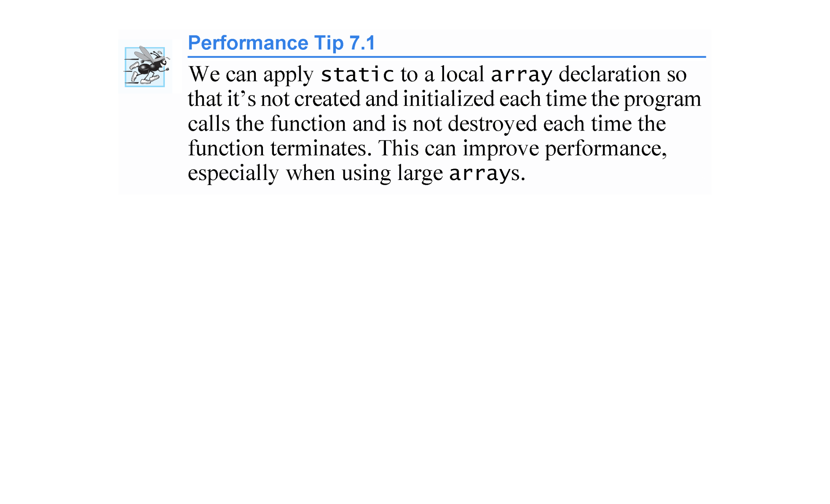

Slide 45
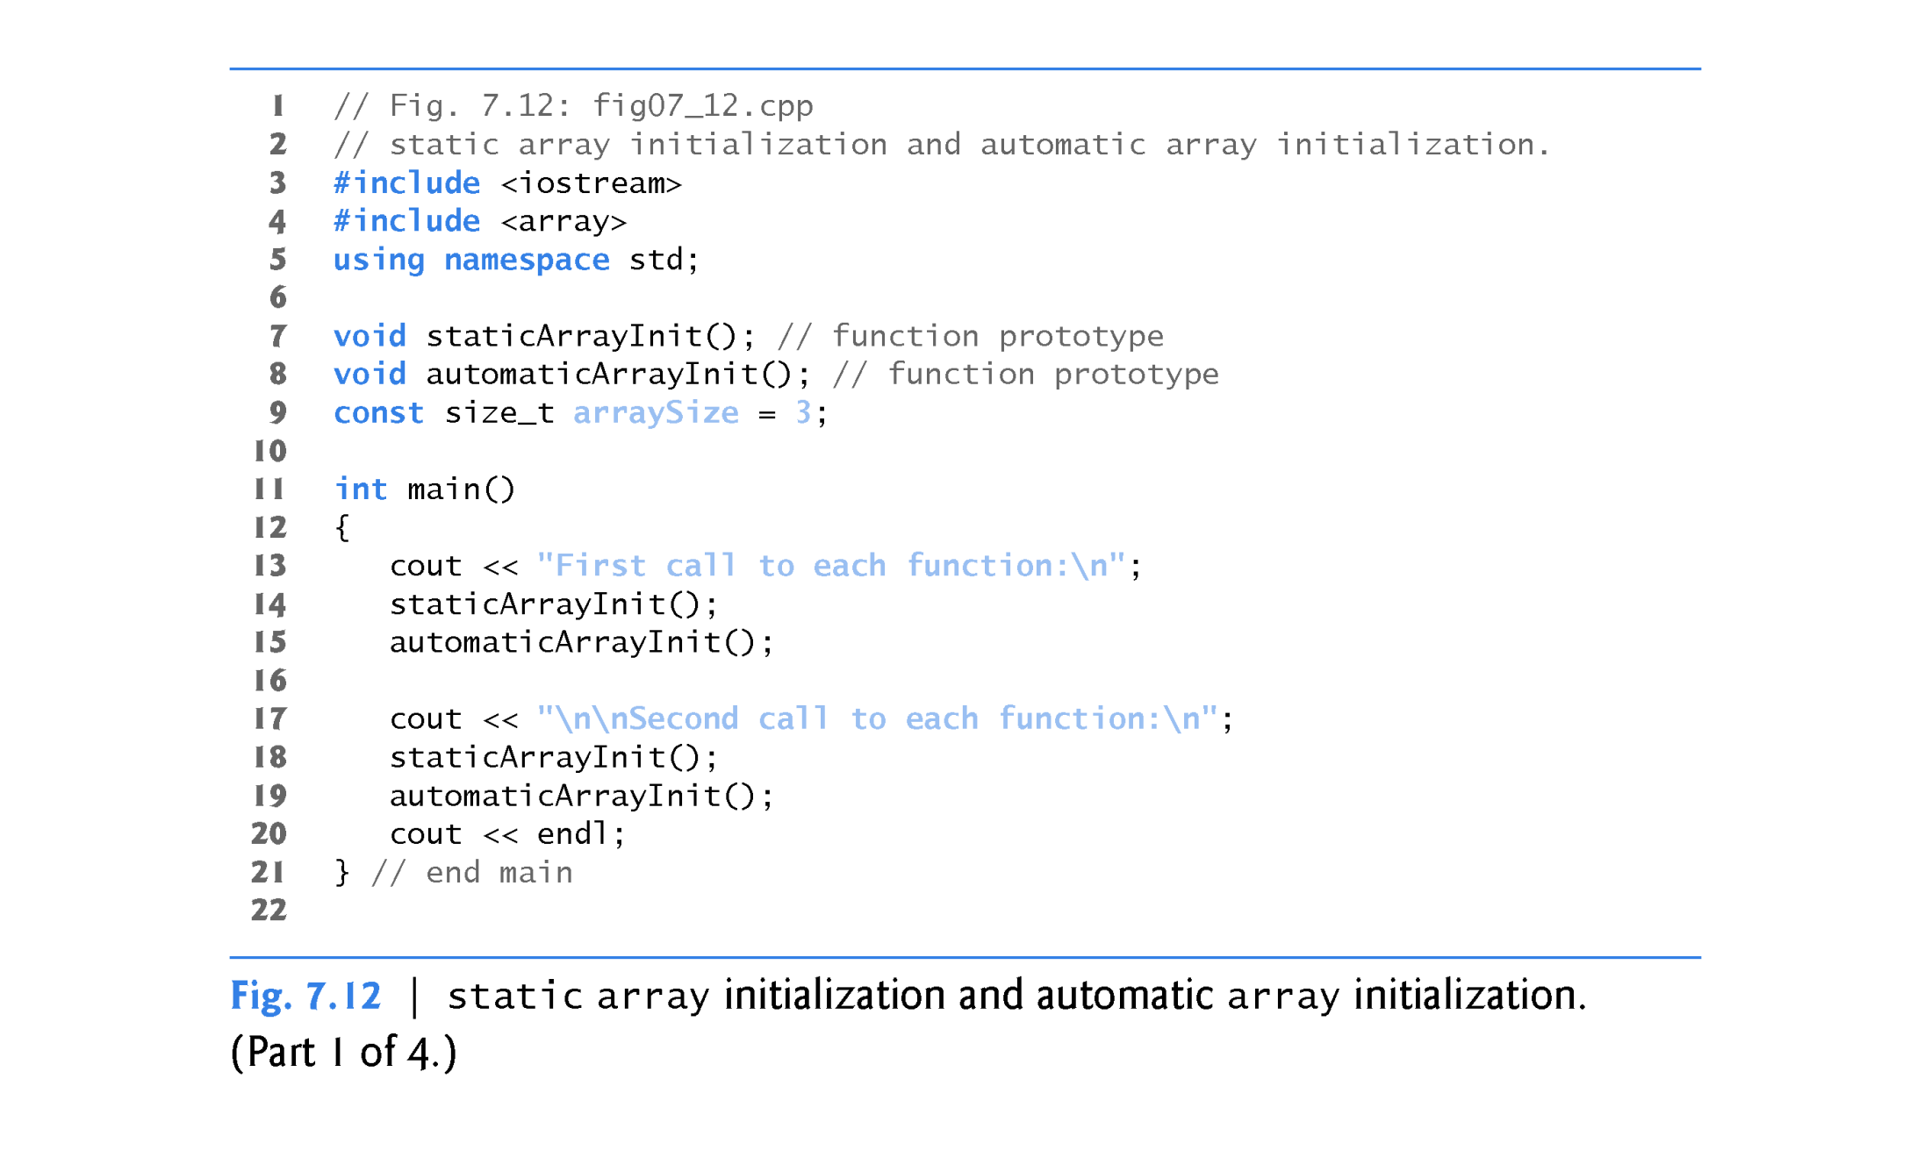

Slide 46
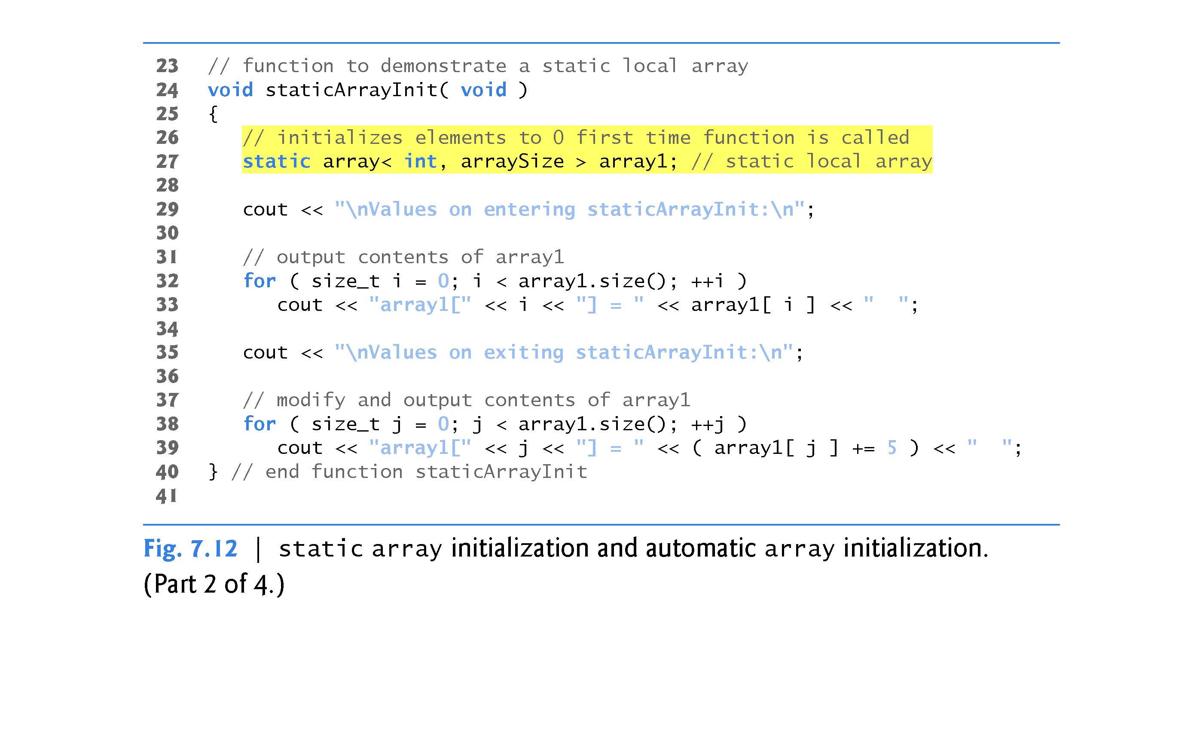

Slide 47
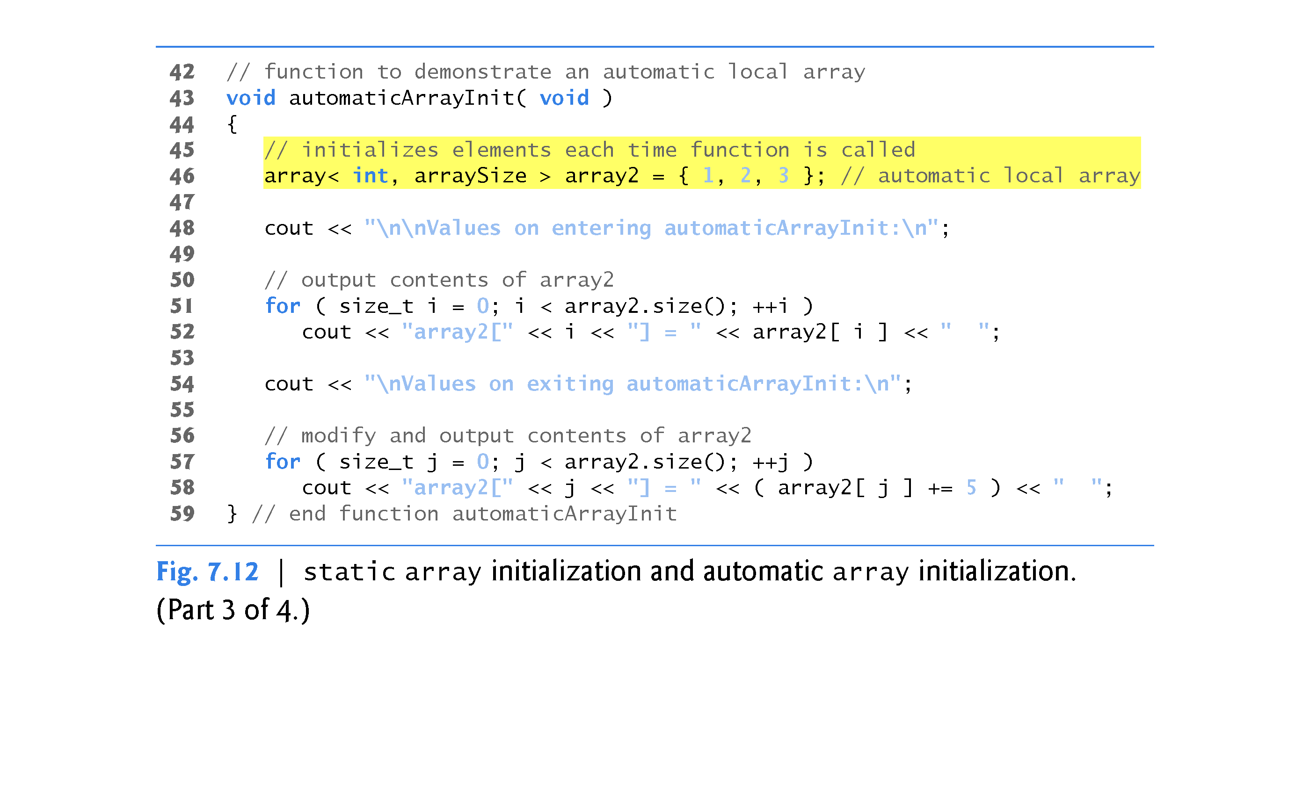

Slide 48
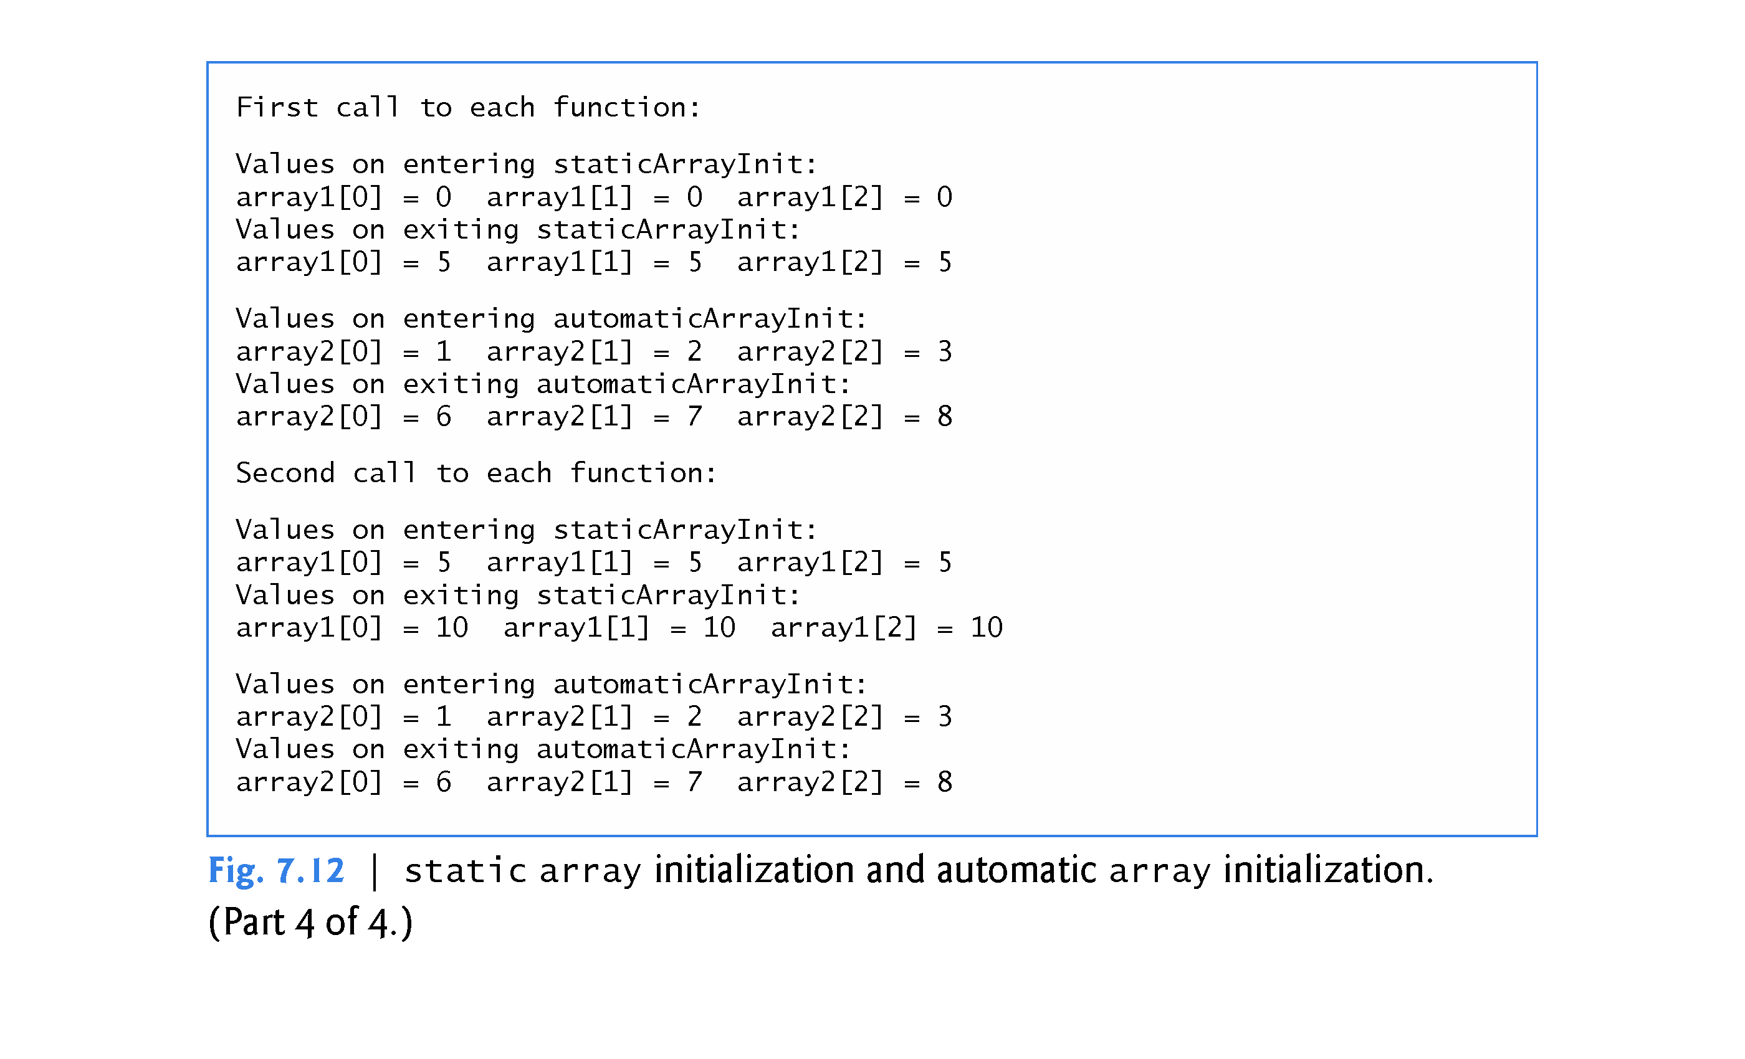

Slide 49
7.5 Range-Based for Statement
It’s common to process all the elements of an array.
The new C++11 range-based for statement allows you to do this without using a counter, thus avoiding the possibility of “stepping outside” the array and eliminating the need for you to implement your own bounds checking.

Slide 50
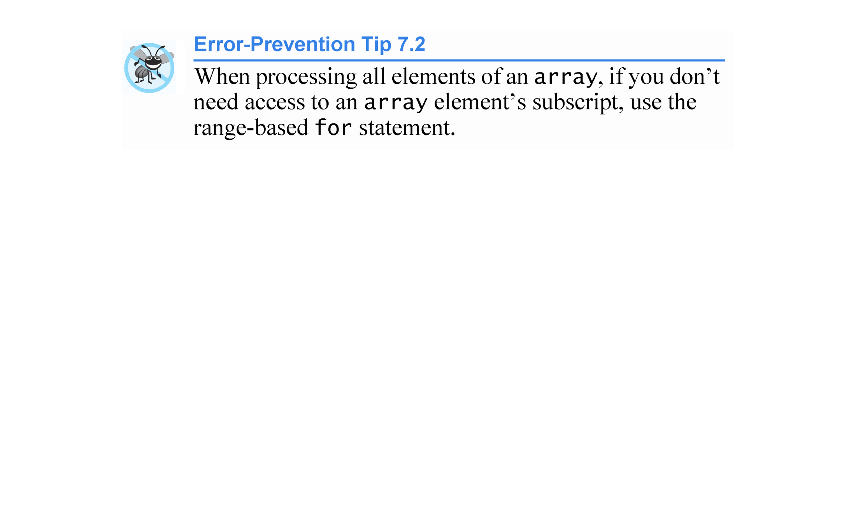

Slide 51
7.5 Range-Based for Statement (cont.)
The syntax of a range-based for statement is:
for ( rangeVariableDeclaration : collection )
statement
where rangeVariableDeclaration has a type and an identifier (e.g., int item), and collection is the array through which to iterate.
The type in the rangeVariableDeclaration must be consistent with the type of the array’s elements.
The identifier represents successive array element values on successive iterations of the loop.

Slide 52
7.5 Range-Based for Statement (cont.)
You can use the range-based for statement with most of the C++ Standard Library’s prebuilt data structures (commonly called containers), including classes array and vector.
Figure 7.13 uses the range-based for to display an array’s contents (lines 13–14 and 22–23) and to multiply each of the array’s element values by 2 (lines 17–18).

Slide 53
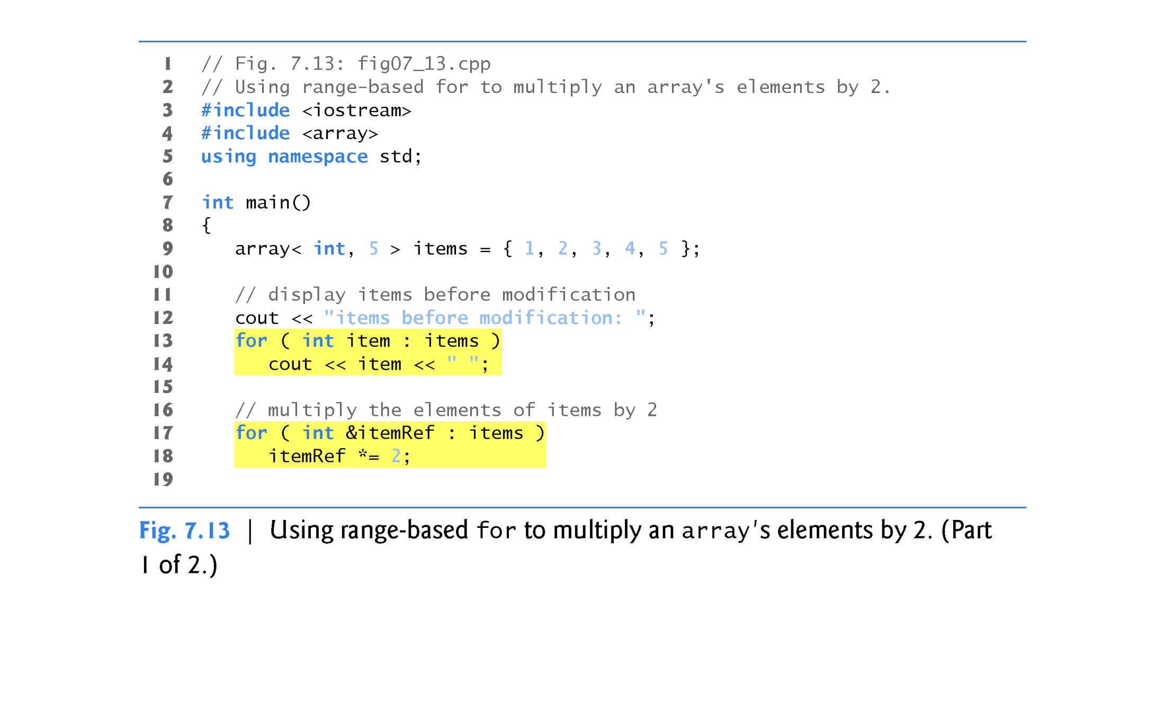

Slide 54
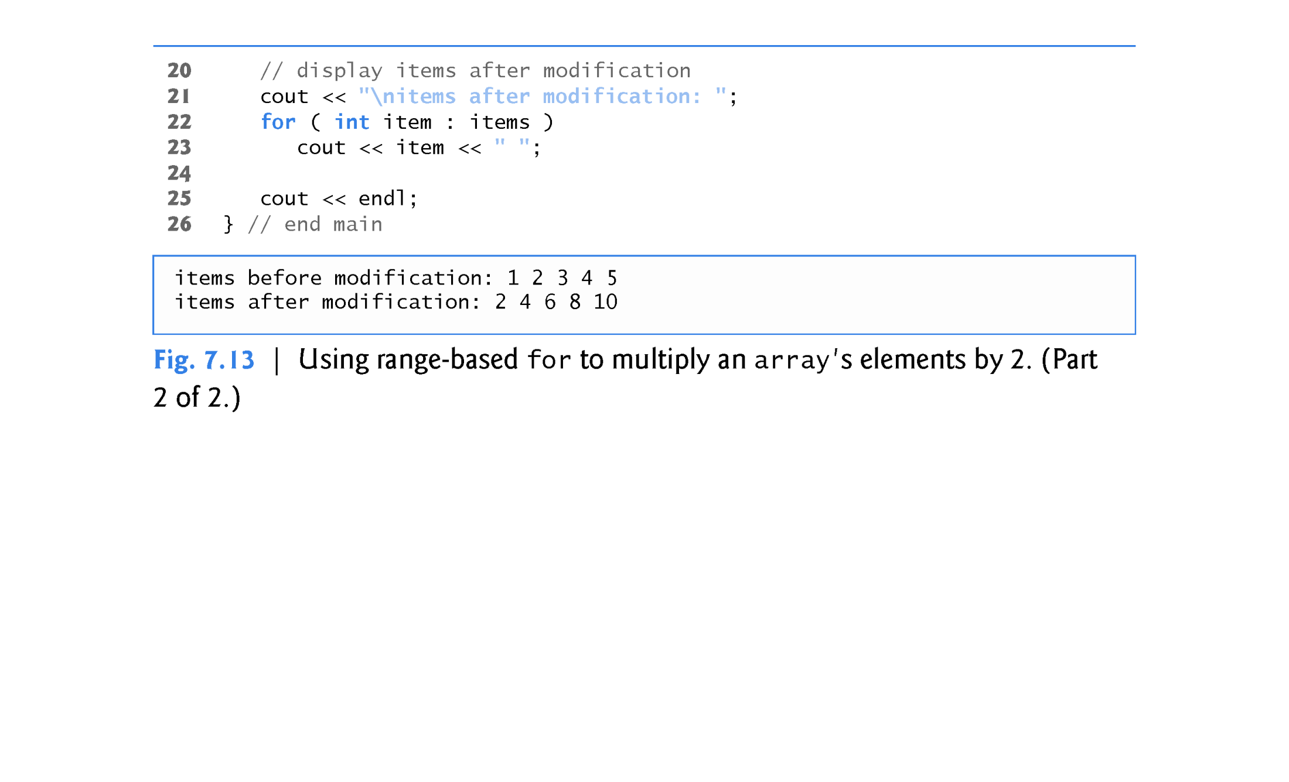

Slide 55
7.5 Range-Based for Statement (cont.)
Using the Range-Based for to Display an array’s Contents
The range-based for statement simplifies the code for iterating through an array (in general a collection).
Line 13 can be read as “for each iteration, assign the next element of items to int variable item, then execute the following statement.”
Lines 13–14 are equivalent to the following counter-controlled repetition:
for ( int counter = 0; counter < items.size(); ++counter )
cout << items[ counter ] << " ";

Slide 56
7.5 Range-Based for Statement (cont.)
Using the Range-Based for to Modify an array’s Contents
Lines 17–18 use a range-based for statement to multiply each element of items by 2.
In line 17, the rangeVariableDeclaration indicates that itemRef is an int reference (int &).
We use an int reference because items contains int values and we want to modify each element’s value - because itemRef is declared as a reference, any change you make to itemRef changes the corresponding element value in the array.

Slide 57
7.5 Range-Based for Statement (cont.)
Using an Element’s Subscript
The range-based for statement can be used in place of the counter-controlled for statement whenever code looping through an array does not require access to the element’s subscript.
However, if a program must use subscripts for some reason other than simply to loop through an array (e.g., to print a subscript number next to each array element value, as in the examples early in this chapter), you should use the counter-controlled for statement.

Slide 58
7.6 Case Study: Class GradeBook Using an array to Store Grades
This section further evolves class GradeBook, introduced in Chapter 3 and expanded in Chapters 4–6.
Previous versions of the class process grades entered by the user, but do not maintain the individual grade values in the class’s data members.
Thus, repeat calculations require the user to reenter the grades.
In this section, we store grades in an array.

Slide 59
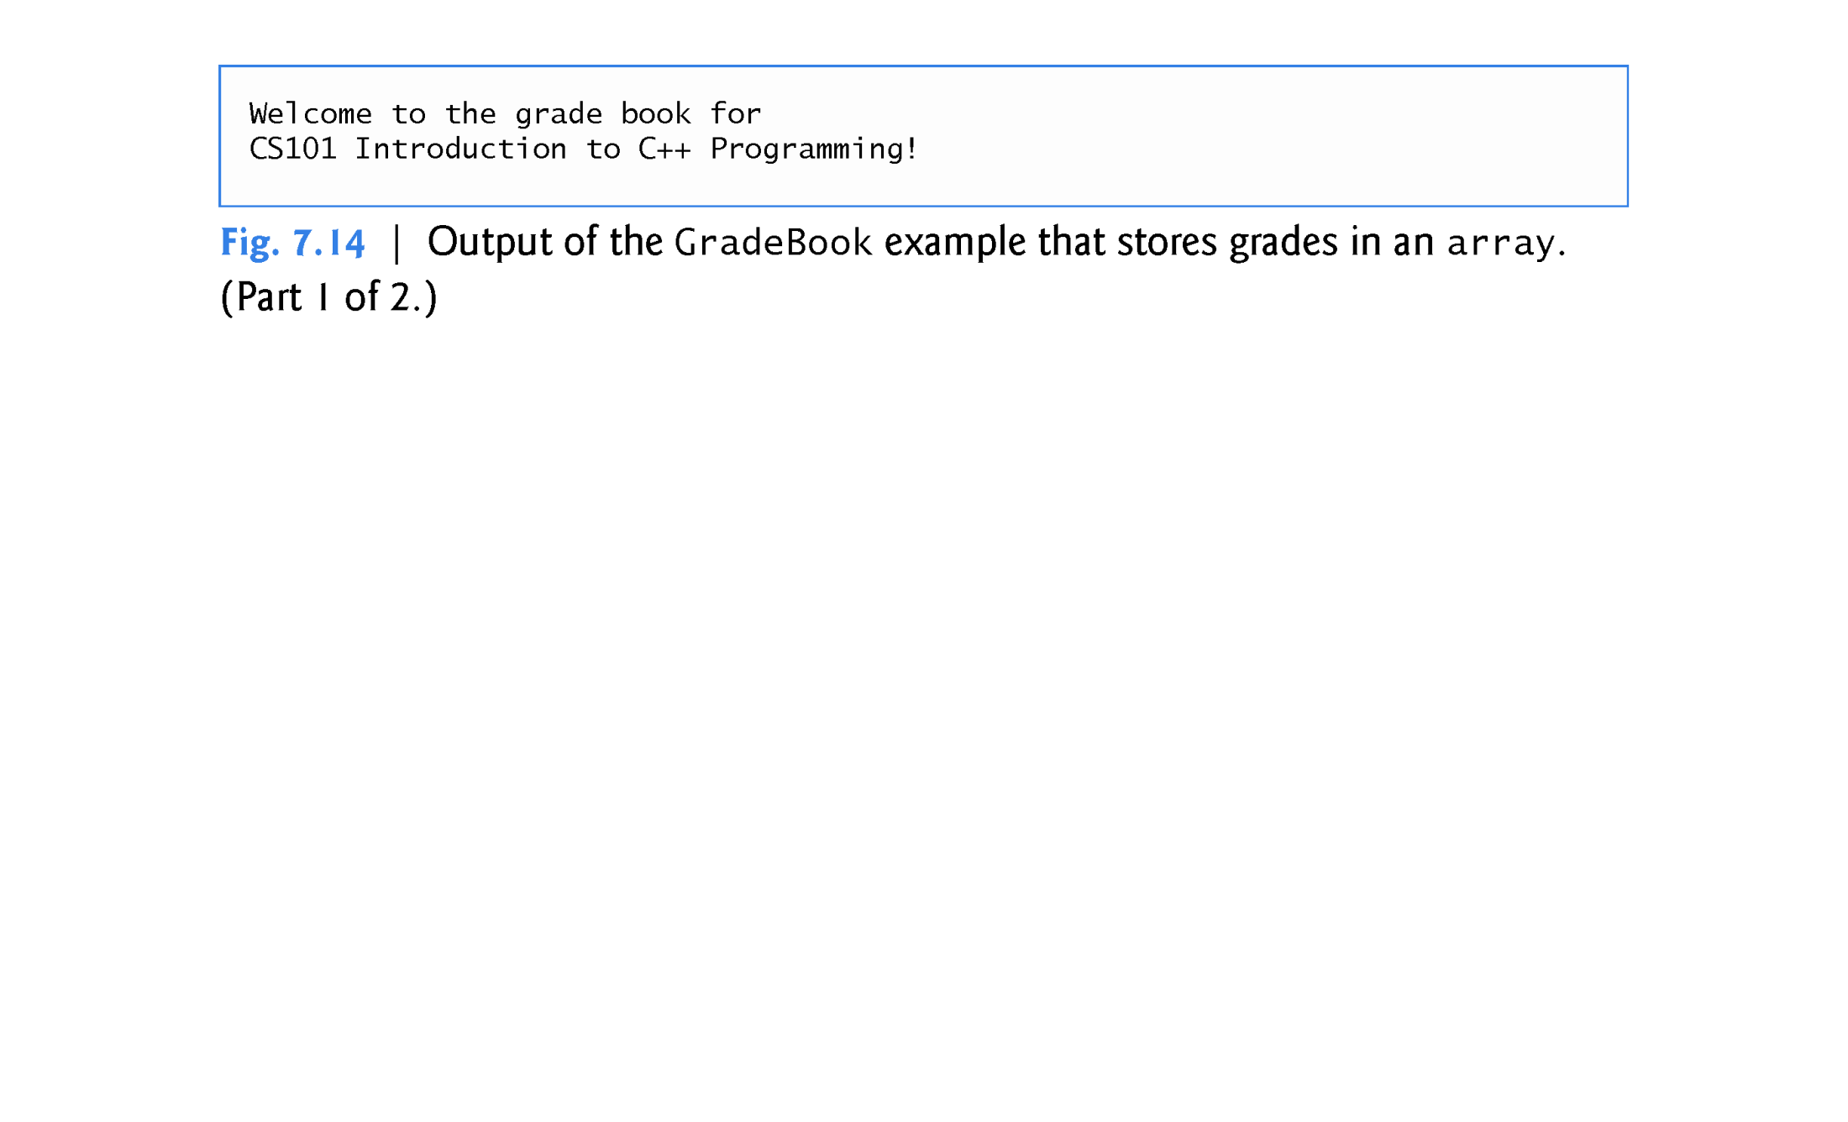

Slide 60
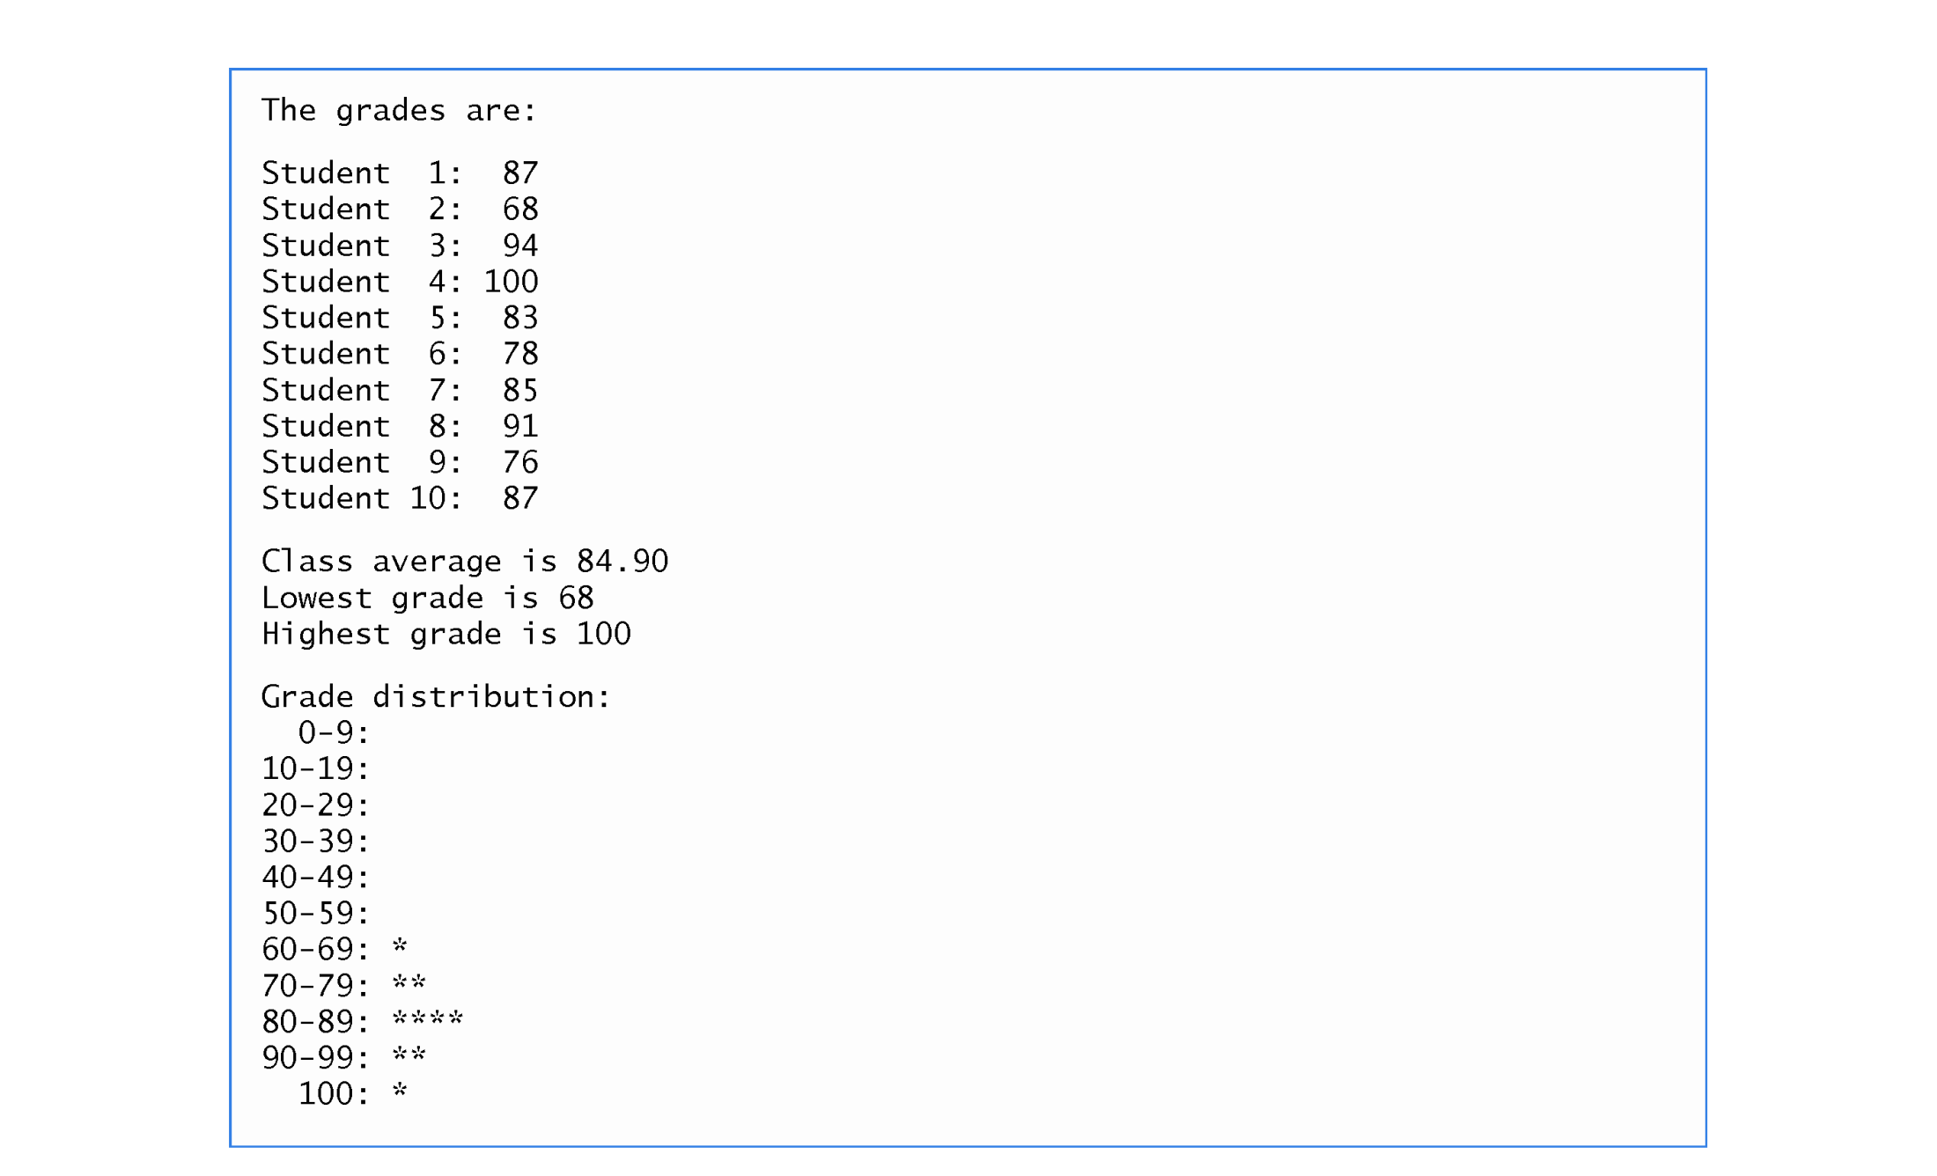

Slide 61
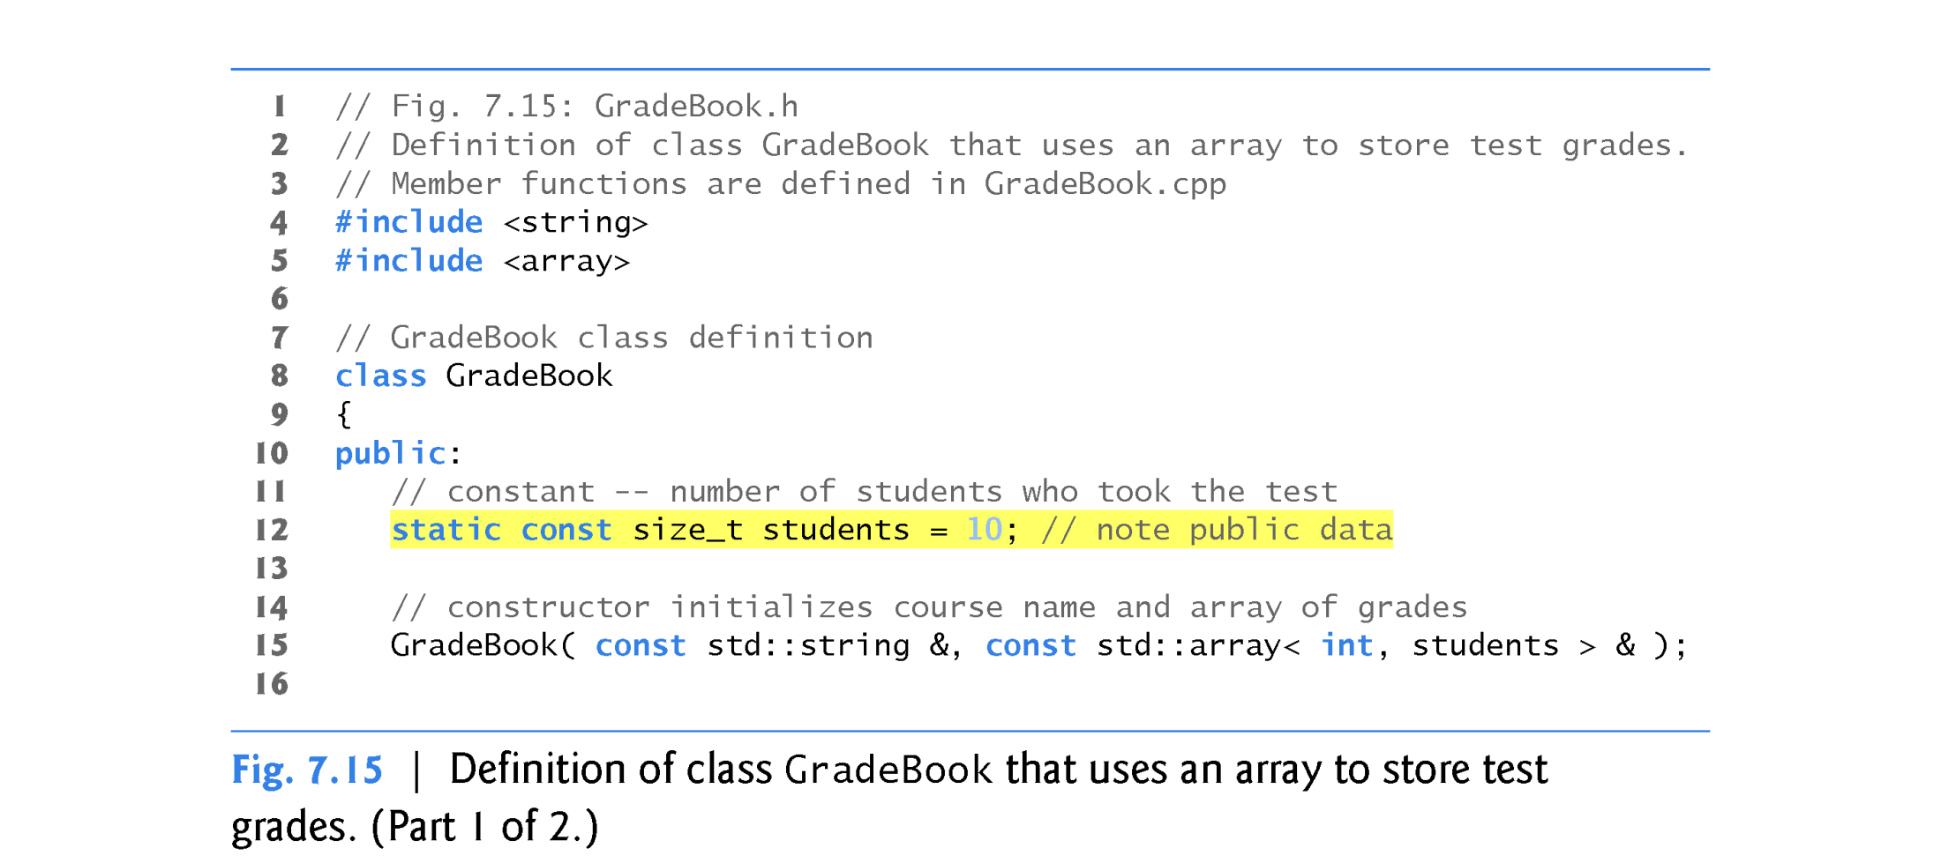
A using statement should NOT be included in a header file.
Do not include the line “using namespace std;”

Slide 62
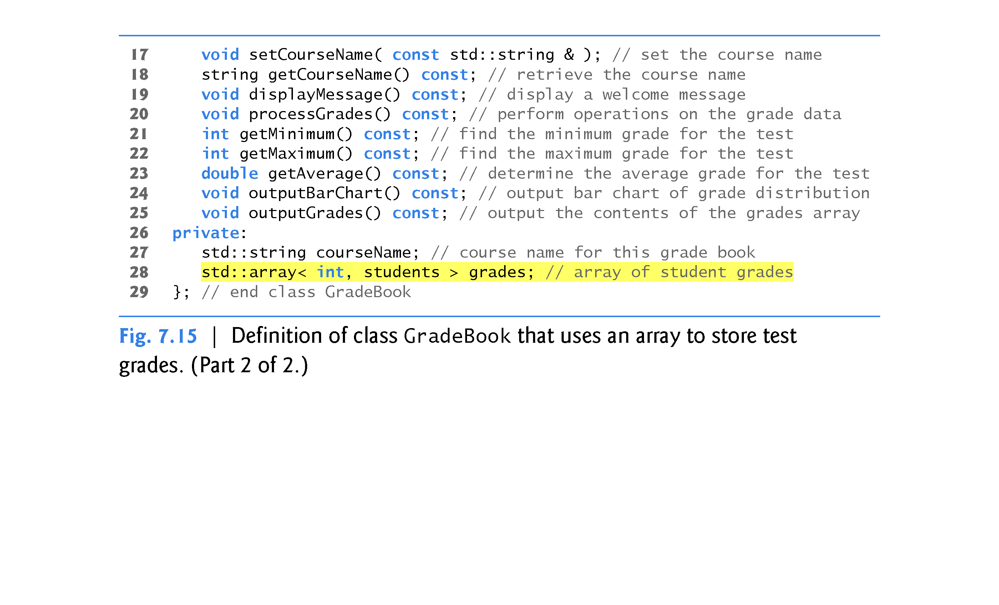
“const” should be used after a member function prototype to specify that the member function does not change any member data items (fields).

Slide 63
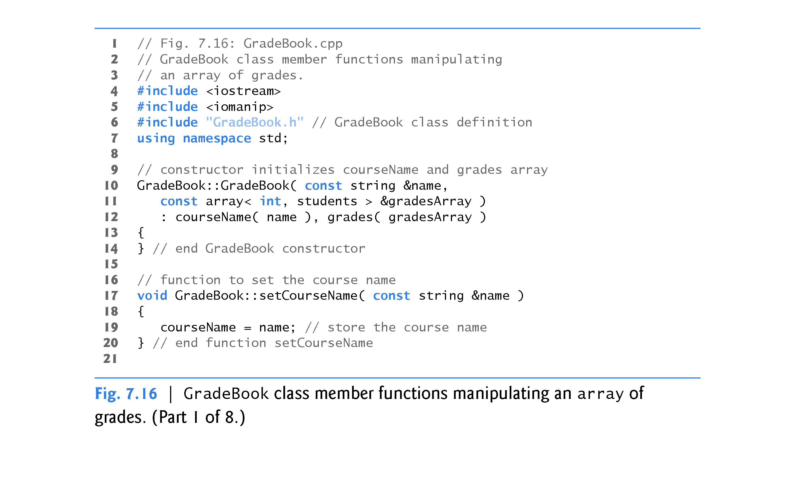

Slide 64
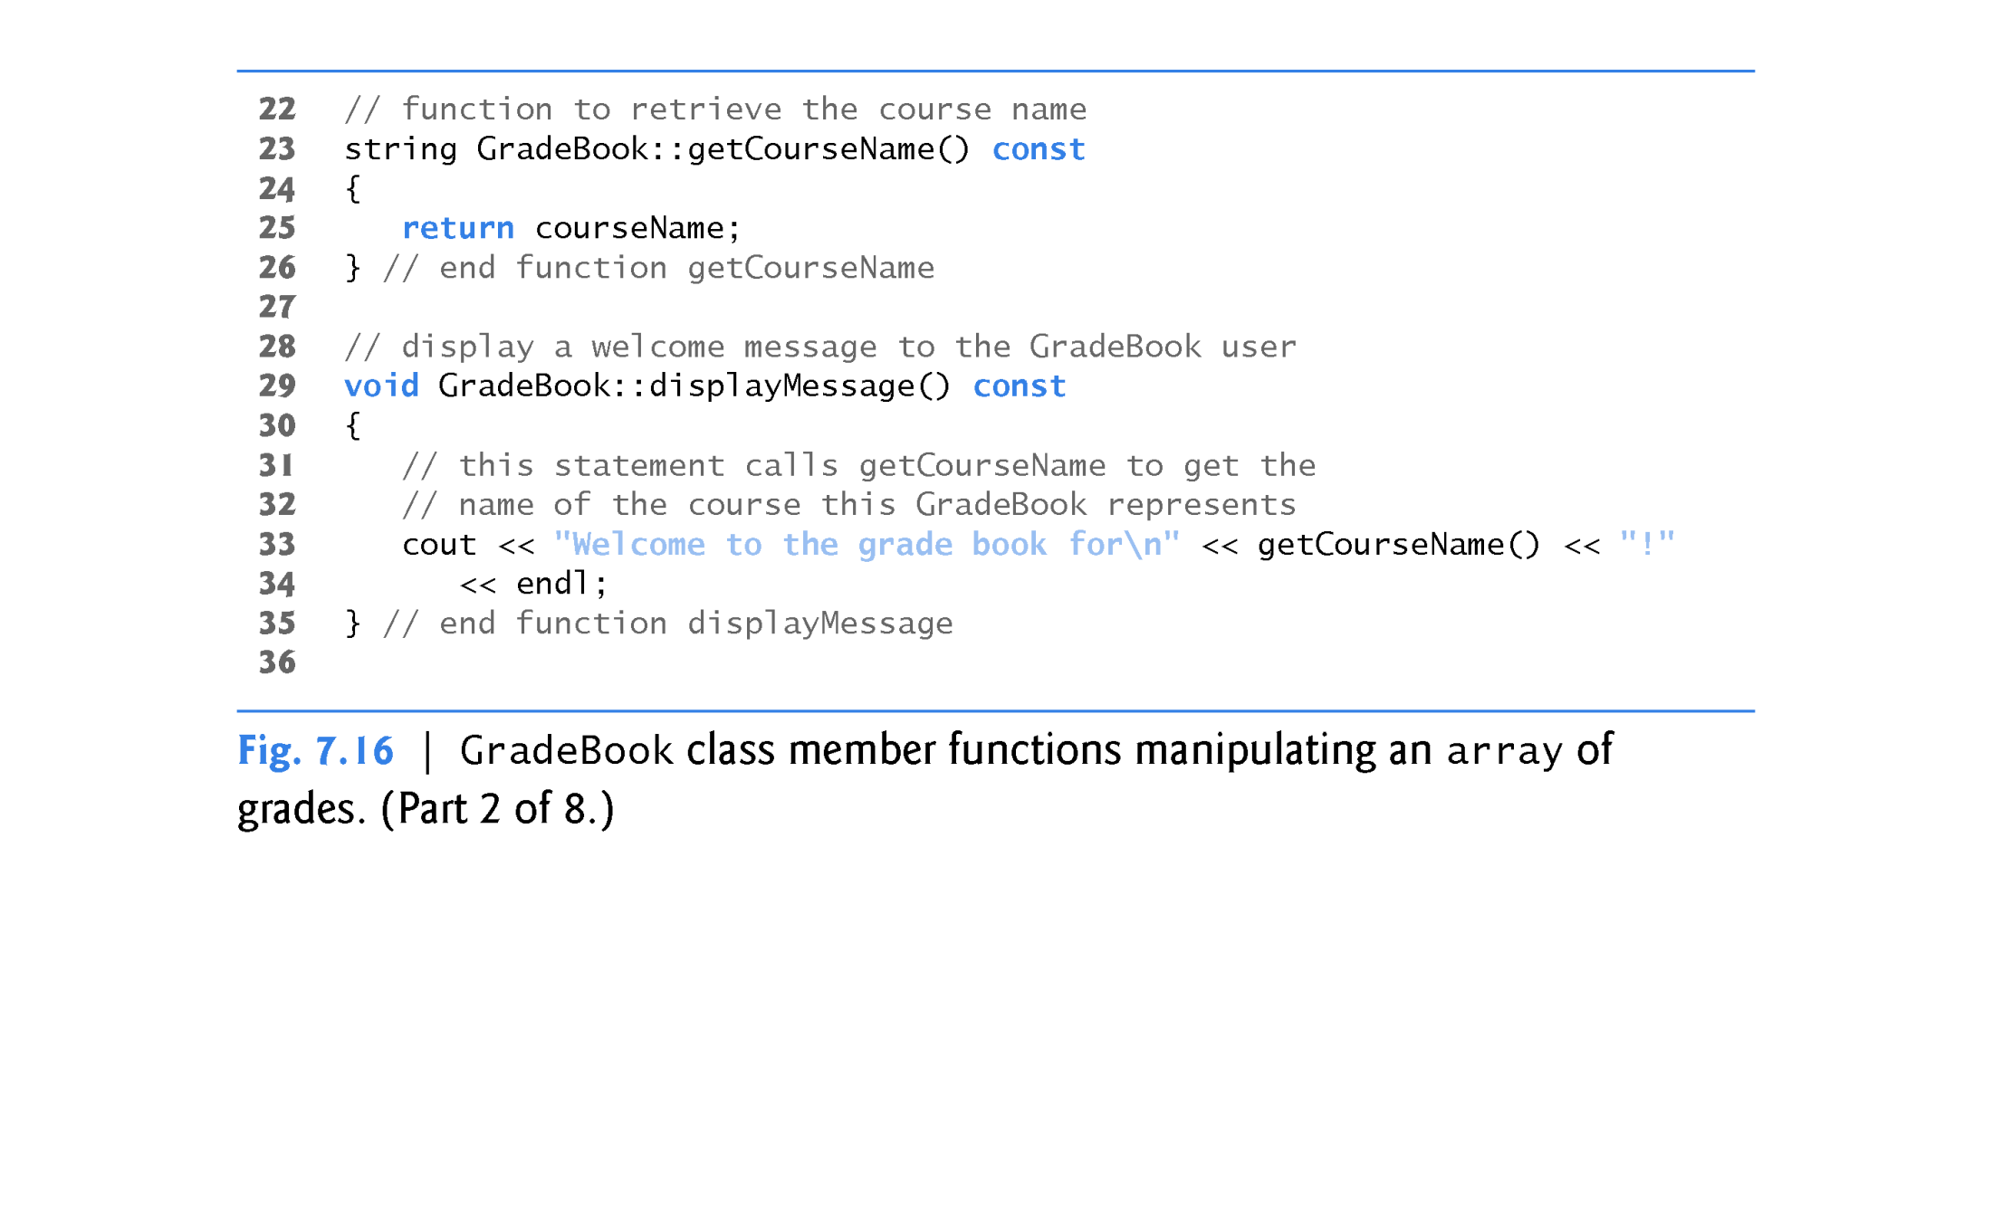

Slide 65
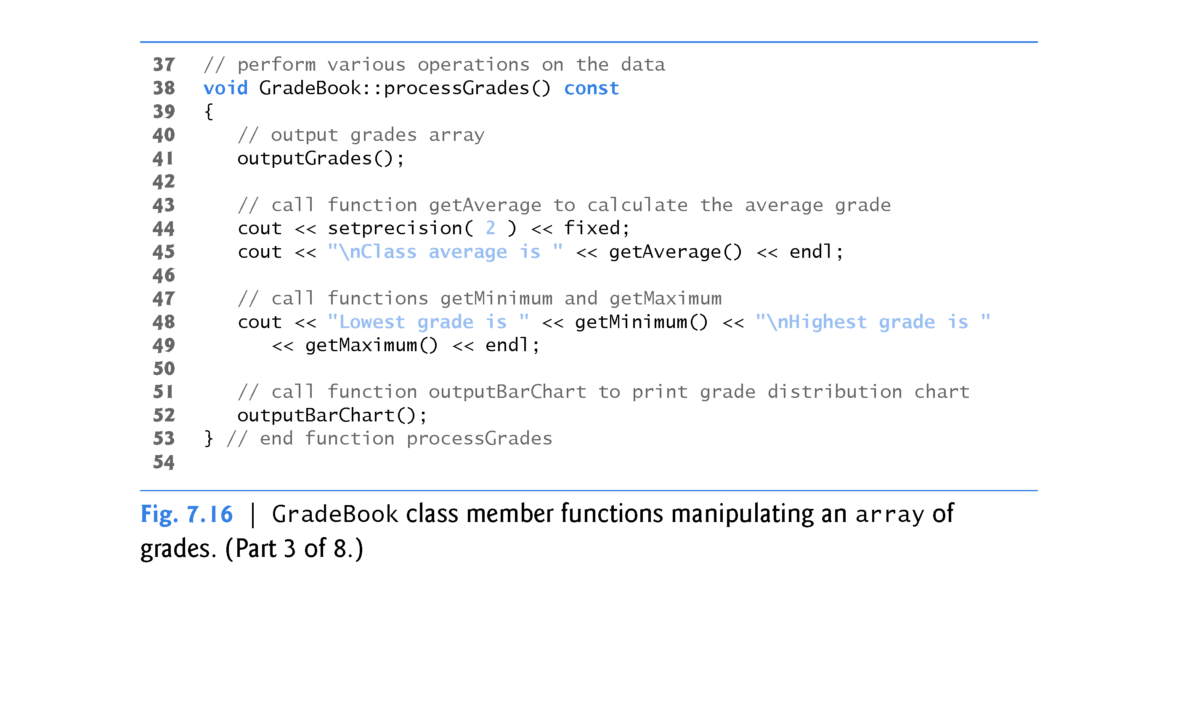

Slide 66
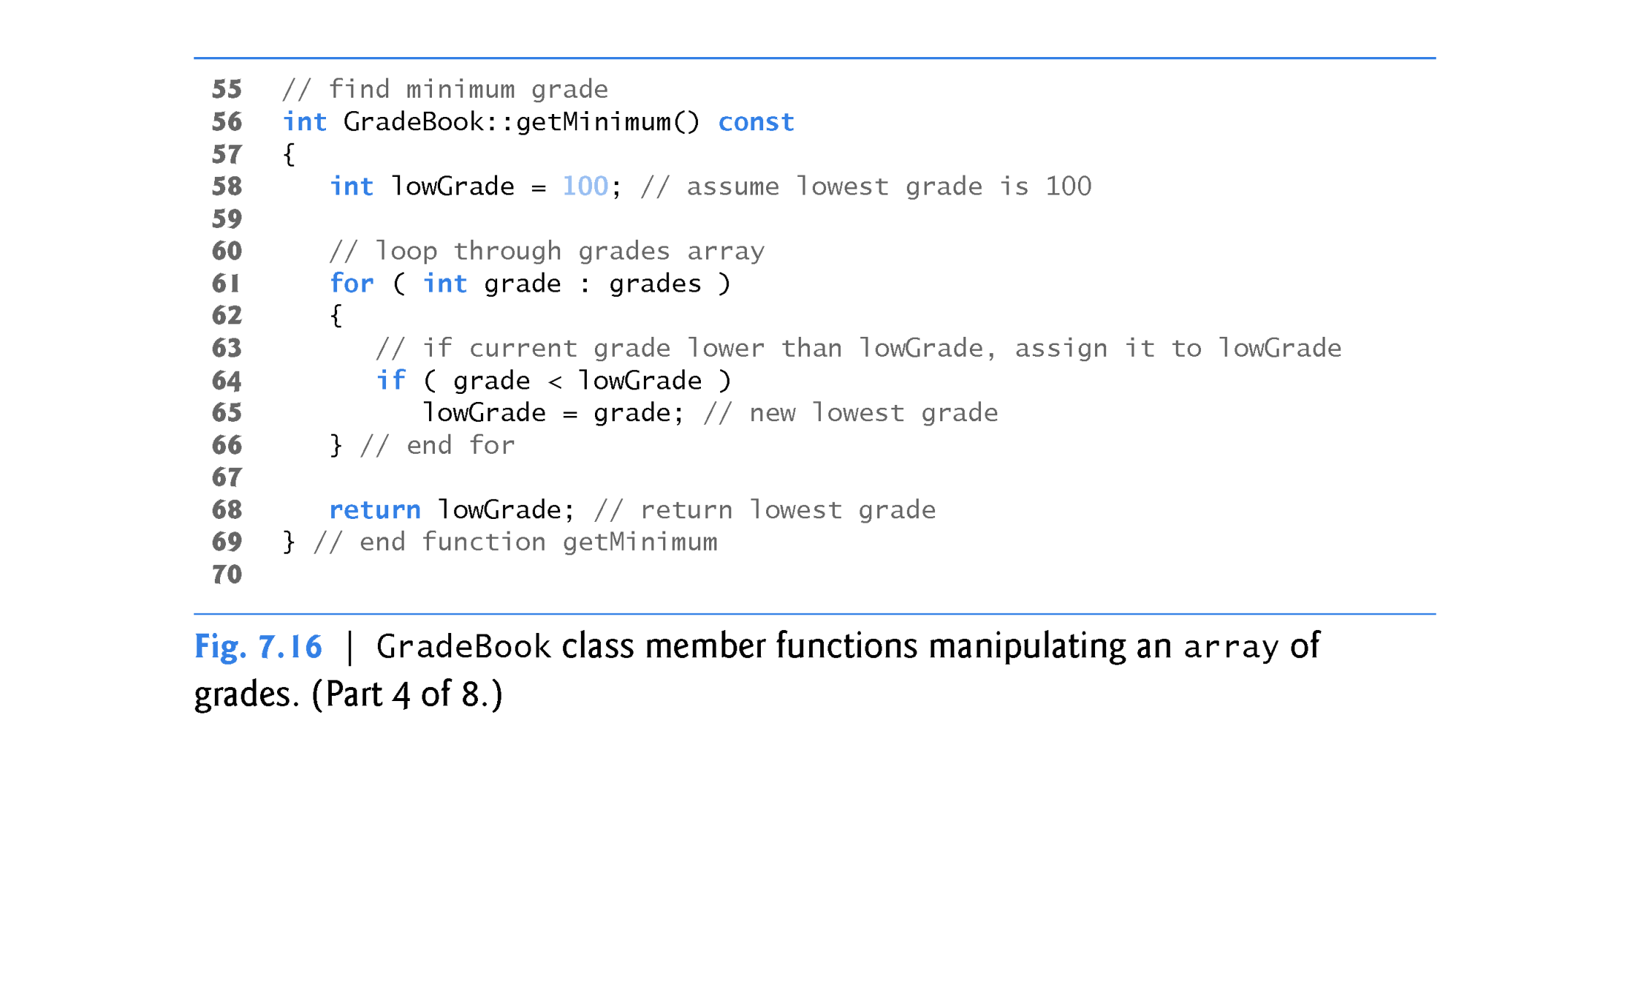

Slide 67


Slide 68
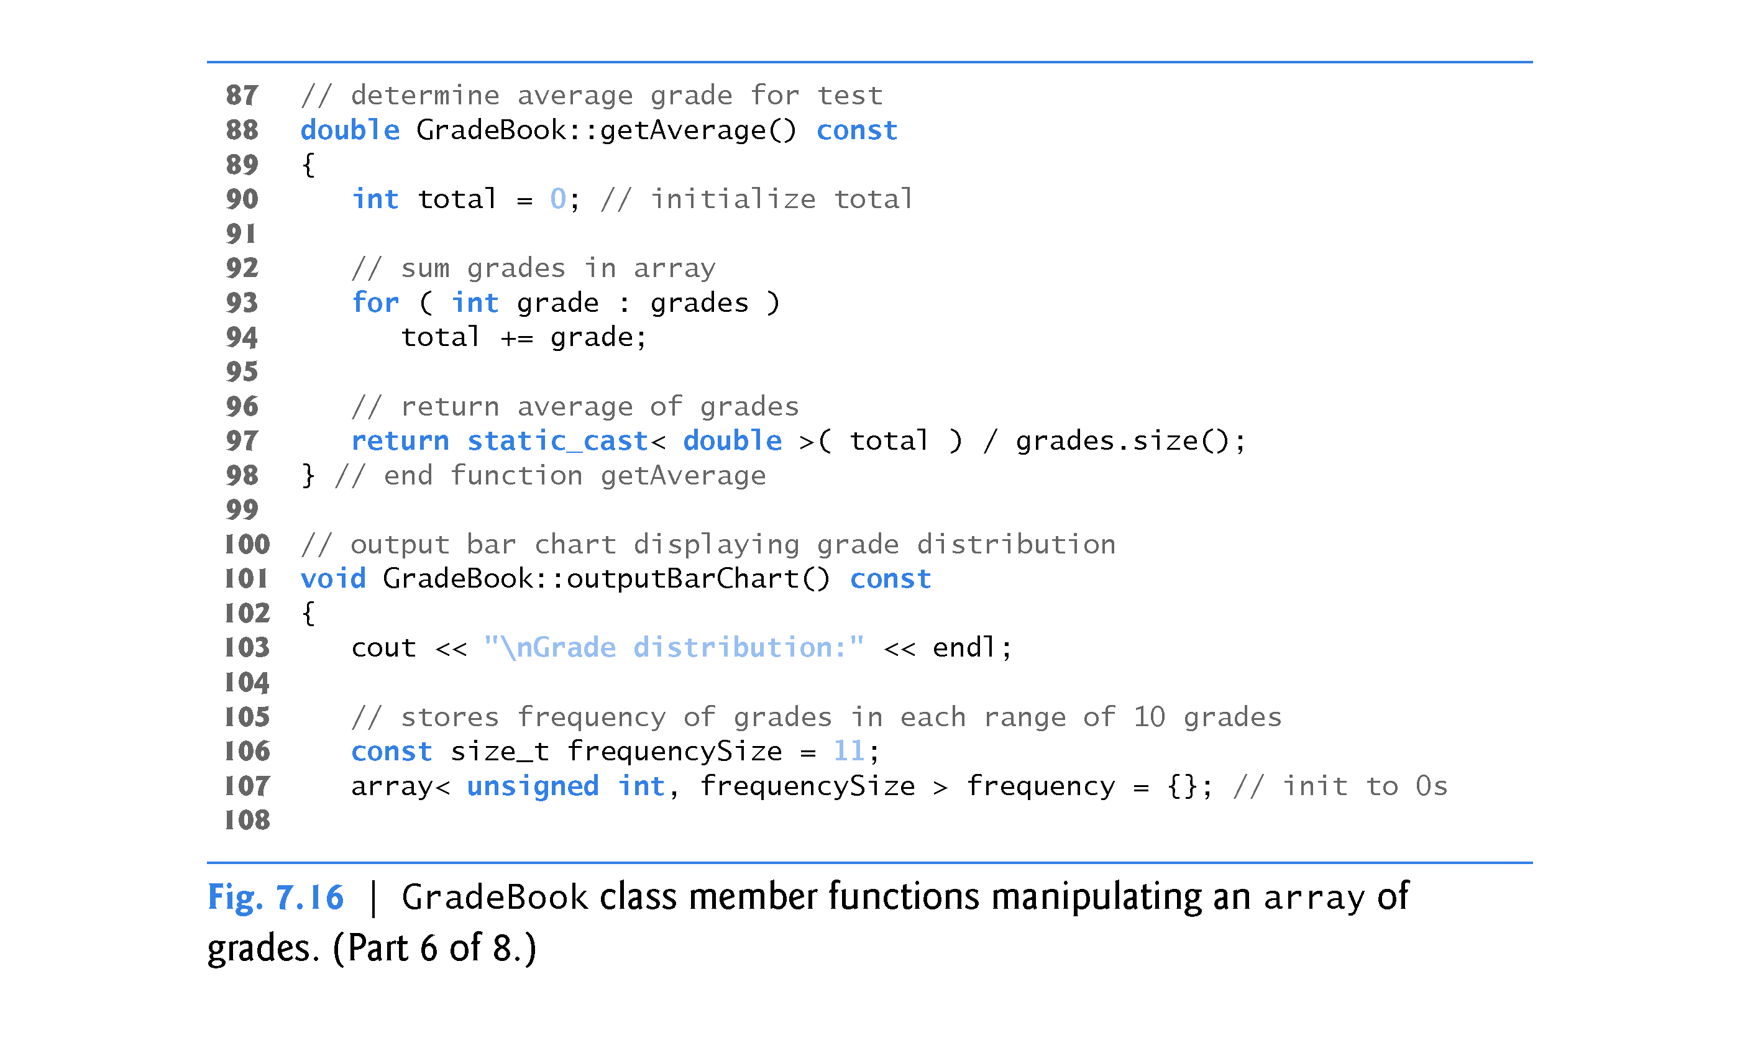

Slide 69
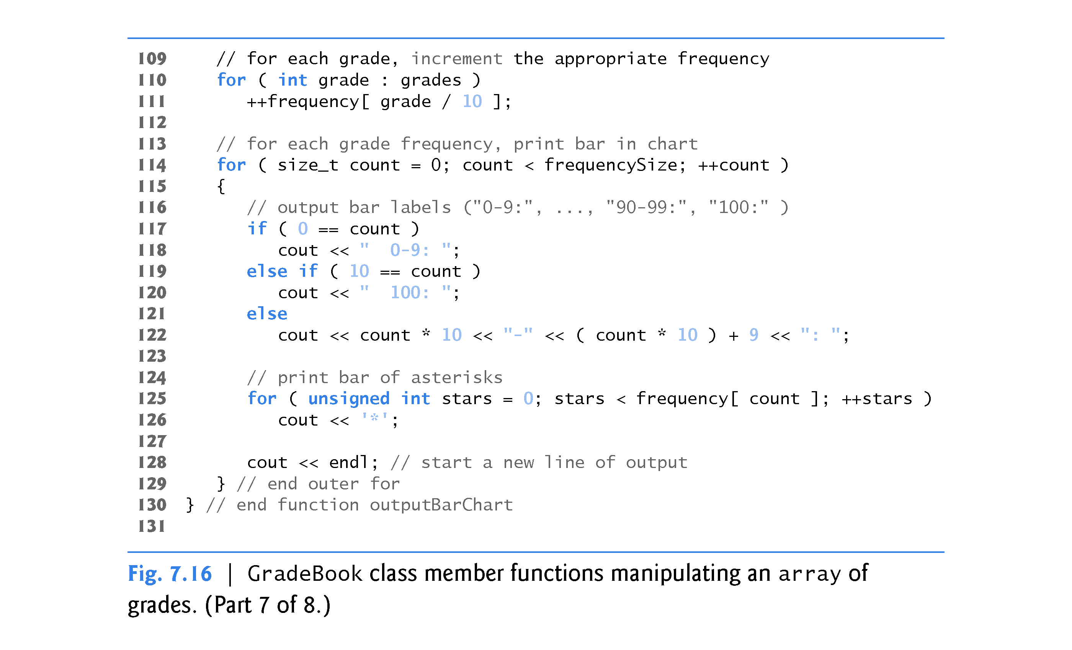

Slide 70
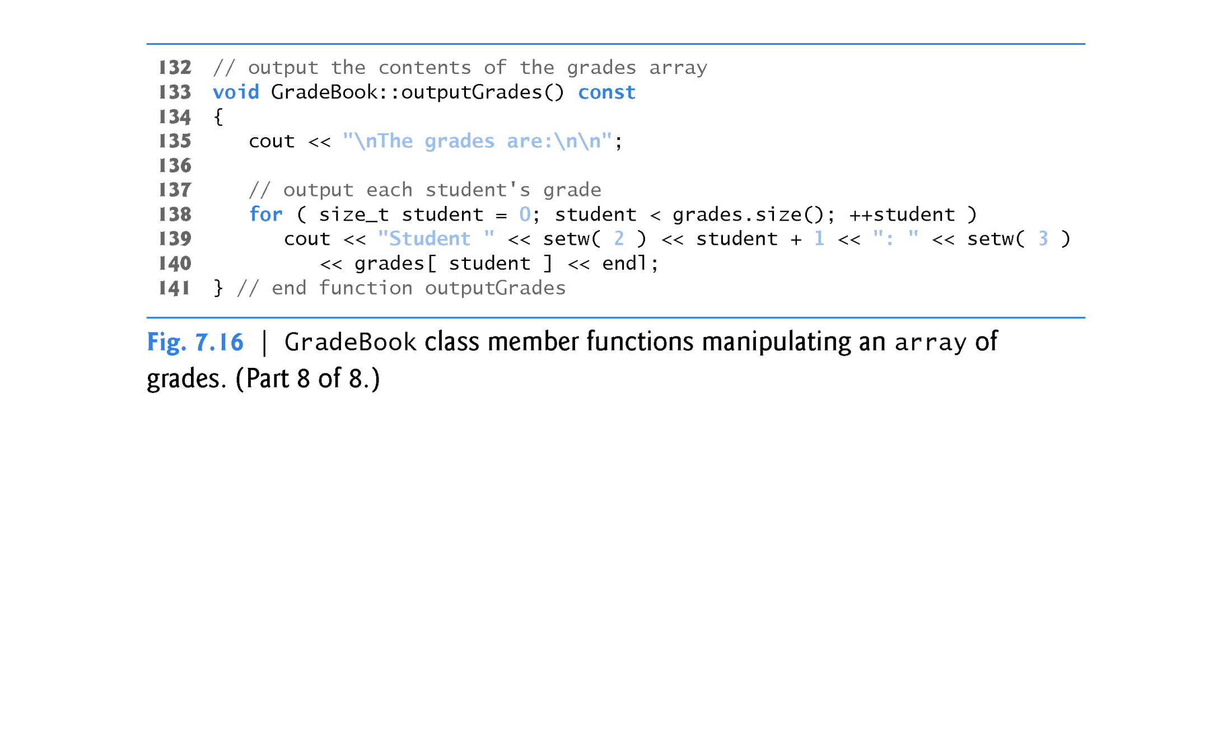

Slide 71
7.6 Case Study: Class GradeBook Using an Array to Store Grades (cont.)
The size of the array is specified as a public static const data member students.
public so that it’s accessible to the clients of the class.
const so that this data member is constant.
static so that the data member is shared by all objects of the class
There are variables for which each object of a class does not have a separate copy.
That’s the case with static data members, which are also known as class variables.
When objects of a class containing static data members are created, all the objects share one copy of the class’s static data members.

Slide 72
7.6 Case Study: Class GradeBook Using an Array to Store Grades (cont.)
A static data member can be accessed within the class definition and the member-function definitions like any other data member.
A public static data member can also be accessed outside of the class, even when no objects of the class exist, using the class name followed by the binary scope resolution operator (::) and the name of the data member. GradeBook::

Slide 73
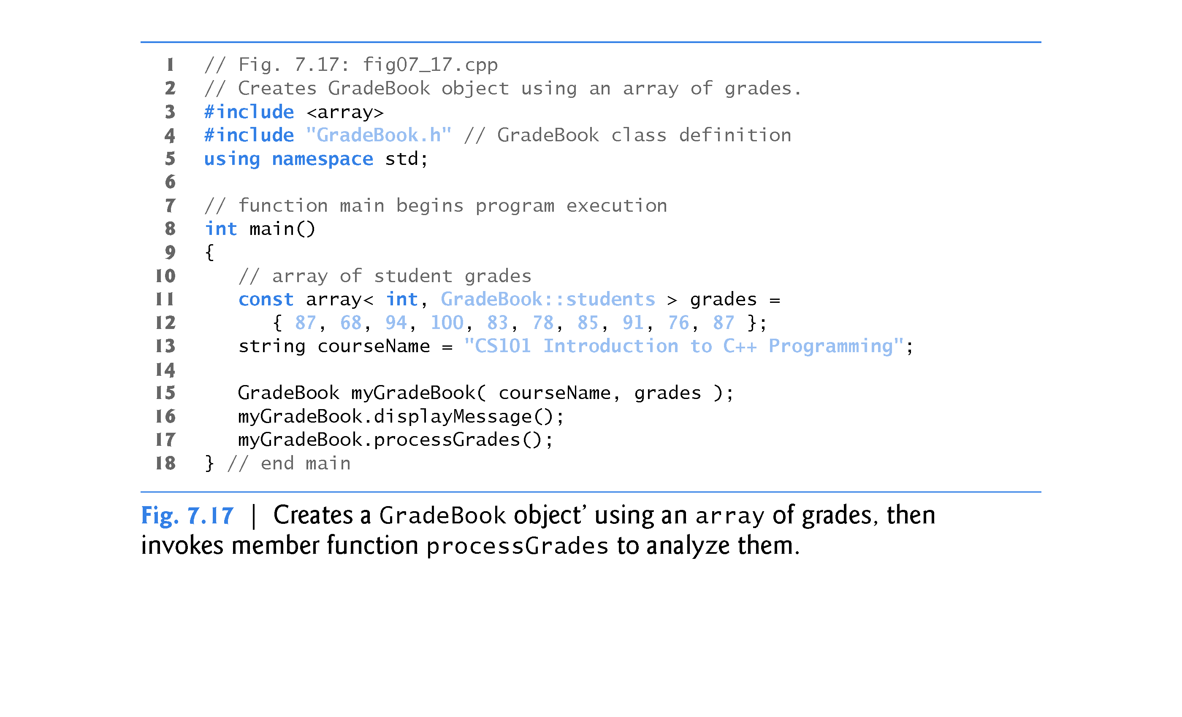
GradeBook :: students

Slide 74
7.7 Sorting and Searching arrays
In this section, we use the built-in C++ Standard Library sort function to arrange the elements in an array into ascending order and the built-in binary_search function to determine whether a value is in the array.
Sorting data - placing it into ascending or descending order - is one of the most important computing applications.

Slide 75
7.7 Sorting and Searching arrays (cont.)
Often it may be necessary to determine whether an array contains a value that matches a certain key value.
Called searching.
Figure 7.18 begins by creating an unsorted array of strings (lines 13–14) and displaying the contents of the array (lines 17–19).
Next, line 21 uses C++ Standard Library function sort to sort the elements of the array colors into ascending order.
Lines 24–26 display the contents of the sorted array.

Slide 76
7.7 Sorting and Searching arrays (cont.)
Lines 29 and 34 demonstrate using binary_search to determine whether a value is in the array.
The sequence of values must be sorted in ascending order first (binary_search does not verify this for you)
The function’s first two arguments represent the range of elements to search and the third is the search key - the value to locate in the array.
The function binary_search returns a bool indicating whether the value was found.

Slide 77
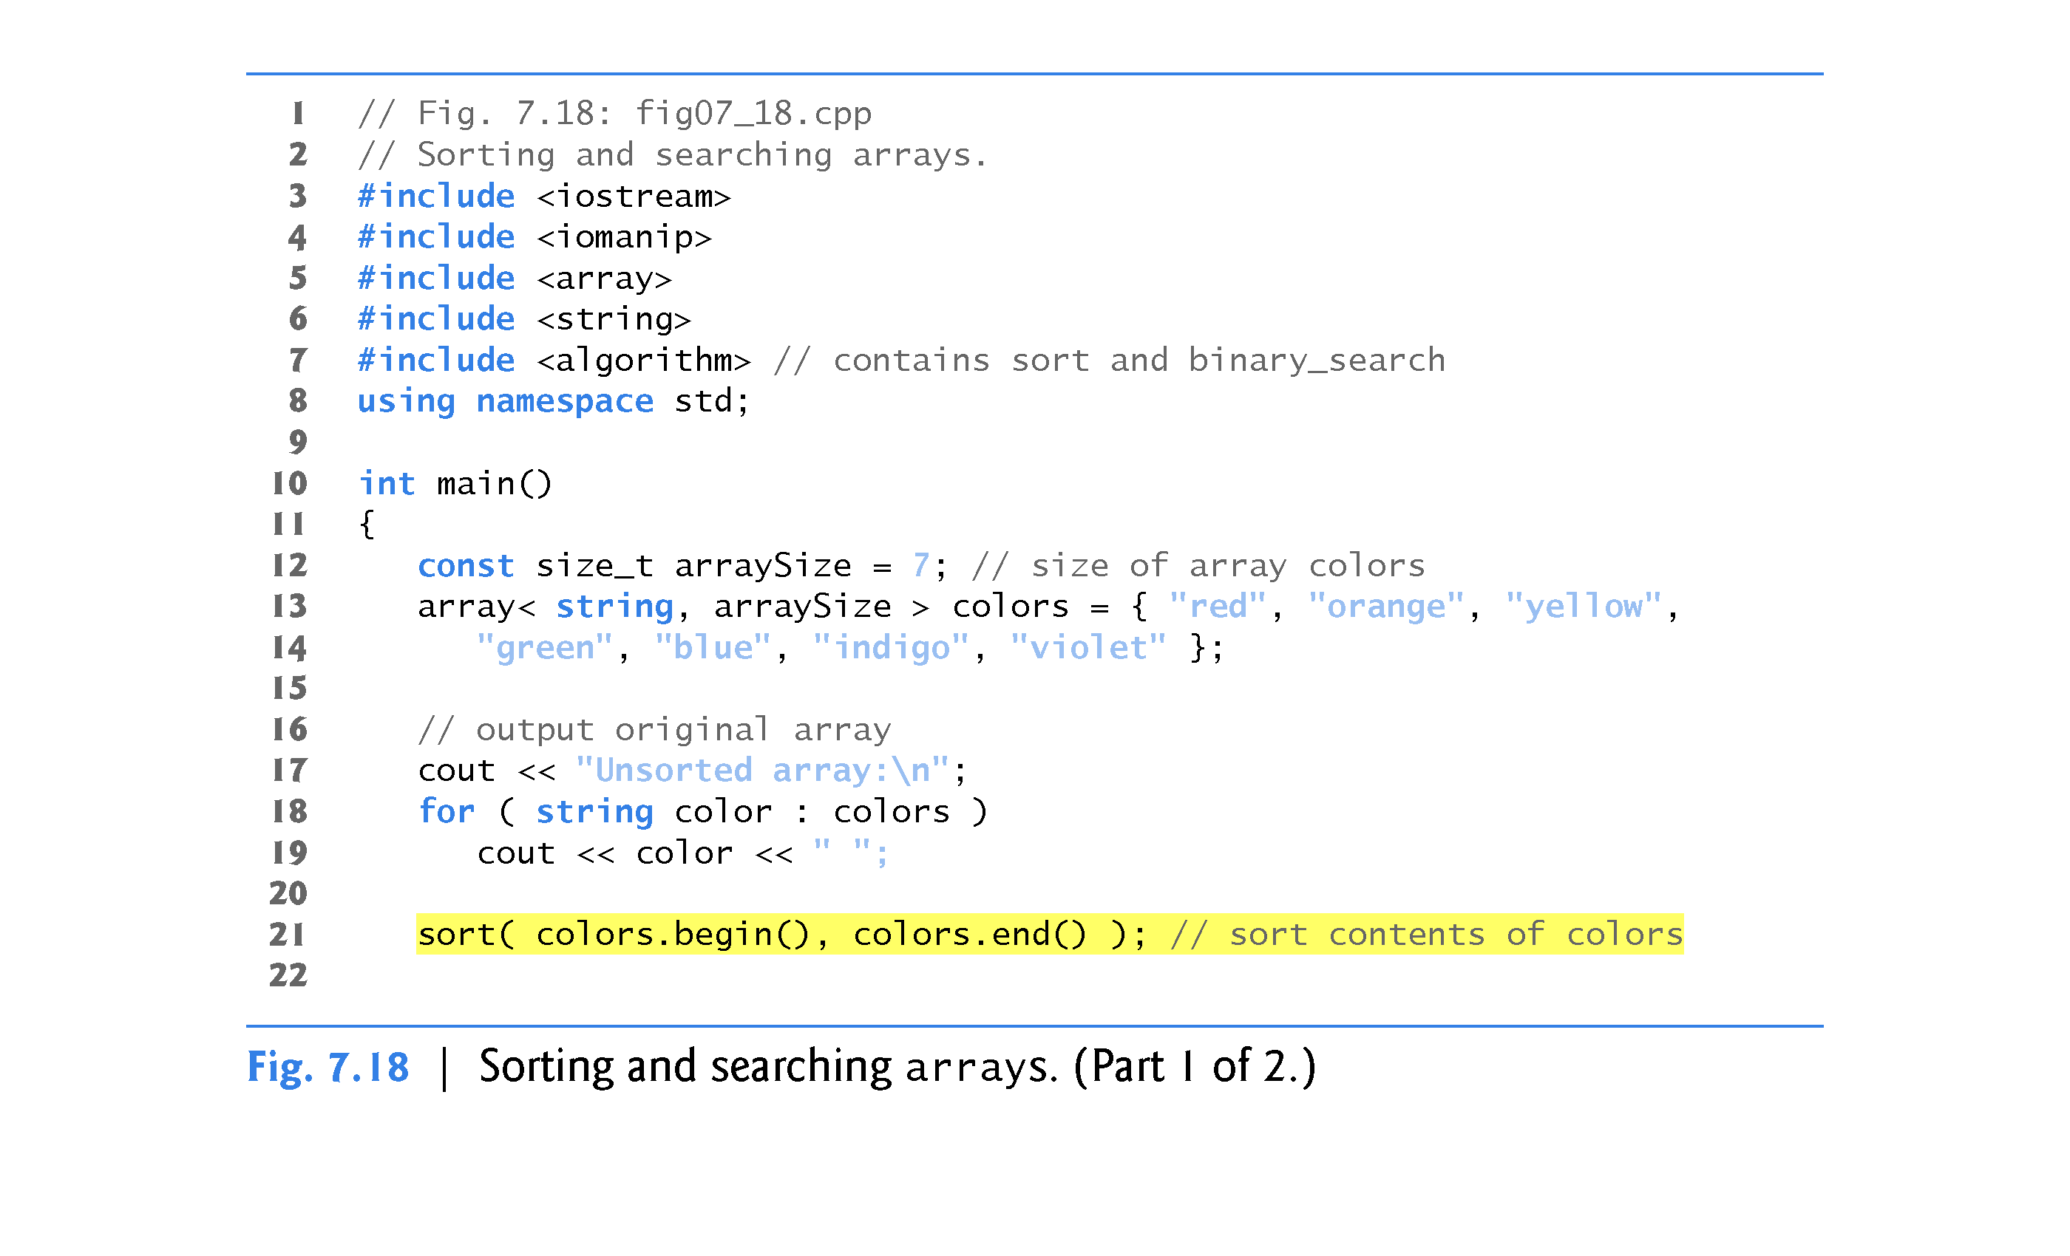
Functions begin and end create “iterators”

Slide 78


Slide 79
7.8 Multidimensional Arrays
You can use arrays with two dimensions (i.e., subscripts) to represent tables of values consisting of information arranged in rows and columns.
To identify a particular table element, we must specify two subscripts - by convention, the first identifies the element’s row and the second identifies the element’s column.
Often called two-dimensional arrays or 2-D arrays.
Arrays with two or more dimensions are known as multidimensional arrays.
Figure 7.20 illustrates a two-dimensional array, a.
The array contains three rows and four columns, so it’s said to be a 3-by-4 array.
In general, an array with m rows and n columns is called an m-by-n array.

Slide 80


Slide 81


Slide 82
7.8 Multidimensional arrays (cont.)
Figure 7.20 demonstrates initializing two-dimensional arrays in declarations.
In each array, the type of its elements is specified as
array< int, columns >
indicating that each array contains as its elements three-element arrays of int values - the constant columns has the value 3.

Slide 83


Slide 84


Slide 85
7.8 Multidimensional arrays (cont.)
Nested Range-Based for Statements
To process the elements of a two-dimensional array, we use a nested loop in which the outer loop iterates through the rows and the inner loop iterates through the columns of a given row.
The C++11 auto keyword tells the compiler to infer (determine) a variable’s data type based on the variable’s initializer value. [ type inference ]

Slide 86
7.8 Multidimensional arrays (cont.)
Nested Counter-Controlled for Statements
We could have implemented the nested loop with counter-controlled repetition as follows:
for ( size_t row = 0; row < a.size(); ++row )
{
for ( size_t column = 0; column < a[row].size(); ++column )
cout << a[ row ][ column ] << ' ';
cout << endl;
} // end outer for

Slide 87
7.9 Case Study: Class GradeBook Using a Two-Dimensional array
In most semesters, students take several exams.
Professors are likely to want to analyze grades across the entire semester, both for a single student and for the class as a whole.
Figure 7.21 shows the output that summarizes 10 students grades on three exams.
We store the grades as a two-dimensional array in an object of the next version of class GradeBook Figures 7.22–7.23.
Each row of the array represents a single student’s grades for the entire course, and each column represents the grades the students earned on the 3 exams.

Slide 88


Slide 89


Slide 90


Slide 91


Slide 92


Slide 93


Slide 94


Slide 95


Slide 96


Slide 97


Slide 98


Slide 99


Slide 100


Slide 101


Slide 102


Slide 103
7.10 Introduction to C++ Standard Library Class Template vector
C++ Standard Library class template vector is similar to class template array, but also supports dynamic resizing.
Except for the features that modify a vector, the other features shown in Fig. 7.25 also work for arrays.
Standard class template vector is defined in header <vector> (line 5) and belongs to namespace std.

Slide 104


Slide 105


Slide 106


Slide 107


Slide 108


Slide 109


Slide 110


Slide 111
7.10 Introduction to C++ Standard Library Class Template vector (cont.)
By default, all the elements of a vector object are set to 0.
vectors can be defined to store most data types.
vector member function size returns the number of elements in the vector.
As with class template array, you can also do this using a counter-controlled loop and the subscript ([ ]) operator.

Slide 112
7.10 Introduction to C++ Standard Library Class Template vector (cont.)
You can use the assignment (=) operator with vector objects. You can NOT do this with array objects.
As is the case with arrays, C++ is not required to perform bounds checking when vector elements are accessed with square brackets.
Standard class template vector provides bounds checking in its member function at (as does class template array).

Slide 113
7.10 Introduction to C++ Standard Library Class Template vector (cont.)
An exception indicates a problem that occurs while a program executes.
The name “exception” suggests that the problem occurs infrequently—if the “rule” is that a statement normally executes correctly, then the problem represents the “exception to the rule.”
Exception handling enables you to create fault-tolerant programs that can resolve (or handle) exceptions.
When a function detects a problem, such as an invalid array subscript or an invalid argument, it throws an exception—that is, an exception occurs.

Slide 114
7.10 Introduction to C++ Standard Library Class Template vector (cont.)
To handle an exception, place any code that might throw an exception in a try statement.
The try block contains the code that might throw an exception, and the catch block contains the code that handles the exception if one occurs.
You can have many catch blocks to handle different types of exceptions that might be thrown in the corresponding try block.
The vector member function at provides bounds checking and throws an exception if its argument is an invalid subscript.
By default, this causes a C++ program to terminate.

Slide 115
7.10 Introduction to C++ Standard Library Class Template vector (cont.)
Changing the Size of a vector
One of the key differences between a vector and an array is that a vector can dynamically grow to accommodate more elements.
To demonstrate this, line 88 shows the current size of integers3, line 89 calls the vector’s push_back member function to add a new element containing 1000 to the end of the vector and line 90 shows the new size of integers3.
Line 92 then displays integers3’s new contents.

Slide 116
7.10 Introduction to C++ Standard Library Class Template vector (cont.)
C++11: List Initializing a vector
Many of the array examples in this chapter used list initializers to specify the initial array element values.
C++11 also allows this for vectors (and other C++ Standard Library data structures).
At the time of this writing, list initializers were not yet supported for vectors in Visual C++.

